Slide 1
Brainstorm – can you think of reasons why coastlines would be submerged under water or rise above sea level?

Slide 2
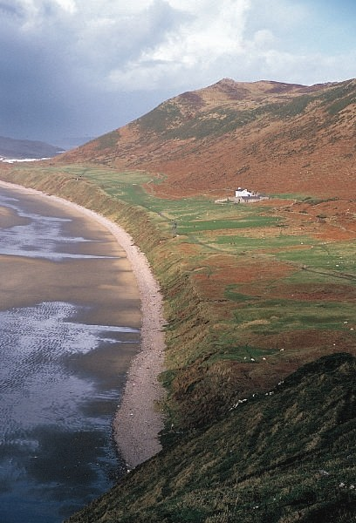
?

Slide 3
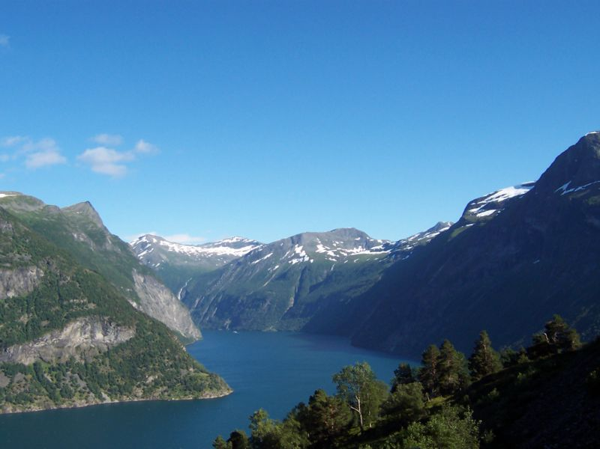
?

Slide 4
Submergent Coastline
A coastline inundated by the sea due to a relative rise in sea levels
Examples:
Rias (drowned river valleys)
Fjords (drowned glaciated valleys)

Slide 5
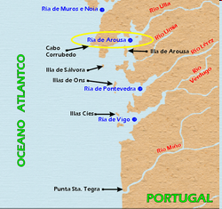
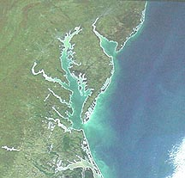
Submergent coastlines experience "drowned" landforms
Rias
Drowned river valley
Almost always estuaries
V shaped valleys which were previously at sea level become submerged.

Slide 6
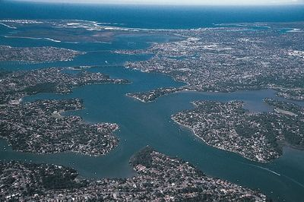
Georges River, in the southern suburbs of Sydney (Australia) is a ria, or drowned river valley. The deeply indented shape of the ria reflects the pattern of drainage that existed before the rise in sea level that flooded the valley.

Slide 7
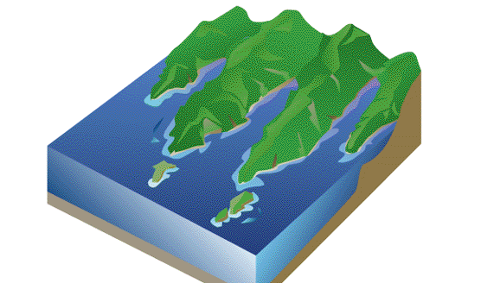
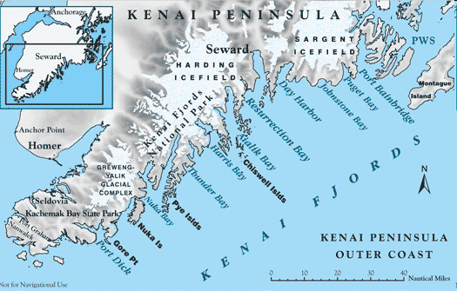
Fjords
drowned glacial valley
narrow inlet of the sea between cliffs or steep slopes
Typical characteristics of a fjord include:
a narrow inlet
deep to allow easy ship navigation
steep-sided walls

Slide 8
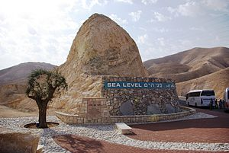
Eustasy: changes in the amount of water in oceans

Slide 9
Emergent coastline
Coastlines which have experienced a fall in sea level
Caused by:
Tectonic activity eg. Plate movement causes uplift
Isostatic uplift (when ice melts and land rises)
Examples:
Wave Cut Platforms
Raised Beaches

Slide 10
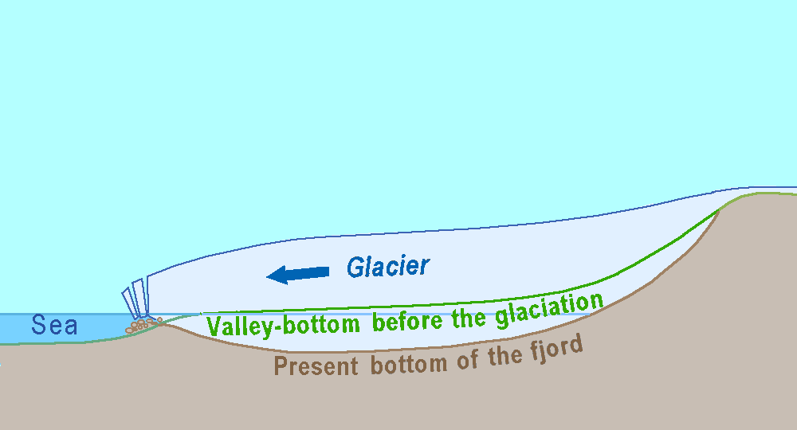
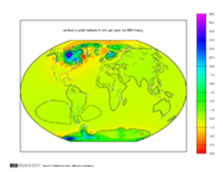
Isostasy: earth rebounding (moving up) from heavy ice load

Slide 11
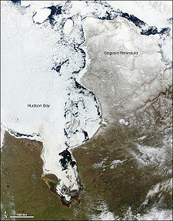
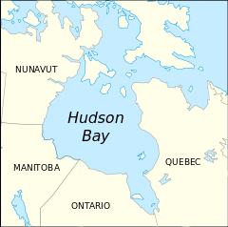
Hudson Bay
Rising as much as 0.67 inches per year due to post-glacial rebound (isostasy) and mantle convection

Slide 12
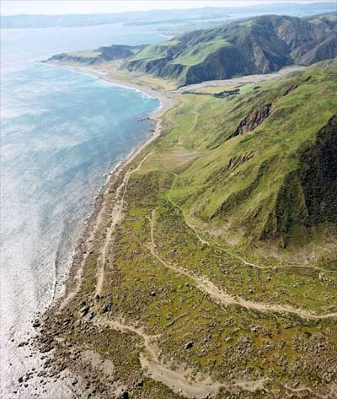
Raised beaches
Beach raised above the shore line by a relative fall in the sea level.

