Slide 1
Review
Where does poverty occur in HIC cities?
Why does it occur there?
Problems in HIC cities:
- As buildings age, people move from city to suburbs/urban fringe, leaving low income groups behind
- Large areas in central parts of the city are ageing and obsolete; with vacant, empty buildings
Inner cities have become poor and decrepit areas, with high poverty and crime
Often ethnic minorities concentrate neighbourhoods here due to cheap housing and proximity to core

Slide 2
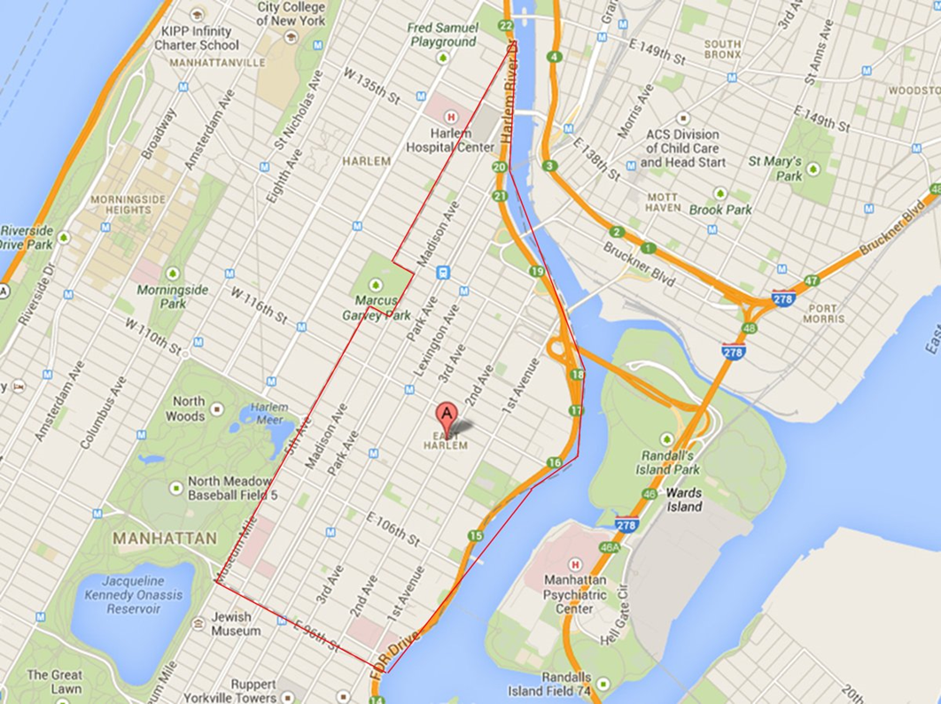
Regeneration or urban renewal
Redevelopment by making improvements to old inner city areas of housing or industry experiencing ‘urban decay’
Instead of new urbanization, city planners revitalize existing areas like core or inner city

Slide 3
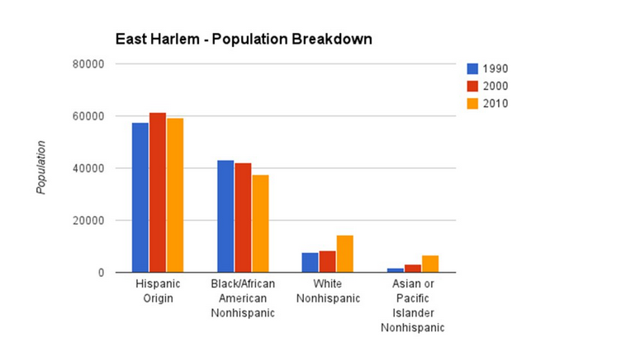
Urban Economic Revitalization has other effects: how has the ethnicity of Harlem changed in recent years?

Slide 4
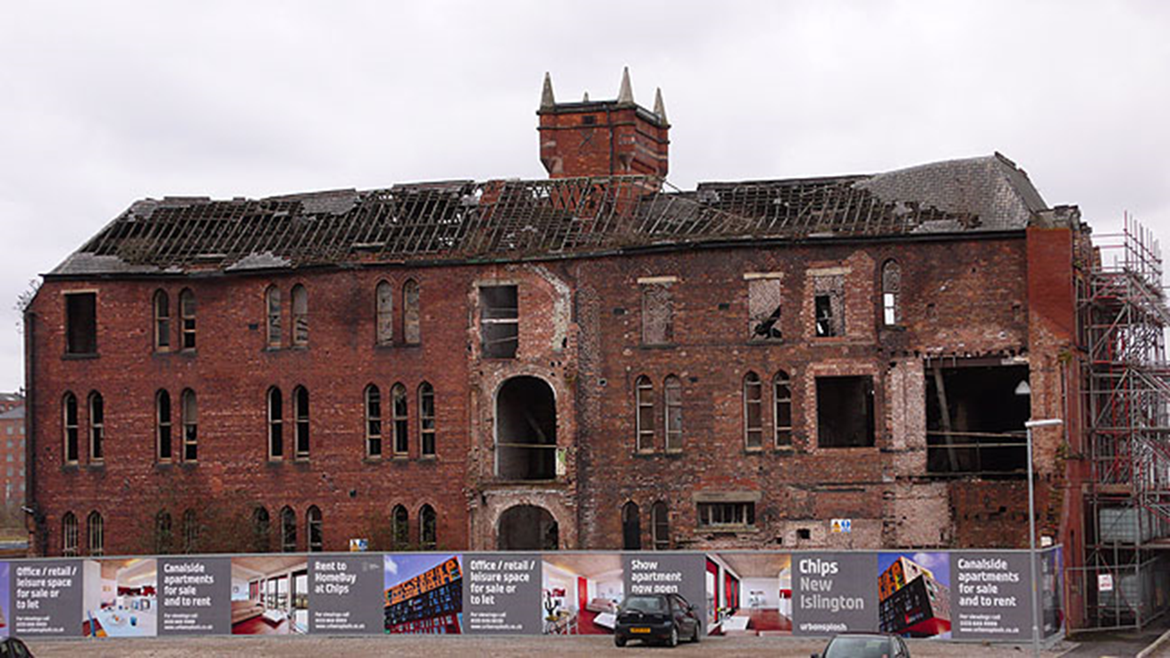
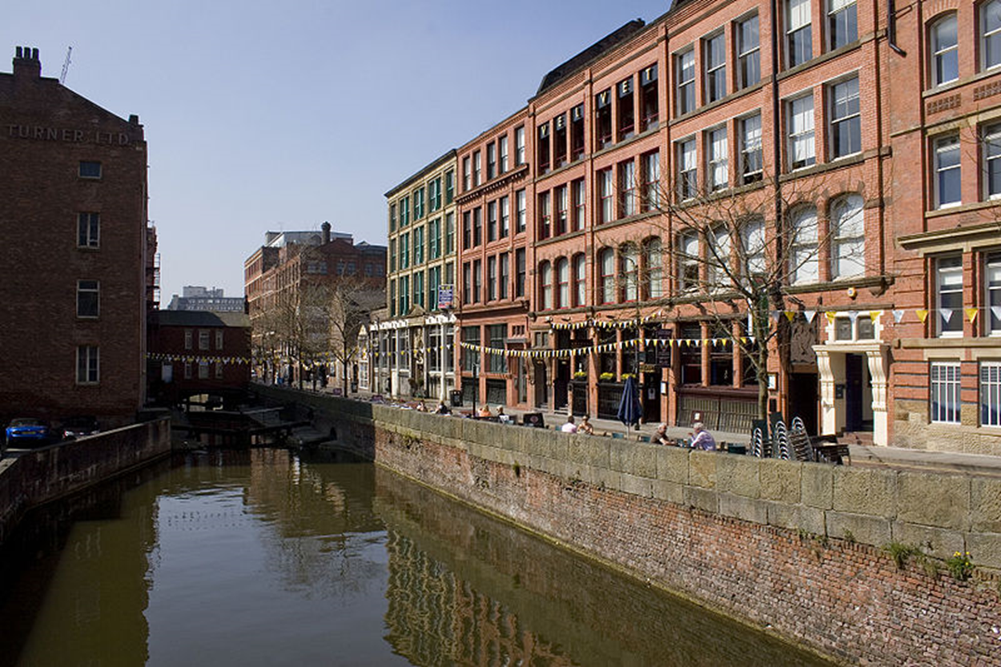
Gentrification:
As quality of buildings increase, wealthier people move in and property prices go up – term often used negatively to describe displacement of poorer people as they are forced to move out of the area

Slide 5
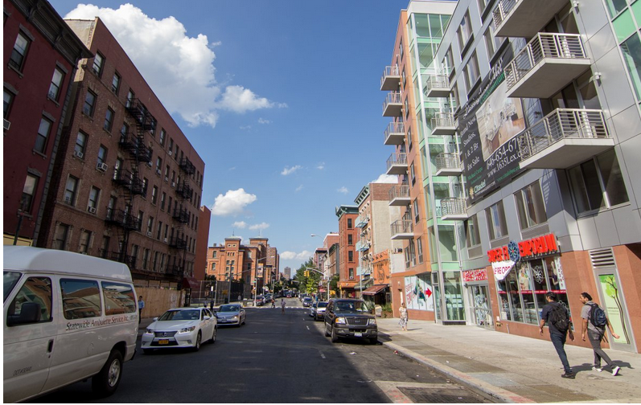
As development takes place in an area, some landlords remove low income residents so they can sell their properties for a high price

Slide 6
Who Benefits Most From Urban Economic Revitalization?

Slide 7
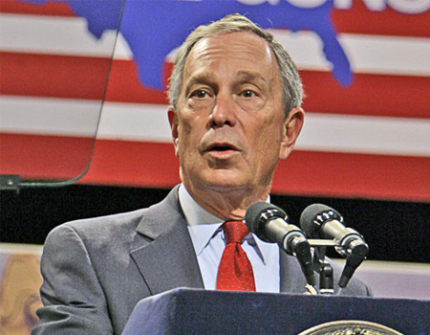
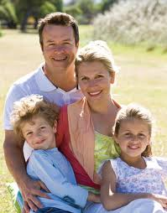
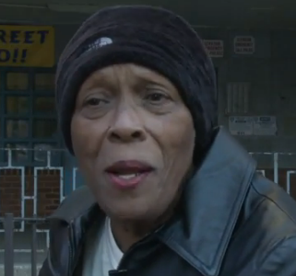
Different people, different views……
Explain in your own words what is gentrification in Harlem…..

