Slide 1
Cliff foot processes Define and Diagram: Use website (9b) and book (155)
Hydraulic Action
Abrasion
Solution
Attrition
Use link on website…

Slide 2
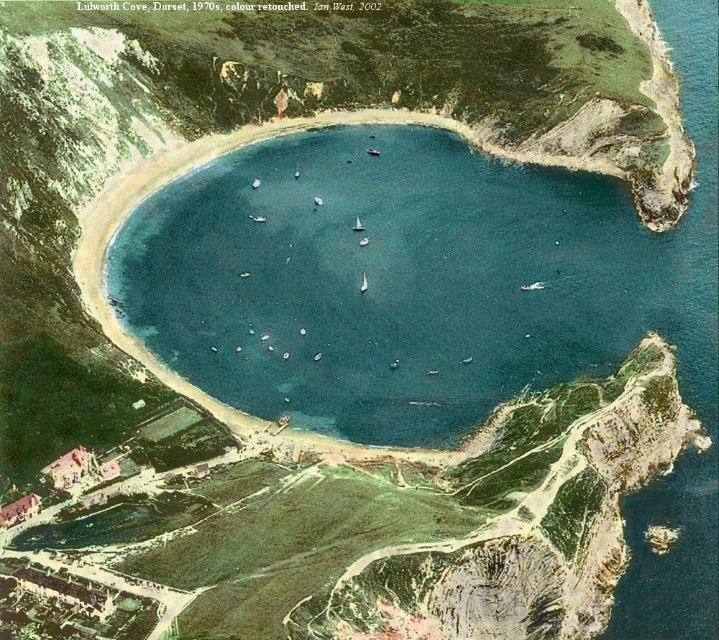

Slide 3
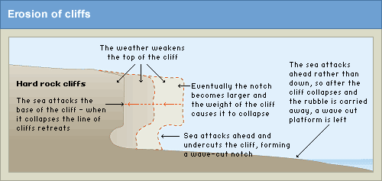
Cliff foot erosion: Wave Cut Platform

Slide 4
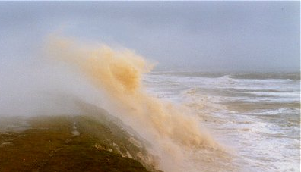
#2 – How Do Waves and Sub-aerial Processes (land-based processes) Affect Coastlines?

Slide 5
Coasts are shaped by a combination of:
Cliff foot process – processes that occur at the BASE of the coast (between high and low tide mark)
Cliff face processes – things that occur on land that affect the FACE of the coast
Human activity

Slide 6
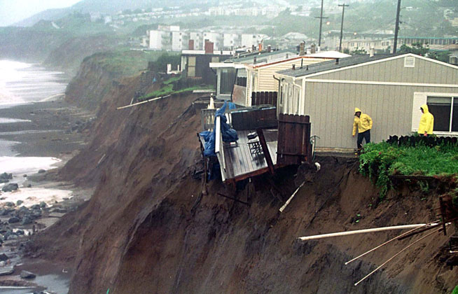
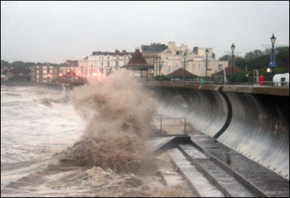
Human activity
Sea defences
Building on cliff top

Slide 7
Sub-Aerial Processes (CLIFF/coast FACE!!)
Land-based processes (ie: weather) which ERODE a coastline through the decay and disintegration of rock – these processes affect the face of the rock
1. Biological Weathering
2. Mechanical Weathering
3. Mass Movement (due to gravity)

Slide 8
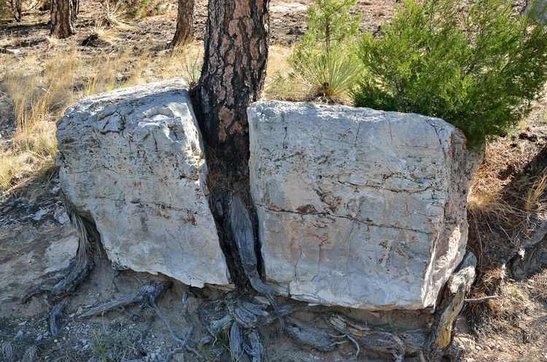
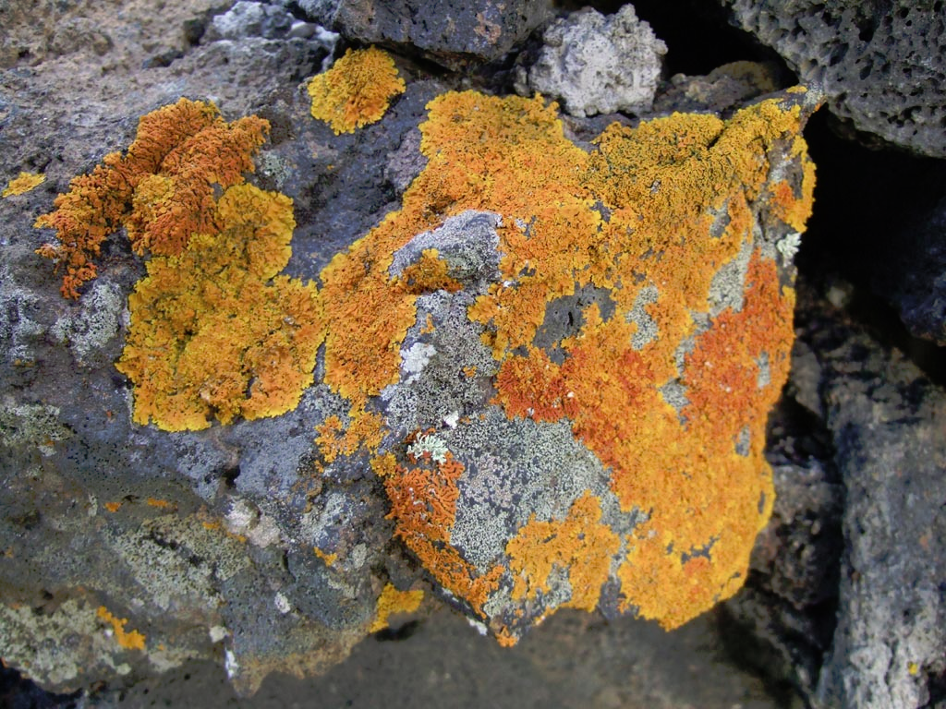
Biological Weathering
Carried out by molluscs, sponges and sea urchins which burrow and browse into rock,
Carried out by plant seeds which are blown into rocks and when grown, fracture coastlines

Slide 9
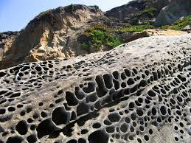
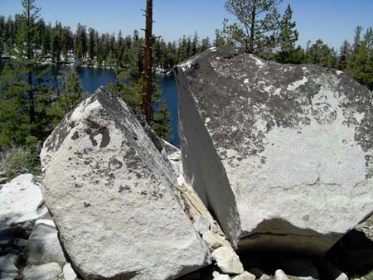
Mechanical Weathering
Fracture/breakdown of rocks
“SALT WEATHERING” sodium/magnesium compounds expand or build up and fragment rocks
“FREEZE-THAW”
Water freezes, expands and fragments rocks

Slide 10
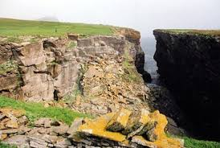
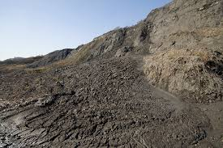
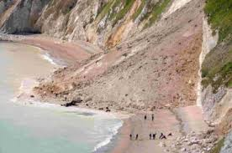
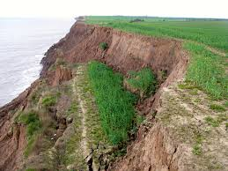
3rd Sub-Aerial Process: Mass Movement
Rockfalls, landslides, mudflows, slumping

Slide 11
Geological Structure and Lithology also have a large effect

