Slide 1
What to do about climate change??

Slide 2
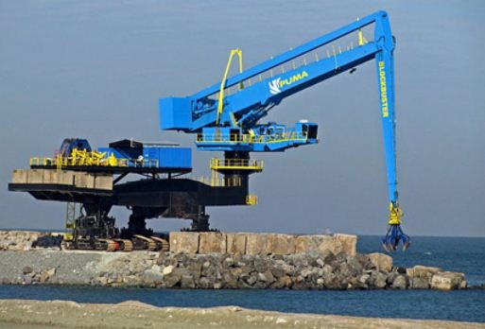
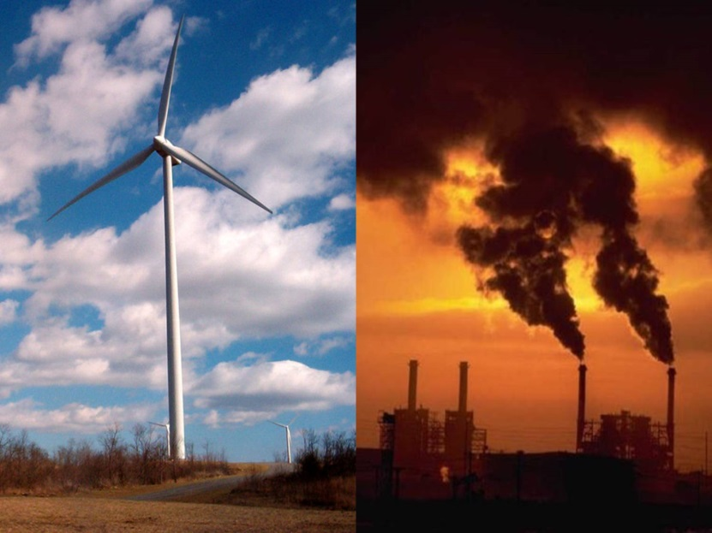
There are two options:
ADAPTATION: to the consequences of climate change
PREVENTION: Try to change the human causes of climate change

Slide 3
Reducing carbon dioxide emissions

Slide 4
We can manage the causes of climate change by:
Using less fossil fuels which reduces the greenhouses gases put into the atmosphere eg. Hybrid cars
Find alternative energy sources such as solar energy which don’t use fossil fuels
Reduce deforestation and encourage afforestation because trees are a carbon sink, they absorb Carbon dioxide
Improve carbon capture techniques to put Carbon dioxide underground instead of the atmosphere.

Slide 5
How can Bangladesh try to adapt to climate change? Is this different than other countries?
Poor countries are more likely to suffer from climate change because they lack the money to adapt.
Examples of adaptation strategies:

Slide 6
How does Carbon capture reduce climate change? Who will use this technology?
- Draw your own labelled diagram to explain what carbon capture is. (pg. 207)
- Complete the Review Quiz online

Slide 7
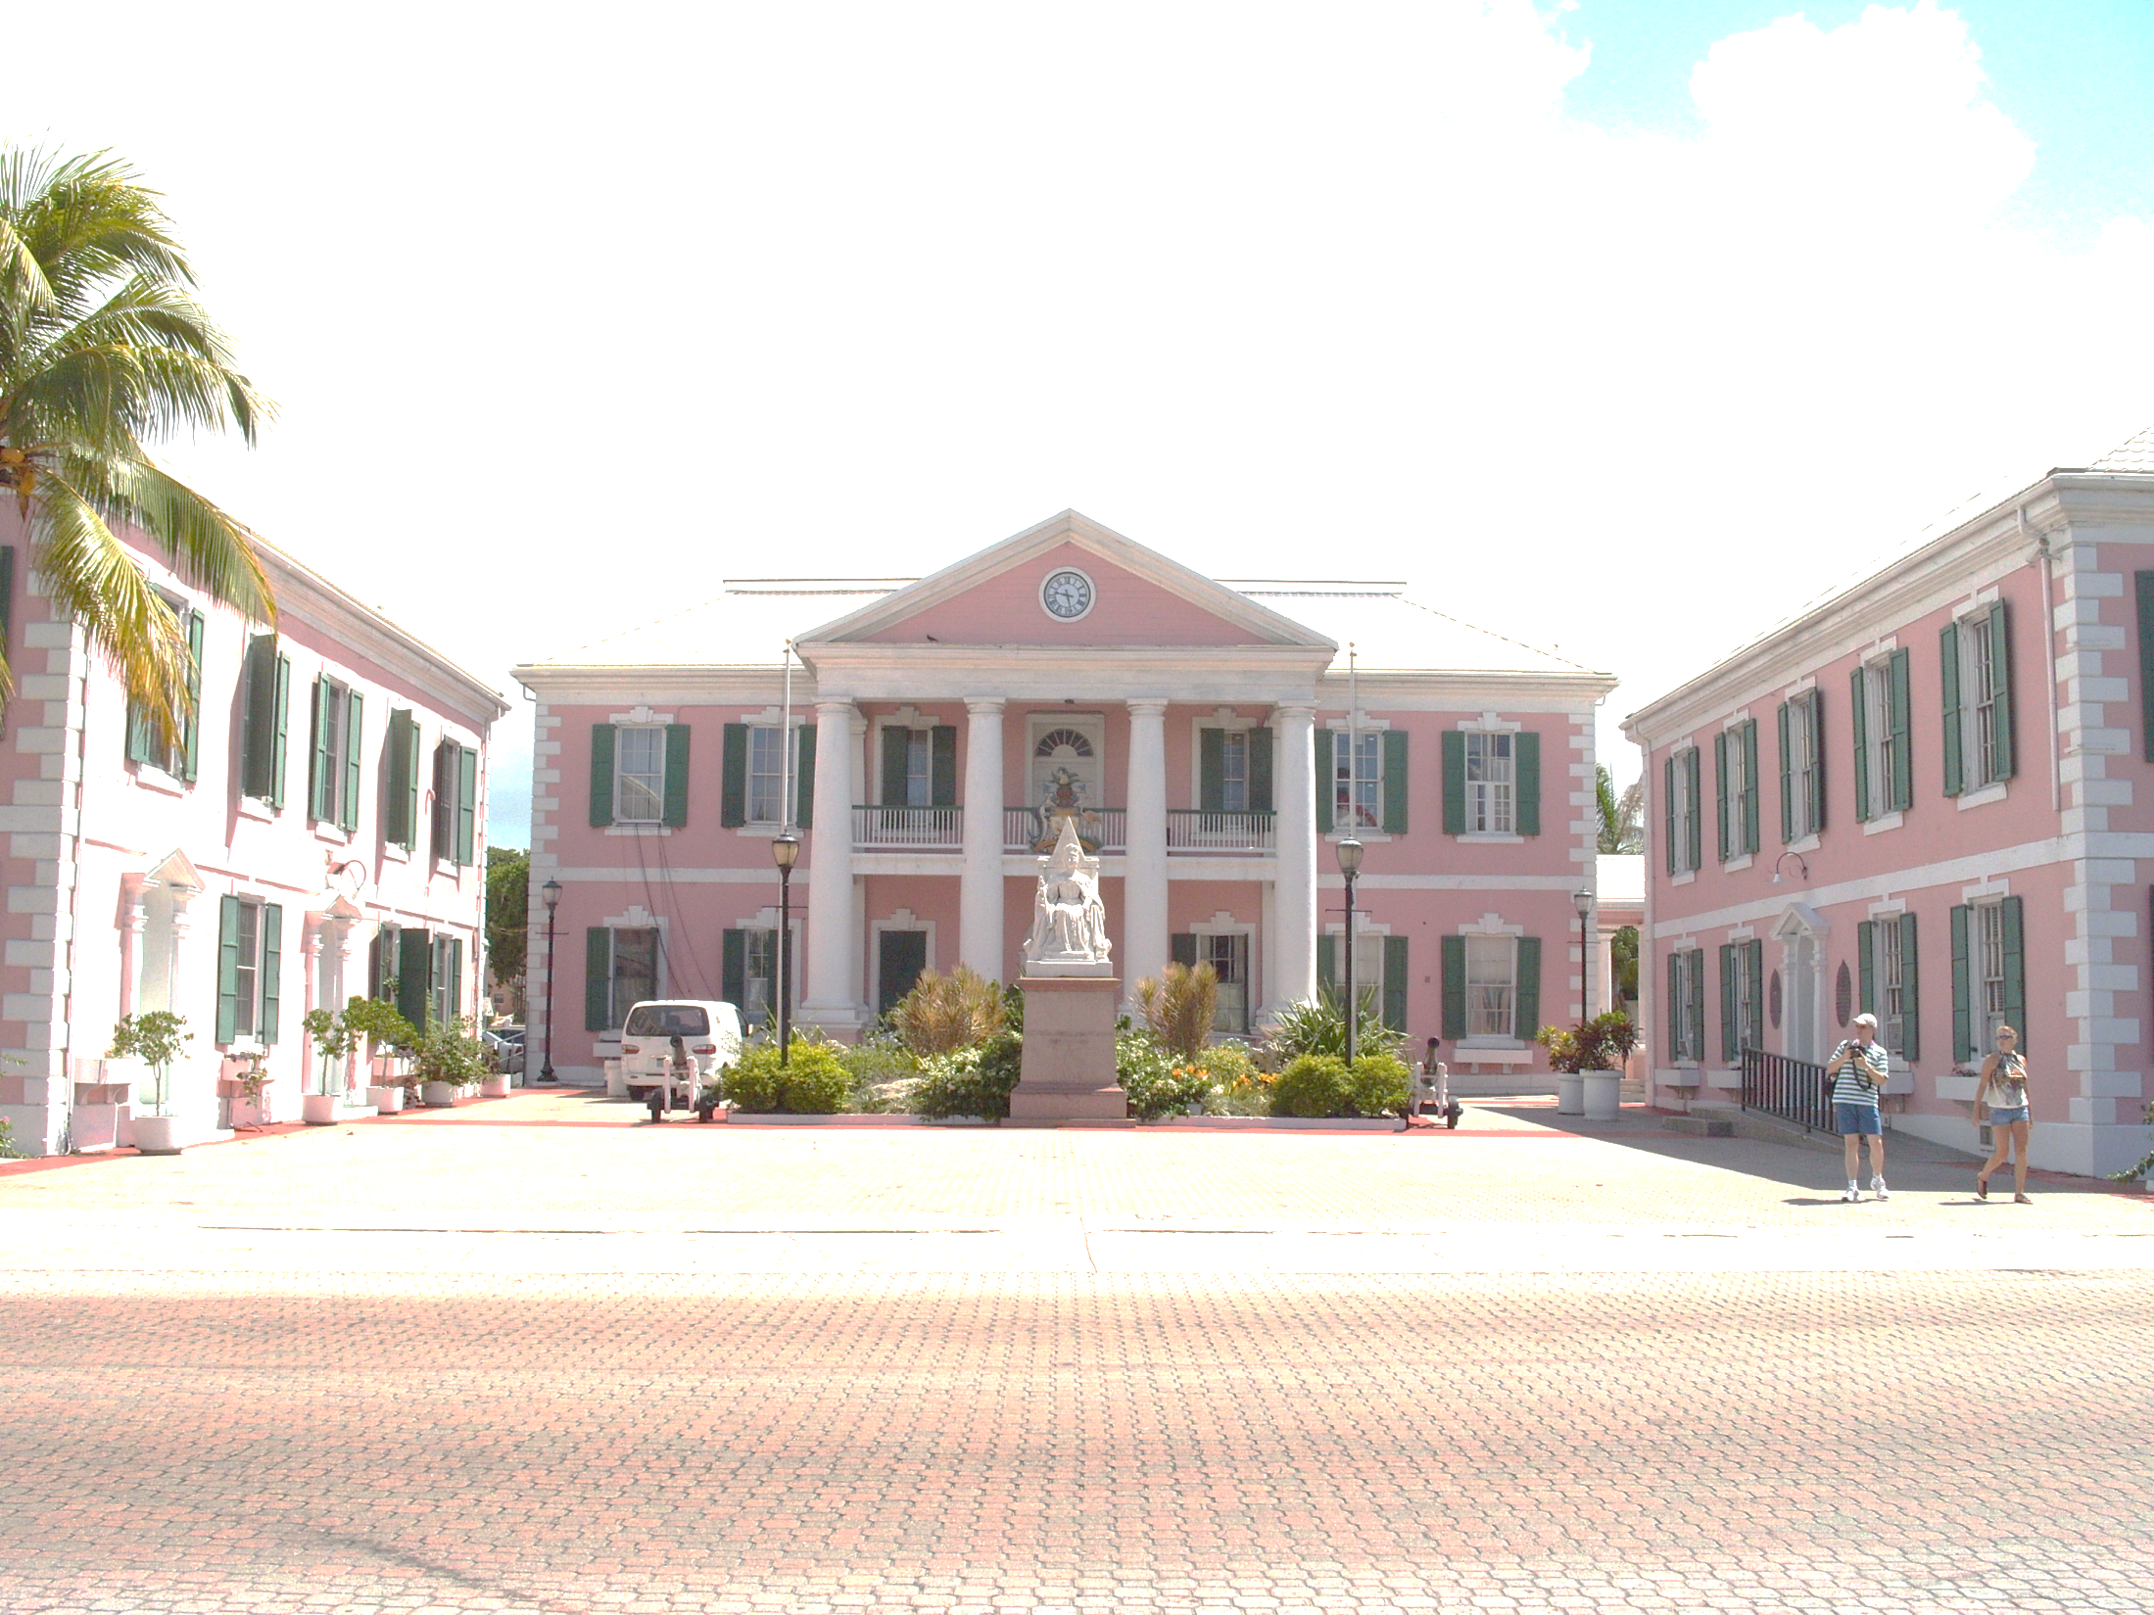
You have been commissioned by the Bahamas government to write a management plan. What does the Bahamas government need to do to adapt to the consequences of climate change.
Task
In your group you will create a one page document to show:
What will be the key consequences on the Bahamas
Ways that you will adapt to and manage these impacts
Some idea of the cost and timescale of these strategies
http://www.youtube.com/watch?v=ldPT6CuDBZI

