Slide 1
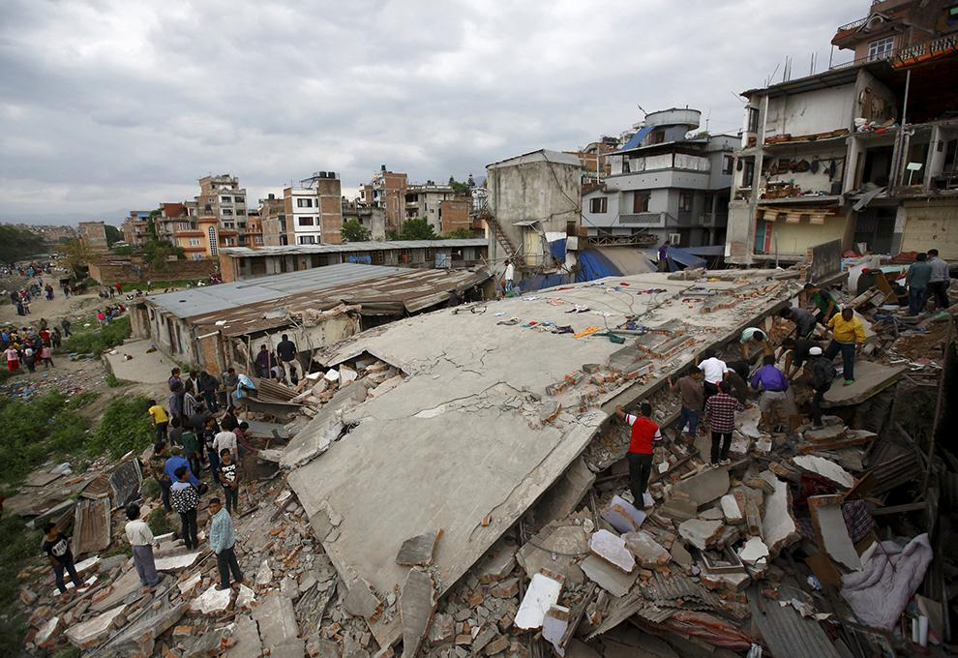
What factors influence how devastating an earthquake event is to an area?

Slide 2
The strongest earthquakes will cause the most damage.
Do you agree or disagree with this statement – explain your answer……
What information do we need to answer this question?…….

Slide 3
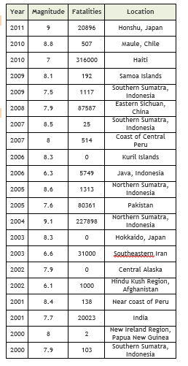
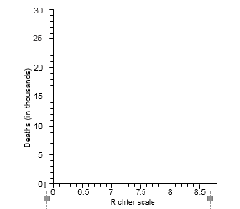
Complete tasks 1, 2, 3 and 4 IN YOUR BOOK
From Damages Worksheet

Slide 4
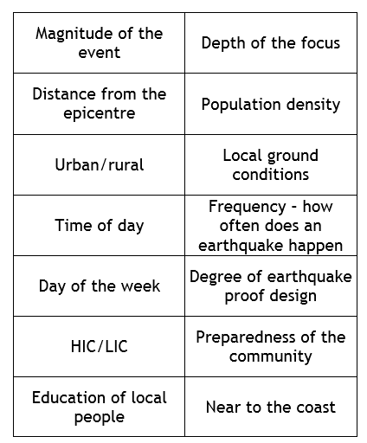
Human or physical
CLASSIFY THE FOLLOWING
Natural
Human

Slide 5
The risk of dying from an earthquake itself is actually quite low… More likely something else will that has been knocked over by the shaking…
“earthquakes don’t kill people, buildings do”

Slide 6
Primary effects happen immediately
Tsunami wave
Collapsing building/ Falling masonry
Broken gas pipes/ Fallen electricity cables
Landslides
Liquefied ground – shaking makes soft rock act like water
Secondary effects usually occur as a result of the primary effects
Diseases spread
Loss of homes/business
Fires
Huge cost to rebuild
Which effect is the worst? Justify your choice

