Slide 1
What has happened to the average line of latitude for urban centres in the past 50 years?

Slide 2
The latitude of the largest cities (mega cities) has moved south.
The most rapidly growing cities are now in developing countries
This is because:
Rural to urban migration
People think there are better opportunities in the city for health, jobs and education
Increase in birth rate
People see children as a financial asset, to help with work and look after parents in old age
Decrease in death rate
Better medical care, improved sanitation and water means people live longer
Birth rate minus the death rate=natural increase

Slide 3
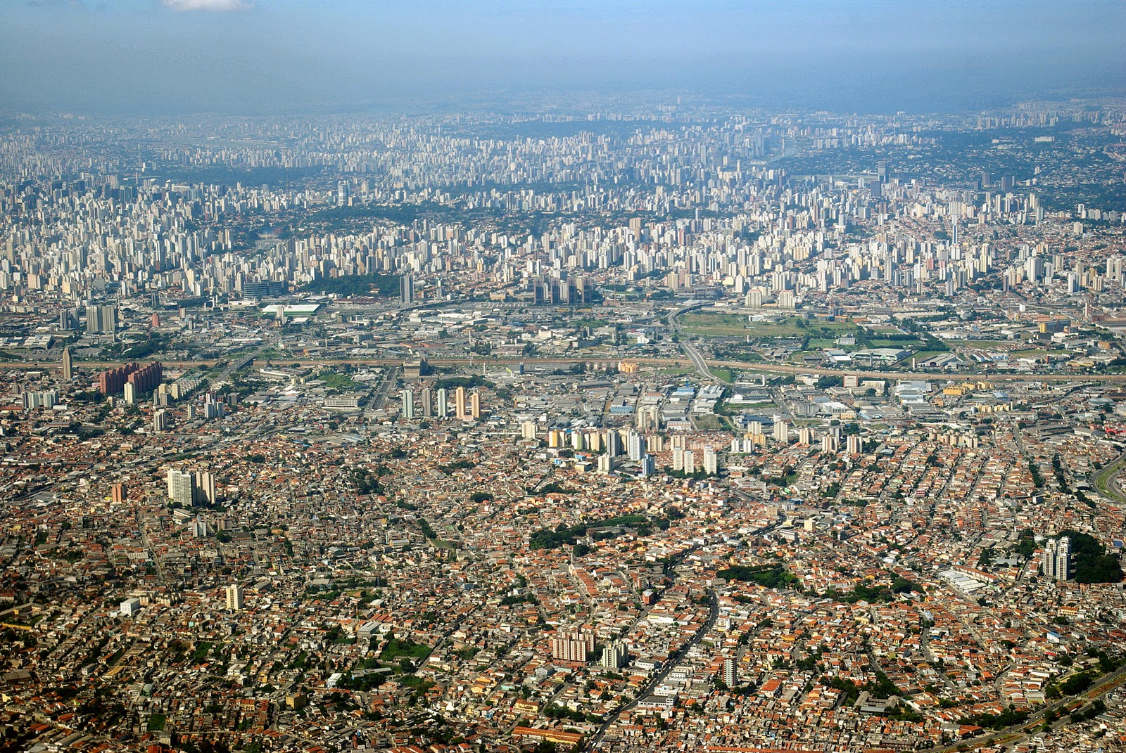
Aim: To define a megacity

Slide 4
A mega city has a population of more than 10 million people.

Slide 5
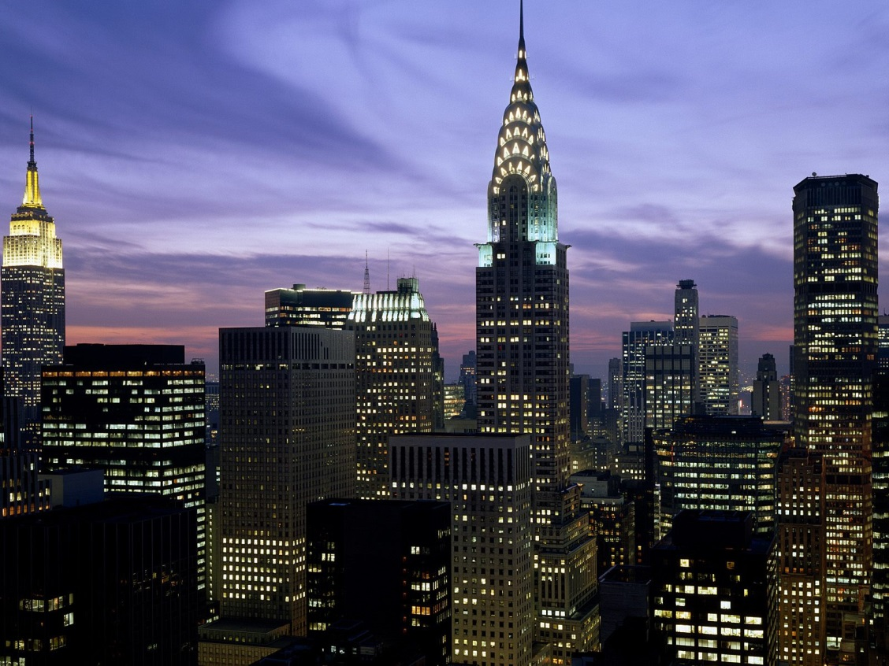
Where am I?
New York

Slide 6
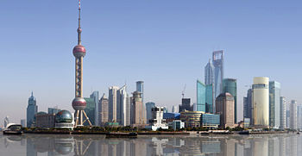
Where am I?
Shanghai

Slide 7
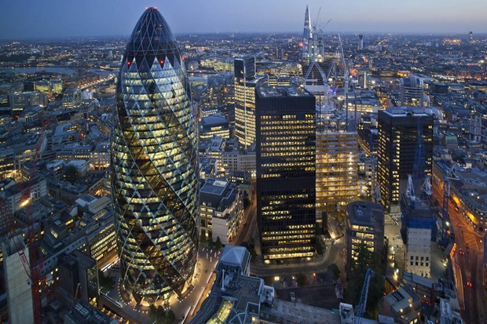
Where am I?
London

Slide 8
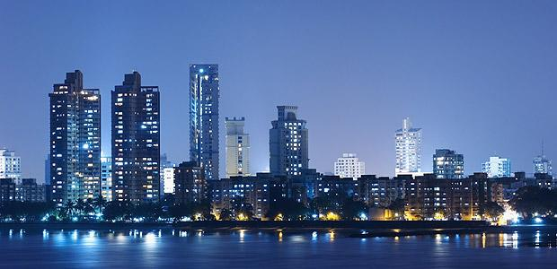
Where am I?
Mumbai

Slide 9
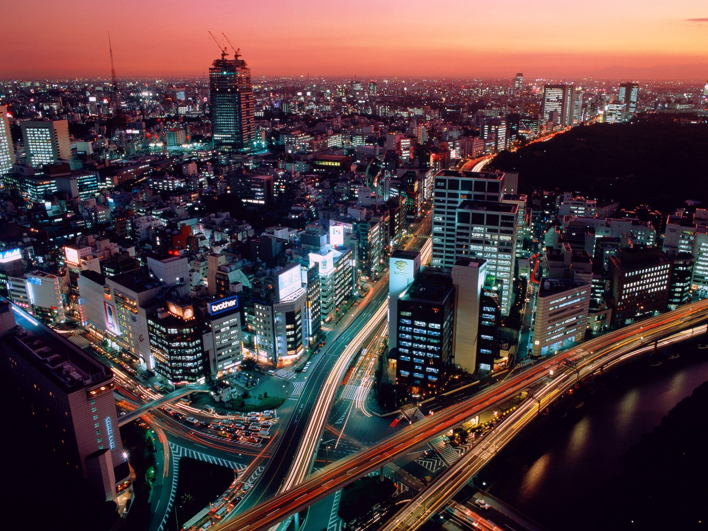
Where am I?
Tokyo

Slide 10
Your task…
Read through the information on your card – you have 2 minutes of silent reading to try and learn it...

Slide 11
Find someone who…
Using your grid, find someone who can answer one of the questions listed…

Slide 12
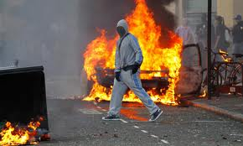
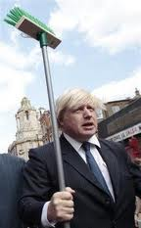
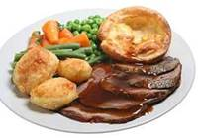
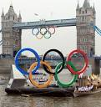
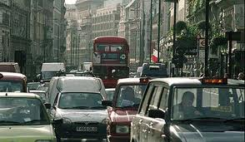
London has over 12,000 people living there.
The name Big Ben is often used to describe the tower, the clock and the bell but the name was first given to the Great Bell.
London
The tallest building in London is the Canary Wharf Tower.
London has just held the 2012 Olympic games bringing in 100,000 tourists (and their money) from all over the world.
There are more languages spoken in London than in any other city in the world.
London received bad press in 2011 when riots struck across the country. However, Boris and his tidy up plan meant that love was shown across the country in the form of tidying up Britain.
London suffers with massive traffic problems, it is one of the only cities in the country to introduce a congestion charge.
A Roast beef dinner served with Yorkshire puddings is a traditional meal served across London.

Slide 13
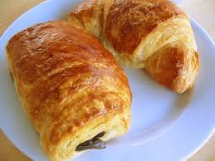
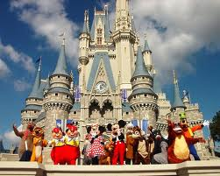
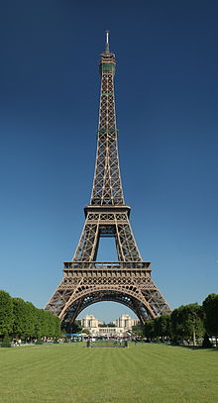
Paris is the smallest megacity with just over 10 million people living there.
Paris is said to be the city of love, it is one of the most romantic places on earth and over 500,000 wedding proposals take place there every year!
Paris
Over 75 million people worldwide speak French and it is the second most commonly taught language behind English.
Paris is the capital city of France and is situated on the River Seine, in northern France.
Paris has the most Michelin starred restaurants in the world. A lot of famous chefs are classically trained in Paris.
The Eiffel Tower built in 1889, was named after the engineer Gustave Eiffel, whose company designed and built the tower.
Paris has lots of problems with theft and pickpocketing in the main city centre often targeting tourists.
Paris is one of the most popular tourist destinations in the world, with over 30 million foreign visitors per year.

Slide 14
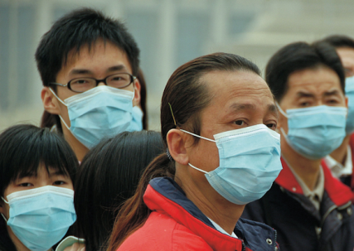
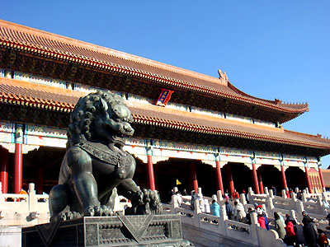
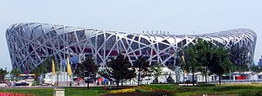
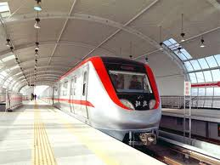
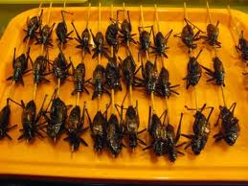
Beijing is known for its poor air quality and tourists are recommended to keep their mouths and noses covered to avoid inhaling the air.
Beijing
Forbidden City Beijing, also called Imperial Palace Museum, is located in the very heart of Beijing. It remained the residence of the emperors for nearly five hundred years. It has over 9,000 rooms.
Beijing airport is the second busiest in the world.
There are over 5 million cars registered in Beijing.
Beijing in the 2nd largest city in China. The largest city is Shanghai, in the south. The population is over 16 million.
The transport network in Beijing is one of the best in the world with regular underground high speed trams.
Street food in Beijing includes a lot of roasted insects and bugs,
Beijing hosted the 2008 Olympics and prior to London 2012 they were deemed the best Olympics ever.

Slide 15
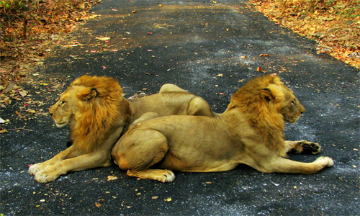
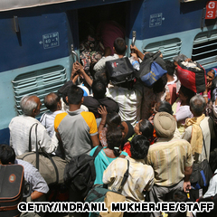
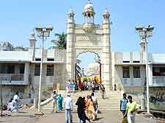
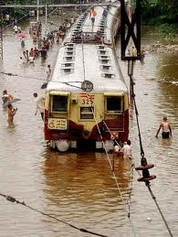
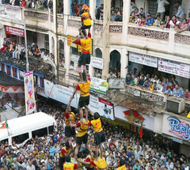
One of the countries greenest national park is in the middle of Mumbai. Where wild animals provide tourists something to see.
Mumbai
Mumbai is also known as Bombay. The national language is Marathi.
Mumbai’s trains carry almost seven million passengers a day. They are high speed and very dangerous so much so that around 3,000 people die in train related accidents each year.
Mumbai is home to a Mosque (Haji Ali Dargah) which was once originally built in the ocean and then joined to land by a thin narrow pathway.
Mumbai is the second biggest city in India. The population here is just over 20 million people.
Mumbai suffers with serious floods very often, The worst in 2005 when Mumbai was cut off for weeks.
During traditional Indian festivals people living in Mumbai build human pyramids – sometimes consisting of over 9 layers of people.

Slide 16
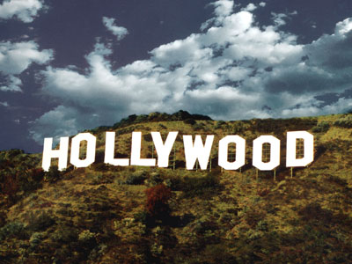
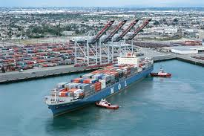
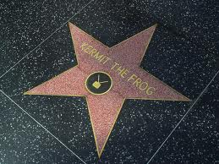
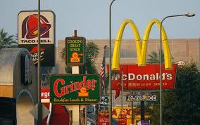
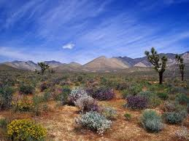
Twenty-four million people come to Los Angeles every year for their holiday. One of the main sights is the Hollywood sign with attracts almost 90% of visitors.
Los
Angeles
The Port of Los Angeles is the busiest in the U.S. and one of the busiest in the world.
LA is famous for making dreams come true and showing people what can happen on the stage. The stars on Hollywood boulevard are a famous landmark.
Los Angeles is one of the most unhealthiest nations in the world with 80% of their restaurants being fast food.
Los Angeles is located in the West of the USA. The population is over 17 million.
Los Angeles has serious problems with homeless people, they have thousands of people looking for life or work in the film industry,
Despite the fact that pictures of LA are always shown with palm trees there is more desert found there.

Slide 17
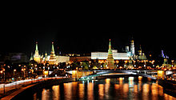
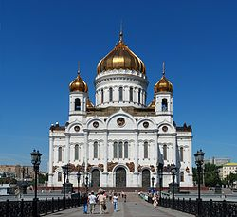
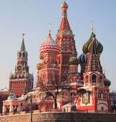
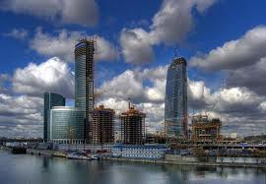
The city is named after the river that runs through it and has lots of magnificent buildings covered in gold.
Moscow
The language spoken here is Russian and it is said to be one of the hardest languages to learn.
Russian food is typically very salty and often dough based, they eat lots of breads oats, chicken is seen a meat for special occasions.
Moscow as a city lacks a lot of green space and people living there have to travel miles to get to parks and open areas.
Moscow is a highly religious city and the churches are some of the most important buildings in the city,
Moscow is one of the only cities in the world where people are not encouraged to speak English.
Moscow is well-known for its unique architecture which consists of many different historic buildings such as Saint Basil's Cathedral with its brightly coloured domes
Moscow is the capital city of Russia. There roughly 16 million people living there.

Slide 18
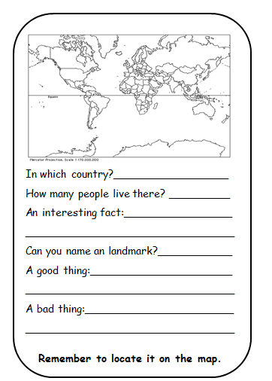
Choose one mega city to write about in on the sheet and glue into your book

Slide 19
task
Read pg145-6
How do urban areas differ from rural ones?
Figure 6.2: Where in the world are there the highest concentrations of people living in cities? Describe using countries and regions…
How do you think this pattern has changed in the last 10 years since the map? Which countries or regions have become more urbanized?
List 4 reasons why high rates of urbanization are occurring in LIC cities…

Slide 20
In which country?_________________
How many people live there? _________
An interesting fact:________________
_______________________________
Can you name an landmark?___________
A good thing:_____________________ _______________________________
A bad thing:______________________
_______________________________
Remember to locate it on the map.
In which country?_________________
How many people live there? _________
An interesting fact:________________
_______________________________
Can you name an landmark?___________
A good thing:_____________________ _______________________________
A bad thing:______________________
_______________________________
Remember to locate it on the map.

