Slide 1
Human Impact & Sustainability
Peri-Glacial Areas

Slide 2
TAPS - Trans-Alaskan Pipeline System
Built in 1973-1977
Owned by Alyeska Pipeline Service Company: BP, ConocoPhilips, Exxon Mobil, Chevron, Koch (consortium of private) companies)
1287 kilometres long, running from Prudhoe Bay in North (on Arctic Ocean) to Valdez in south (on the Gulf of Alaska)
Supplied approximately 25% of oil to USA at peak 1980s (7-10% now)
Approximately $1million pumped in section/hour

Slide 3
Environmental Impacts: Spillage
In 1980s, frequent spills common, but number of spills/year has declined over time
1989 – Exxon Valdez spills 11million gallons crude oil into Prudhoe Bay contaminating 1, 300 miles of coastline (due to rupture in lines)
Investigative Oversight
2006, over 250 000 gallons spilled (half of one day’s volume)
2009, flow line rupture causes thousands of barrels to

Slide 4
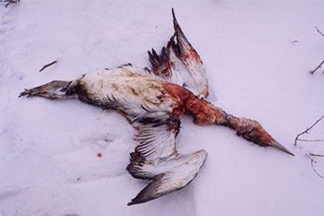
Oil Spills
‘Oiled’ seabird found on beach in Dutch Harbour, Alaska, from Kuroshima oil spill, 1997
Effects on Animals
Chemical makeup of oil is poisonous to animals and birds, affecting these organisms through ingestion, inhalation, external exposure
Most affected; sea otters (ability to stay warm depends on being clean), sea birds, terrestrial animals (snails, turtles), clams, etc.
Oil decomposes rate of apprs. 4%/year, some sections of shoreline still toxic (Prince William Sound)

Slide 5
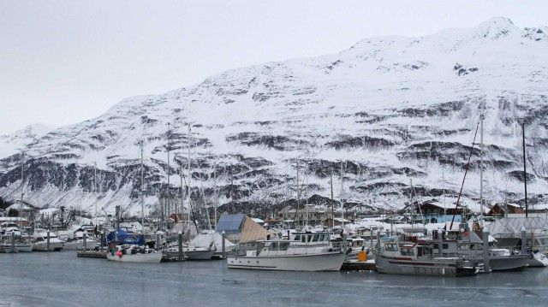
Oil Spills
Effects on Local Economy:
Fisherman experience decline in fish stocks as animals migrate away from spill (25 years later Alaskan fisherman still experience decreased stocks in crab and herring)
At time of spill, over 2,000 Alaskan Native Americans and 13,000 other subsistence permit holders lost the source of their food. Continues into present
Tourism industry lost over 26,000 jobs and more than $2.4 billion in sales

Slide 6
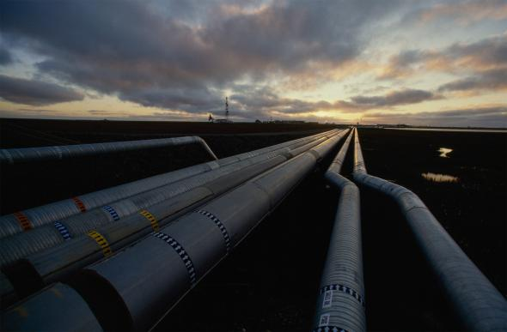
Sustainable?
By nature, oil is an unsustainable resource
Since 2015, volume of barrels has decreased, and by law, Alaska is required to remove all traces of pipeline upon close (no set date)
Alaska has a primary resource economy meaning a reliance on oil (after pipeline opened in 1977 average incomes rose 500%!!) despite 1980s peak
Approximately 90% of Alaskan state revenue comes from oil

Slide 7
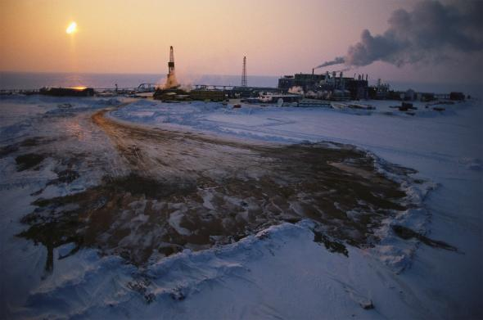
Tapping the ANWR
Read the controversial plan to tap the Arctic National Wildlife Refuge for oil:
What has Obama done and where?
Why does Alaska need money?
Where and why do private companies want to drill?
How do the indigenous feel about proposal?
What is life like for the Inupiat?
What is the significance of the ANWR?

