Slide 1
Aim: To discuss the geographic factors that determine the relative emphasis placed by policy-makers, in one country or region, on prevention as opposed to treatment of disease.

Slide 2
Why are some diseases prevented while others are treated? Examples??
Which type of policy approach is more expensive?
Which diseases have existing vaccinations?
Has there already been a disease outbreak?
How does the disease spread? What factors exist in the country which would affect the spread?

Slide 3
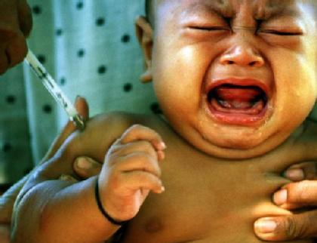
Are all babies vaccinated? Are diseases vaccinated against the same all over the world?
There is a great deal of variation in the adoption of Primary Health Care (PHC) measures on a local and national scale.
It is likely that when you were younger you were vaccinated against a range of diseases. These will have been the ones which were thought to be the most prevalent, or the ones that you would most likely encounter.
If prevention measures are not used, illness can become established in an area.
It is often more expensive to treat an illness or condition that has developed, rather than prevent it's establishment in the first place.

Slide 4
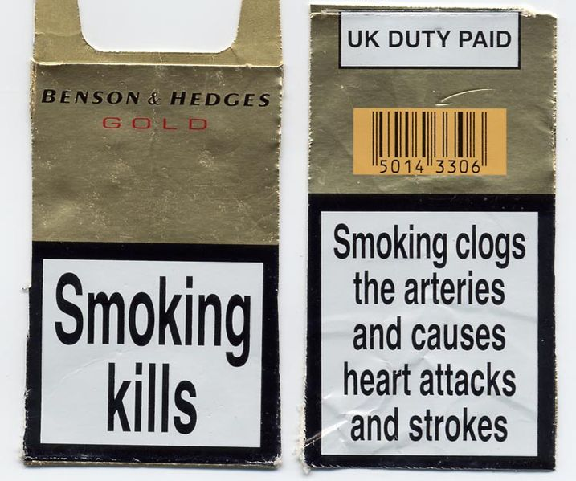
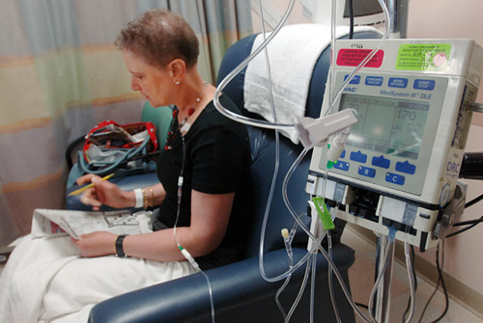
Eg. Lung Cancer – What is the strategy?

Slide 5
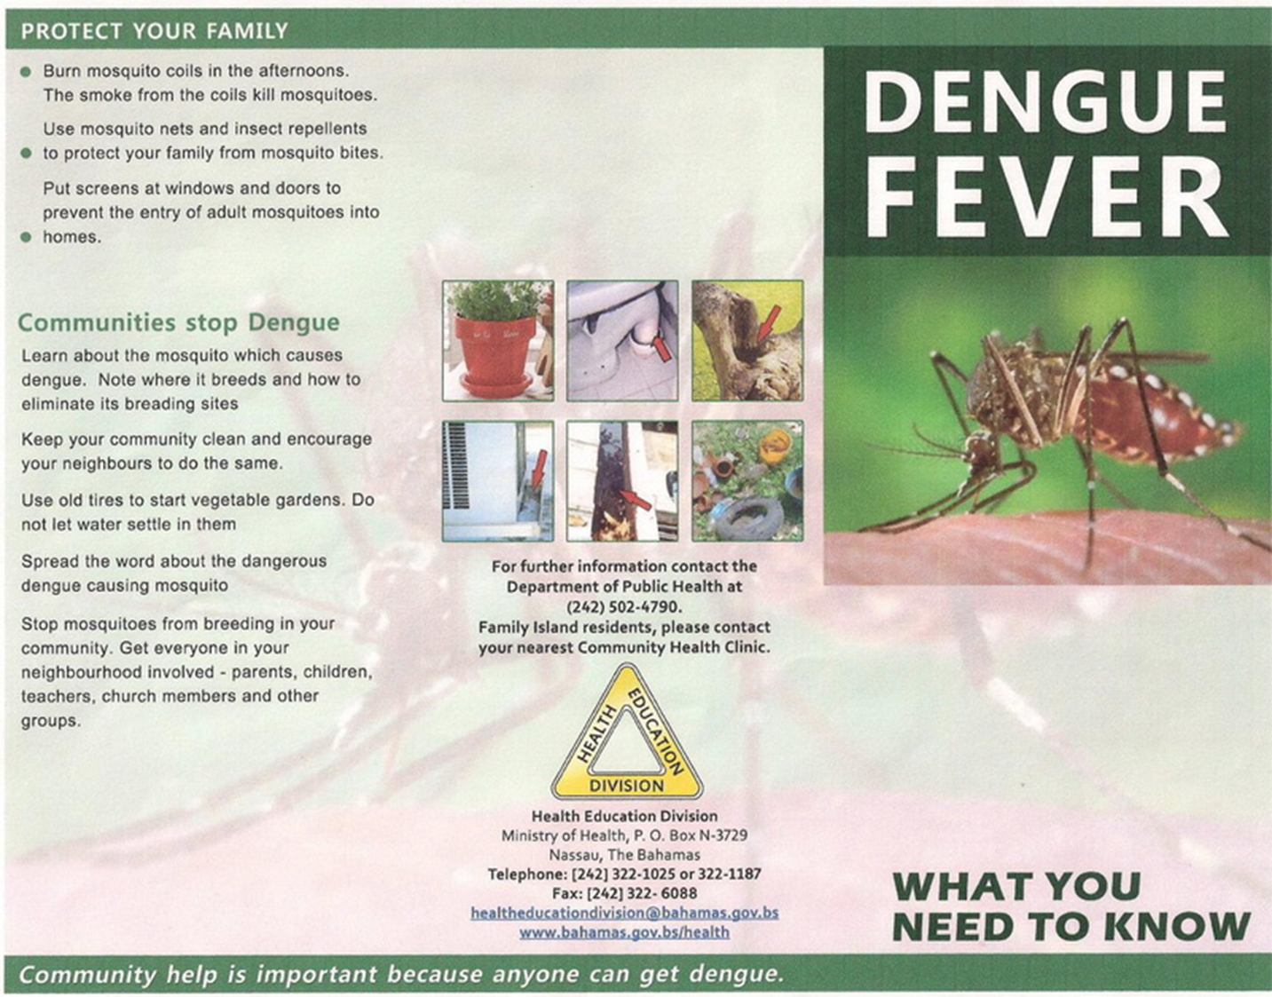
What is dengue fever? What is the strategy?
“a debilitating viral disease of the tropics, transmitted by mosquitoes, and causing sudden fever and acute pains in the joints”

Slide 6
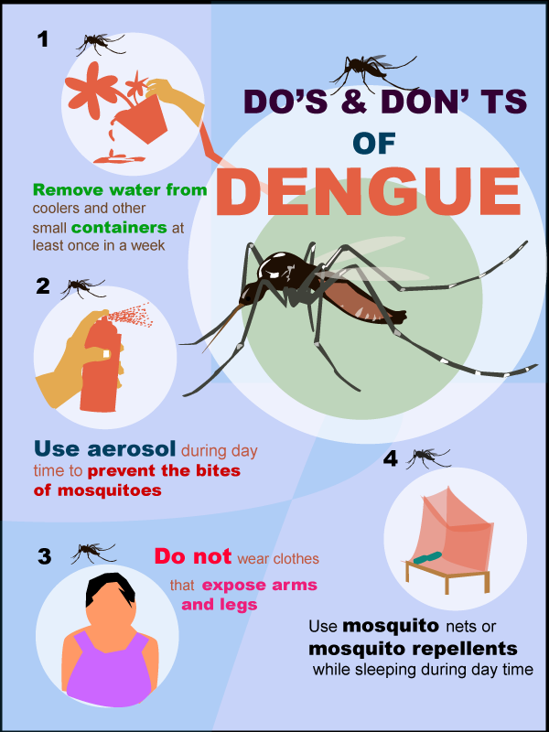
What geographic factors may affect prevention or treatment of dengue in the Bahamas?
Where will the government focus efforts to prevent this disease?
Because dengue fever is caused by a virus, there is no specific medicine or antibiotic to treat it. For typical dengue, the treatment is concerned with relief of the symptoms and signs. Rest and fluid intake for hydration is important

Slide 7
Moderate Cases:
Fortunately, this viral disease is usually self-limited and usually adequate hydration and pain control will help the person through the infection. However nonsteroidal anti-inflammatory agents such as aspirin should be avoided because of the tendency of the dengue viruses to cause hemorrhages
Most Serious Cases
IV hydration, blood transfusions, platelet transfusions, blood pressure support, and other intensive-care measures may need to be utilized in these patients

Slide 8
What geographic factors may affect decisions on preventing and treating disease?
NATURAL Sun – exposure to skin cancer Rivers – water borne diseases Humidity – mosquitoes Cold – exposure Remote (urban or rural) – access to hospitals Natural disasters eg. Cholera outbreak in Haiti Geographically isolated – eg. no rabies in UK but is in EU | ECONOMIC Affordability of prevention and treatment. Eg. lung Cancer treatment much more expensive than prevention. In LIC’s, prevention and barriers for spreading are cheaper than treatment Social medicine or private Eg. should a young person sign up to Obamacare? Costs increase with remoteness (link to nature)
WHO DECIDES Attitude to wards certain disease eg. HIV Link to social V private system Pressure from NGO’s eg. Cancer charities | SOCIAL Housing – eg. slum dweller at greater risk Population density – increases spread of disease by DIFFUSION Clean water for sanitation Education – reading leaflets of prevention or medicine directions Communication and transport – (access to hospitals – link to economic and environment)

Slide 9
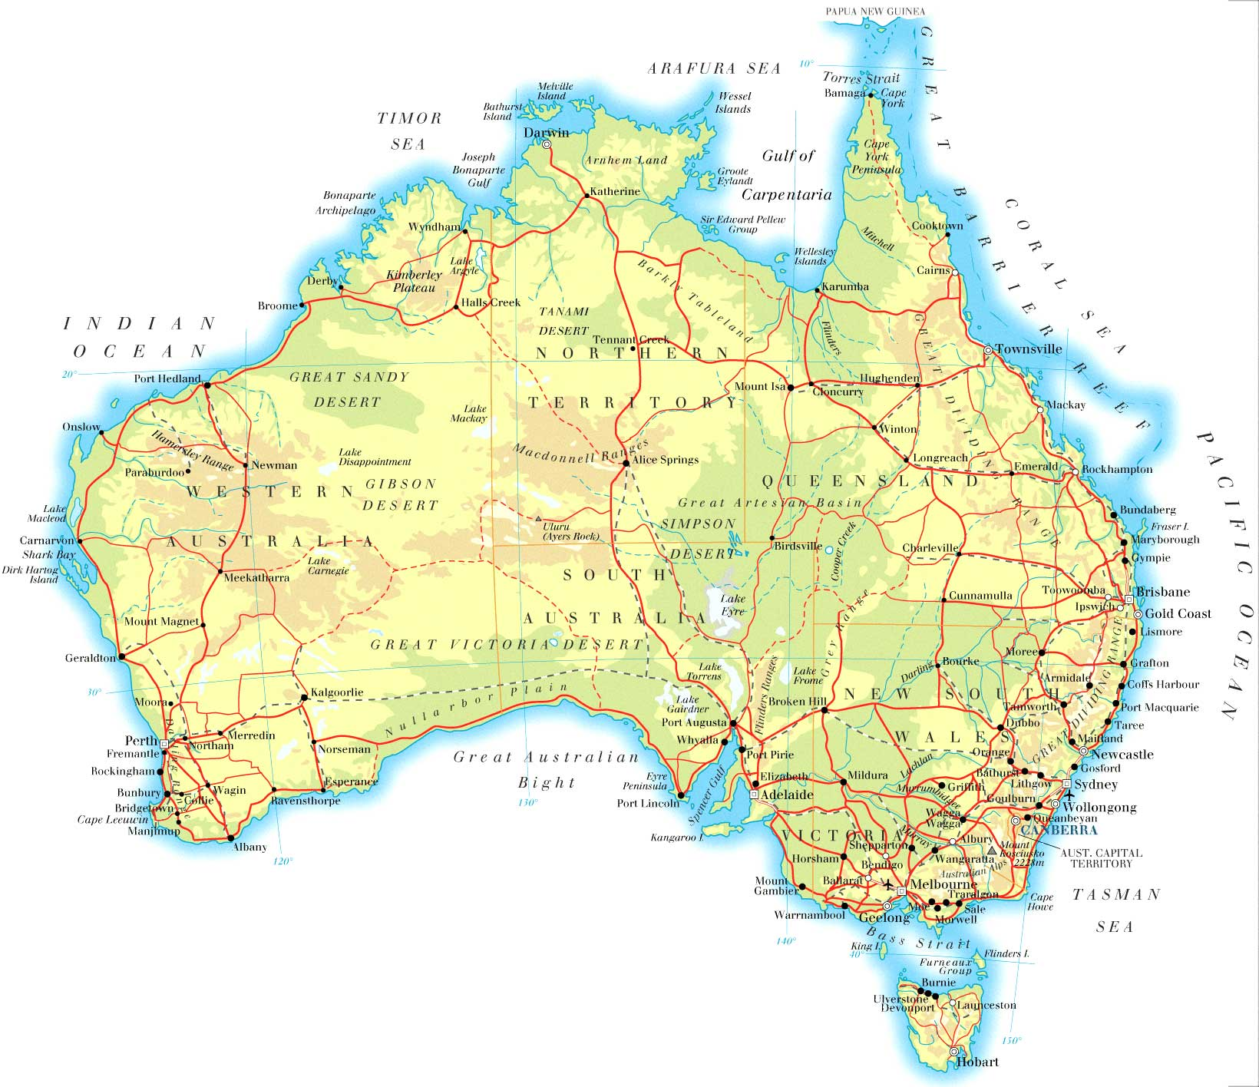
Case study country:
Have you studied before?
Example of how ethnicity affect disparities in development
What do you remember……….

Slide 10
How do we know we are dealing with a HIC?

Slide 11
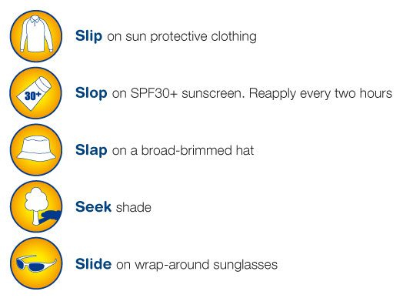
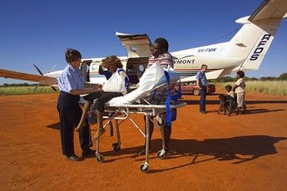
Classify worksheet statements

Slide 12
Disease – Cholera in Haiti
http://www.arcrelief.org/site/PageServer?pagename=haiti_cholera
http://thebritishgeographer.weebly.com/uploads/1/1/8/1/11812015/haiti.pdf

Slide 13
Referring to one or more diseases, discuss the factors that determine the relative importance of policies of disease prevention as opposed to policies of treatment. [10 marks]
Numerous factors are relevant to this response, depending on the particular
disease or diseases chosen. They include: relative costs per patient of treatment
compared with prevention; cost, effectiveness and availability of disease-specific
preventative measures such as vaccinations; whether or not the disease in question
spreads by diffusion, and if so by which type of diffusion; potential long-term
health or economic impacts of an outbreak of the disease in question; pressure
from disease-specific non-governmental organizations.
Responses which show a good knowledge of one or more diseases and which
discuss both prevention and treatment policies are likely to be credited at band D
or above.

