Slide 1
British, Australian and North American life expectancy began to increase drastically after the industrial revolution with improvements to housing, sanitation, and healthcare (think Louis Pasteur)
Rapid development period: 1880 – 1950
Former colonies of France and Britain, such as those countries in Africa, Asia and South America (Niger and Brazil) did not begin increase in life expectancy until they gained independence shed dictators or corrupt governments. Still developing now, some faster (Brazil) than others (Niger)
Rapid development period: 1940 – present
Countries such as China and Russia (former communist countries) experienced a decrease in life expectancy trends before and during the beginning of the communist period (1920s-1960s) due to backward government policies.
Rapid development period: 1880-1930s / 1990-present

Slide 2
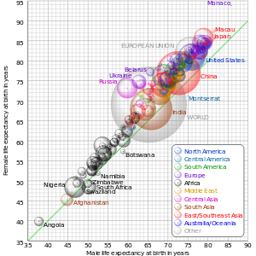
Aim: To evaluate different indicators of health

Slide 3
Indicators we need to define and evaluate:
life expectancy
infant mortality rate (IMR)
child mortality
HALE (health-adjusted life expectancy)
calorie intake
access to safe water
access to health services

Slide 4
Argue the case for your indicator to be the best one.
Overall, which do you think is best and why

Slide 5
What is HALE?
Health-adjusted life expectancy is a variation on life expectancy
A person may be alive, but not in full health for periods of time at various stages during their life.
There is an adjustment to the average figure for the time that is spent in ill health.
Different types of disabilities are given different weightings.
It is a general indicator of the overall health of a population, but is also related to quality of life.
Includes age specific and sex specific data
Takes into account impact of chronic illness (long term illness) on the quality of life of a person.

Slide 6
Evaluation of HALE
Disadvantages
Lack of reliable data on mortality and diseases especially from LIC’s
Internal variations within a country not taken into account eg. Differences between rural and urban areas
Advantages
Takes into account quality of life not just quantity of life
Data comes from WHO and is therefore reliable

Slide 7
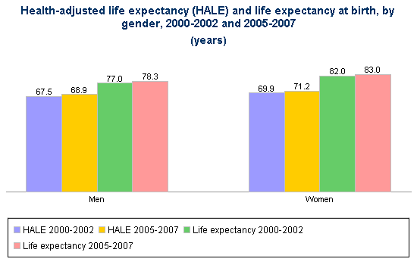
Eg. Canada
What do we notice:
Hale is lower than life expectancy. This is because…..
Although women had higher life expectancy, men were expected to spend a higher proportion of their life in good health.

Slide 8
Explain why health-adjusted life expectancy (HALE) is a better way to quantify the health of a community than infant mortality. [6]
Infant mortality reflects health of mothers, nutrition, health care education and services. Many countries have reduced infant mortality with relatively small investments in health care services. Infant mortality is a “snap-shot”, reflecting a limited time period.
The HALE includes many more health-related issues, and all age-groups. It also reflects a longer time period, including infant mortality, but also including mortality of other age-groups, and more importantly, ill-health throughout the population.
Award up to [3 marks] for the explanation of how each measure is used to quantify health. For full marks, HALE must be clearly shown to be the better measure.

