Slide 1
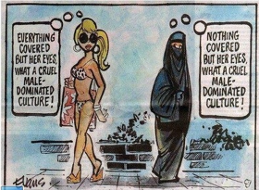
Review: What is Cultural Diffusion?
The process by which different cultures and practices around the world are converging and becoming increasingly similar due to increased global interactions

Slide 2
Does cultural diffusion have same impacts everywhere?
No.
Some groups of people are particularly vulnerable…
Like Who?
Politically unstable nations
Recently changed governments
Low income communities
Some rural communities
Indigenous Societies

Slide 3
Indigenous Societies… Are?
DEFINE the following words
Indigenous
Modernity
Primitive
Stone Age
Uncontacted
Civilization
Nomadic/Semi-Nomadic

Slide 4
Day One: Indigenous Societies
Go to www.survivalinternational.org
- browse the first page of the site and tell me what it is about
- Click on ‘About Us’ then ‘Terminology’
Define ‘indigenous’
- Read & record definitions of ‘Modernity, Primitive, and Stone Age”
(you may need a paragraph to describe this, IN YOUR OWN WORDS)
- Choose 3 “place-specific” names you don’t know / record definitions
- Under “uncontacted” find more info on the 100 uncontacted tribes
Find three reasons uncontacted tribes should be allowed to survive.

Slide 5
The Awá of Brazil: The most endangered tribe on earth…

Slide 6
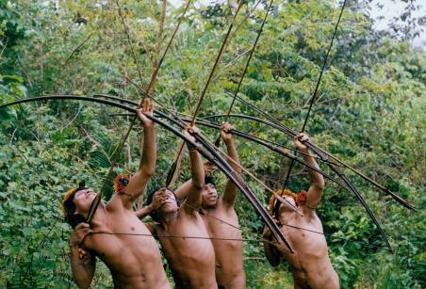
Who are the Awá tribes of Brazil?
Live in the eastern Amazon forests of Brazil
Today there are approximately 350 – of which 60-100 have chosen no contact with the outside world
Originally settled communities, adopted nomadic lifestyle in 1800 as a way to avoid incursions with Europeans
Up to 1980s managed to
avoid any major contact with
Brazil authorities/outsiders…

Slide 7
Global Interactions…
Without government intervention it seemed very likely that the Awá and their ancient culture would become extinct.
In 1982, Brazil received a loan from the World Bank and European Union on the conditions the government would protect and mark off the Awá tribal lands
The government was extraordinarily slow to do this (finally completed in 2003) but still illegal loggers on Awa land
Between 2003-2011 approximately 450 Awa have been killed. In 2011, Awá girl tied to a tree and burned alive by illegal loggers inside the protected state of Maranhão

Slide 8
Define Cultural Imperialism
The practice of promoting the culture, values or language of one nation in another.
It is usually the case that the former is a large, economically or militarily powerful nation and the latter is a smaller, less affluent one
What is the difference to cultural diffusion?
What has been the experience of the Awa?

Slide 9
Your Task:
Go to www.survivalinternational.org/tribes
Scroll down and choose one tribe to research
Read as much info from website as possible
Prepare a one-page overview on your tribe. Include:
- Stats; picture, map, brief history
- current issues / effects of globalization
- evidence of cultural imperialism
- your opinion; diffusion or imperialism?
(may be helpful to compare to experience of the Awa)

Slide 10
“The negative effects of globalisation on cultural traits have been overstated.” Discuss this statement. (15)
You will produce one essay in your group. Each person is responsible for a different paragraph
Task 1 – Brainstorm ideas – one person record ideas in a mind map
Task 2 – consider the vocabulary relevant to this question
Task 3 – decide on the main point of each paragraph. What will you use to develop each main point. Fill in burger for each main point.
Task 4 – assign different paragraphs to people.
Task 5 – write your paragraph and include it in a google doc.
Task 6 – get together and read your essay – come to a conclusion – it must be substantiated. Everybody writes a conclusion. Then choose the best one.
Task 7 – mark the essay written by the other group.

Slide 12
Day Three: Homogenization Of Culture
Display your report; give us an overview
As you listen to others find two comparisons with your own tribe; differences or similarities
What were your comparisons?
What is happening to cultures in these tribes?
Where in the world are most uncontacted tribes located? Why is this?
Do LICs and HICs differ in their treatment of indigenous peoples?
Are increasing sociocultural exchanges limiting or expanding freedom? Why?

Slide 13
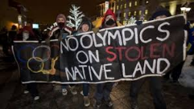
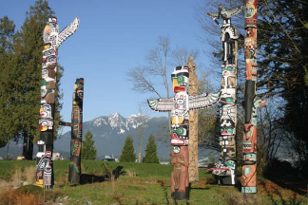
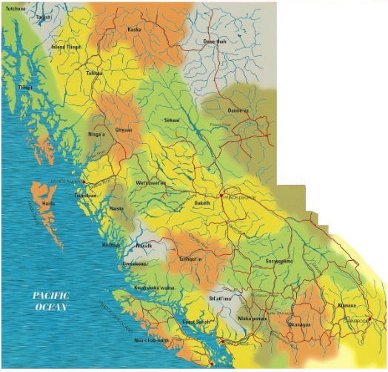
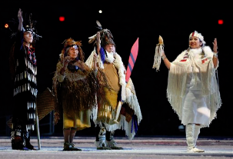
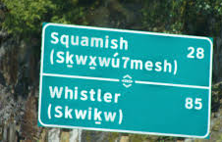
Indigenous Resurgence
British Columbia, Canada

Slide 14
Homogenization of Landscapes?
Uniform urban landscapes helped by the spread of consumer culture through TNCs
Style of architecture, construction is becoming the same in all industrialized societies (and most societies strive for industrialization)
Our world is becoming ‘Americanized’ with skyscrapers and McDonalds as the status quo
Do you agree or disagree? Why
Adaption vs. Adoption

Slide 15
Planet geography pg 619-628
What is the difference between expansion diffusion and relocation diffusion? – give an example of each.
Give an example of a culture trait that has been adopted and a culture trait that has been adapted.
Using examples, explain why TNC’s may have an impact on cultures in many parts of the world.
What is meant by homogenisation of landscapes?
Explain why homogenisation usually results in “westernisation” of cultures
Give some examples of ways in which music can a) build bridges between cultures and b) erode individual cultures
Respond to four of the above questions

