Slide 1
Cultural Diffusion

Slide 2
Culture: a definition….
Systems of shared meaning for a community
- Inherited ideas, beliefs and values
Gives us a sense who we are and where we belong – an identity

Slide 3
Cultural diffusion is…….
Different cultures and practices around the world are converging and becoming increasingly similar
Result of two processes:
1. Export of supposedly superior traits from West leading to their worldwide adoption
2. Mixing or hybridization of culture through greater interconnection and transport leading to a new universal cultural practice.

Slide 4
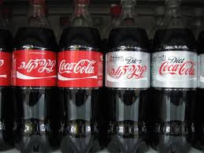
What factors cause cultural diffusion?….
transnational corporations(TNCs)
global media networks
migration
tourism
the Internet
actions of governments
technological change

Slide 5
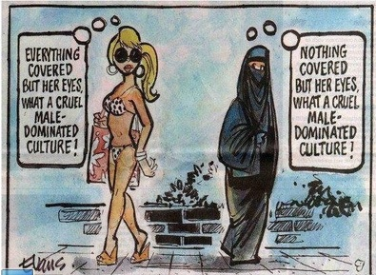
Cultural Traits: (components of cultural complex)
- Language
- Customs
- Food
- Beliefs
- Dress
- Images
- Music
- Technology

Slide 6
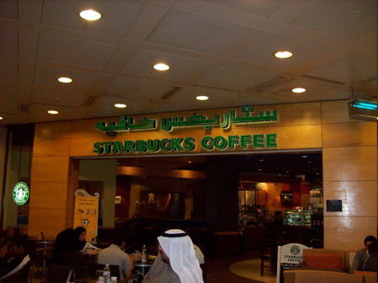
You are a photo-journalist for National Geographic; your current job is to document increasing diffusion of culture around the globe. Take (or find) 5 representation photos…
Create a photo essay documenting the cultural diffusion of one group through traits (music, food, etc.)
- Choose the 5 most important traits to your specific culture – the ones which have permeated the most (diffused) through other cultures and suggest why this may be the case in a caption
- Due to me by tomorrow – email me your copy direct before class.
Andrew – Irish
Trevor – British
Audrey – Indian
Nicholas – Chinese
Liam – American
Sydney - Caribbean
American food ‘brands’ are carried to the rest of the world through their large corporate presence

Slide 7
TNCs, Media and Consumer Culture: Branded Commodities
Perhaps the most influential driver in our worldwide spread of cultural diffusion, cultural blending, and rise of consumerism…

Slide 8
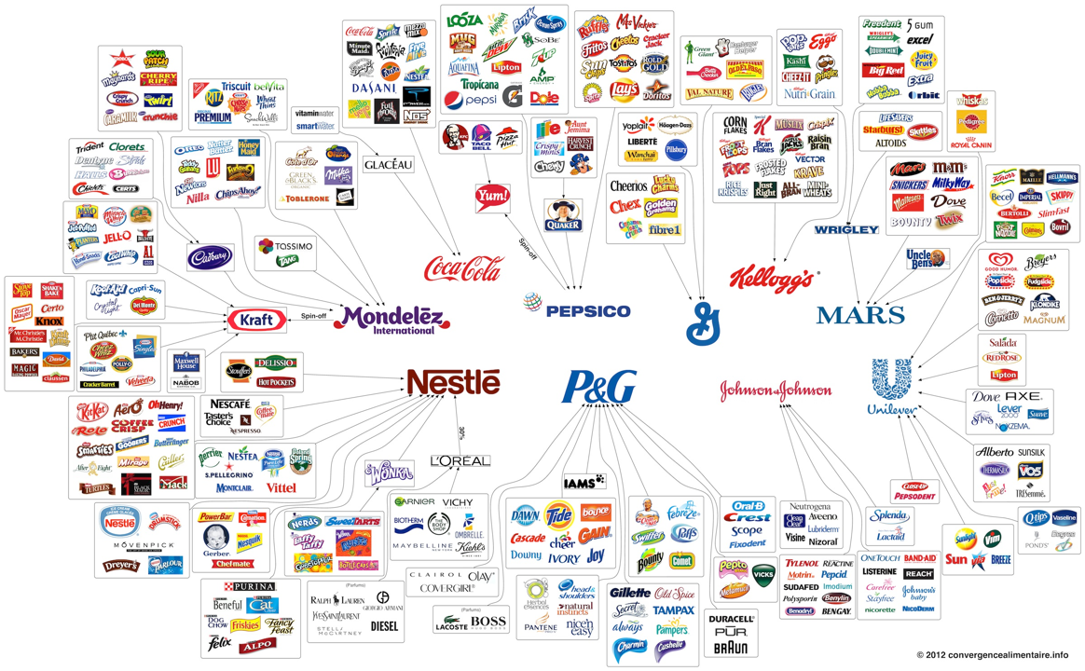
Cultural Diffusion: Branded Commodities & TNCs

Slide 9
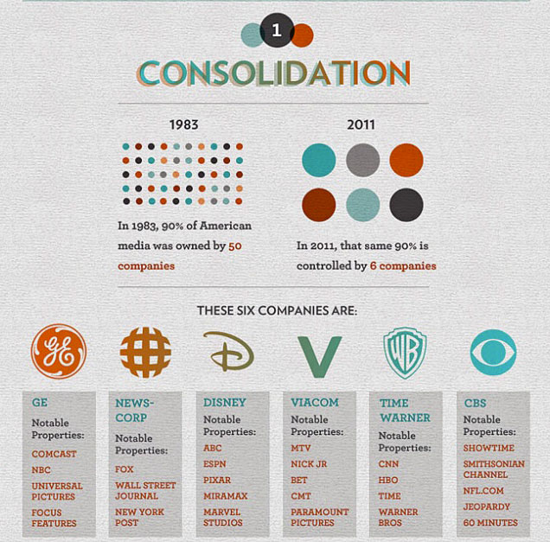
Media Corporations Are No Better

Slide 10
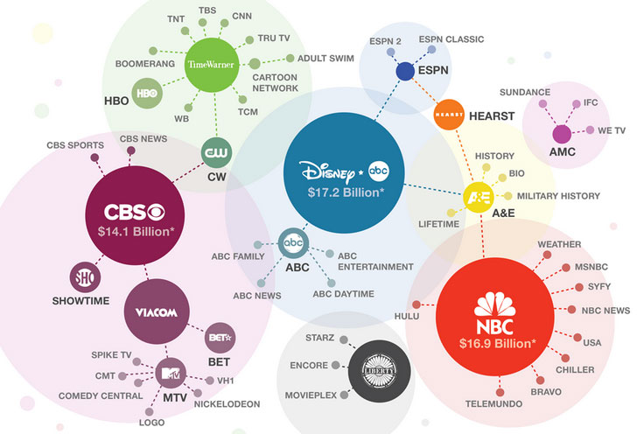

Slide 11
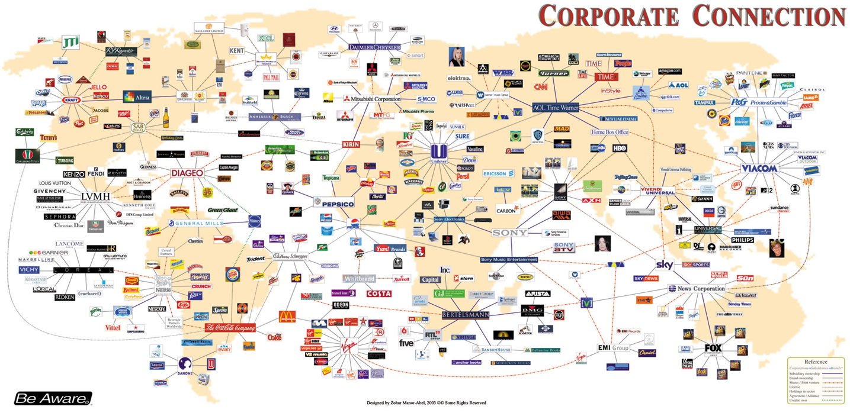

Slide 12
transnational corporations(TNCs)
Rise in TNCs = Loss of sovereignty for nations (political)
Over 50 million people are employed by TNC’s
TNC’s have massive power – more GDP than some nations!
Walmart – GDP – 379 billion dollars
Singapore GDP – 161 billion dollars
Uganda GDP - 11 billion dollars
Core and periphery
HQ tend to be in core and factories in periphery.
Media companies themselves are TNC’s!
Aim is to create a global brand desirable in all nations. Media helps them do this. Eg. Product placement in films.

Slide 13
global media networks
National media is being superceded by global media companies
Around 20-30 large TNC’s dominate – all are from the west (core), most are from USA
Own newspaper, news shows, films, TV shows, theme parks so views of a few people can dominate completely!
Examples
CNN - FOX – BBC - Time Warner - Disney

Slide 14
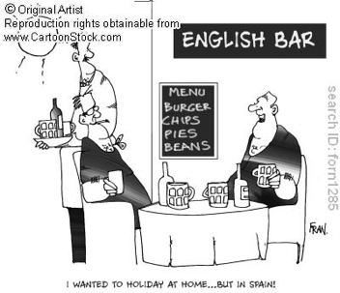
tourism
More exposure to different places through media and internet has increased tourism
As well as NEW culture, tourists want comforts and traditions of their home whilst on holiday eg. British tourists/migrants to BAHAMAS where there are English pubs, rugby leagues, etc.

Slide 15
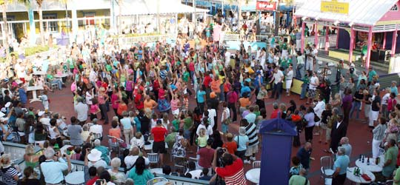
Migration
- Mixes cultures and migrants bring music, foods, dress and traditions from their own country eg. St Patricks day in Bahamas!!!!!
- Accelerating: more people are moving and more WOMEN

Slide 16
technological change
Allows almost instantaneous communications eg. Skype
Much easier to spread ideas and information from one country to another
Certain countries dominate the information flow (USA?)
Not all countries have same access to technology eg. Rural areas because where there is less demand, there will be less incentive to invest in new technologies
Has enabled TNC to dominate global economy
ICT based industries have enabled development of some countries such as India where there is skilled workforce but production is cheaper than in an MEDC. Worth 1 billion dollars a year employing 150, 000 people

Slide 17
the Internet
How many years did it take to reach 50 million users?
Radio
38 years
TV
13 years
Internet
4 years
Enables global business – the world is your market!
Spread information instantaneously – adverts, you tube, news
Disparities in access, should access to internet be considered as a human right?

Slide 18
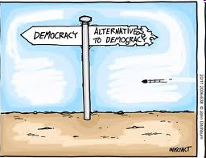
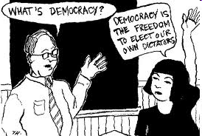
actions of governments
Spread of liberal democracy – now practiced in nearly all countries and is seen as the ‘right’ way to run a country
Diffusion of Western belief that this is the most desirable form of government?

Slide 19
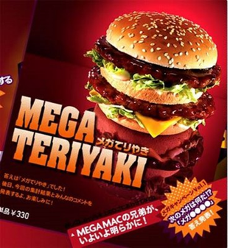
TNCs and Branded Commodities: Due Friday Watch one video by Friday on website In short answer form 1. summarize spatial and temporal adoption of ‘branded commodities’ across the globe

