Slide 1
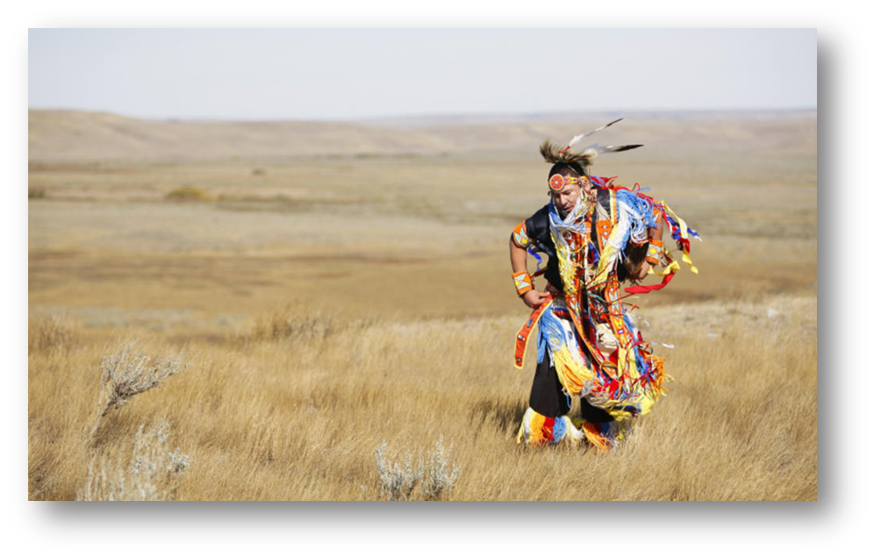
First nations/ native americans
Culture and society

Slide 2
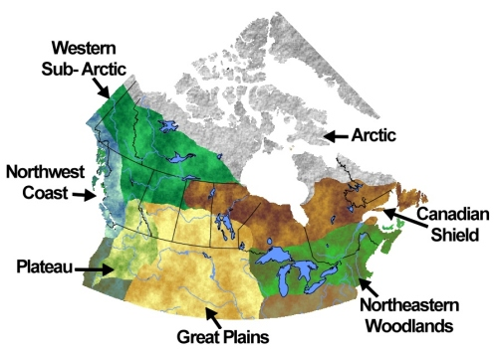
First peoples: - First peoples of north America - arrived between 12 000 and 40 000 years ago can we call them immigrants? textbook page 58 (MAP of USA)

Slide 3
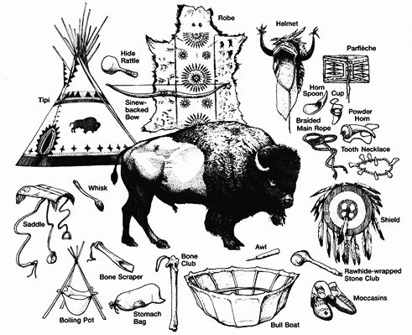
environment - used for everything: food, clothing, housing, tools, ornamentation, ceremonial objects - practiced sustainability; do not use more than nature can replace - believed in balance of nature; the circle

Slide 4
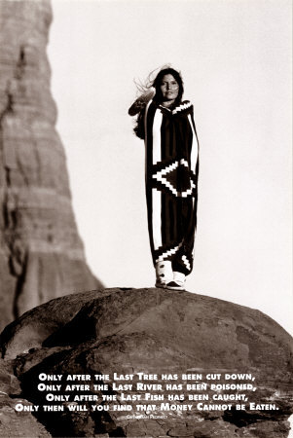

Slide 5
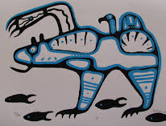
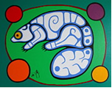
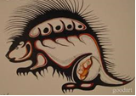
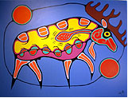
Totem: - symbol of ‘vision quest’ – people and animals have similar characteristics - represents connection and responsibility to nature and our earth

Slide 6
Questions: read your textbook: pages 58-59 1. How long ago did the first nations come to north and south America? How? 2. how did the tribes adapt to their environments? 3. what was the impact of European settlers on the first nations way of life? 4. How is first nations perspective different than a western perspective?

