Slide 1
Today: Explain the causes and effects of one major flow of labour between two countries.

Slide 2
Main points
Flow of labour is slower than flow of capital
Labour flow is restricted by various political barriers
Skilled labour flow is to large cities where there is a high economic return
Most world migration is internal, from periphery areas to the core. Due to agglomeration, where similar businesses can benefit from locating near each other.
Pattern of migration used to be from South to North. Now more likely to be South to South
Top 3 receiving countries USA, Germany and France
A core region in an area of periphery is a magnet for migrants eg. South Africa in the context of other Southern African countries

Slide 3
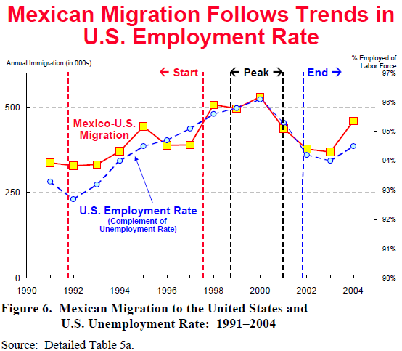

Slide 4
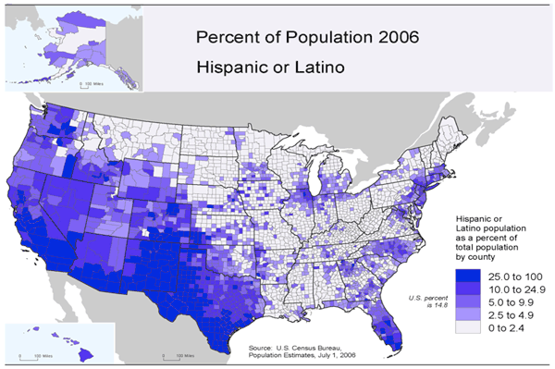

Slide 5
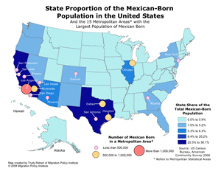

Slide 6
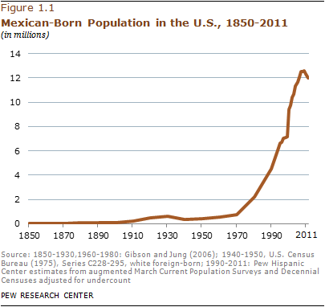

Slide 7
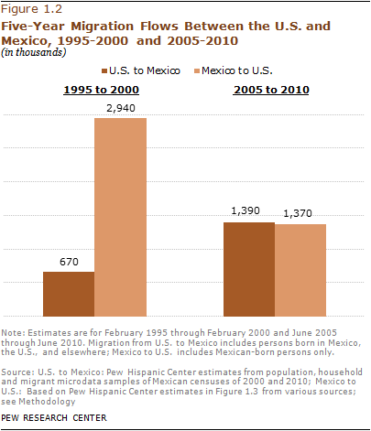

Slide 8
Mexico to USA revision
Using your overview sheet, answer the following questions in your notes:
1. (Causes) Why do people migrate from Mexico to the United States of America. You need facts and figures to back up your suggestions.
2. - Describe benefits/disadvantages to source country
- Describe benefits/disadvantages to host country (especially economic ones)
(Consequences) Describe attempts that are made to control migration across the Mexican/USA border
(Consequences) Describe the effect of Mexican migration on Mexico as whole.

