Slide 1
Capital Flows Pt. 2
FDI, Remittances and Debt
Let’s Compare

Slide 2
How do capital flows enhance or restrict countries economic options?
Loans
Debt repayment
Development aid (ODA)
Remittances
Foreign direct investment
Repatriation of profits

Slide 3
Where/how does capital flow for other types?
1. Find:
Total volume of flows ($), examples of ‘major players’, core-periphery relations (including regional differences)
Use overviews on website, textbook and the wider web
Loans / Debt repayment (Shania, Chad, Andre)
2. Define: debt, loan, interest
Remittances (Heidi, Alisa)
2. Define: remittance, hawala
FDI/ Repatriation of profits (Asif, Zoe)
2. Define: foreign direct investment, MNCs, profit repatriation
Each pair must create a work of art on your assigned board by the end of class…

Slide 4
Review: Define
Protectionism
Free Trade
the institution of policies (tariffs, quotas, regulations) that protect a country's industries against competition from cheaper imports.
a hypothetical situation whereby producers have free and unhindered access to markets everywhere
Neocolonialism
Neoliberalism
the use of economic, political, cultural, or other pressures to control or influence other countries, especially former dependencies.
laissez-faire economics; whose advocates support extensive economic liberalization, free trade, and reductions in government spending in order to enhance the role of the private sector

Slide 5
Useful definitions for your back pocket
Terms of Trade
Trade deficit/ surplus
the price of a country's exports relative to the price of its imports, and the changes that take place over time
when the value of a country's exports is less than the value of its imports / when the value of exports is greater than imports

Slide 6
World Trade Organization
There are a number of ways of looking at the WTO. It’s an organization for liberalizing trade. It’s a forum for governments to negotiate trade agreements. It’s a place for them to settle trade disputes. It operates a system of trade rules. Above all, it’s a negotiating forum … Essentially, the WTO is a place where member governments go, to try to sort out the trade problems they face with each other.

Slide 7
"Grant someone a special favour and you have to do the same for all other WTO members.“ What do you think? Who controls the WTO?

Slide 8
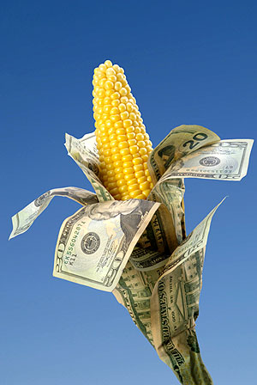
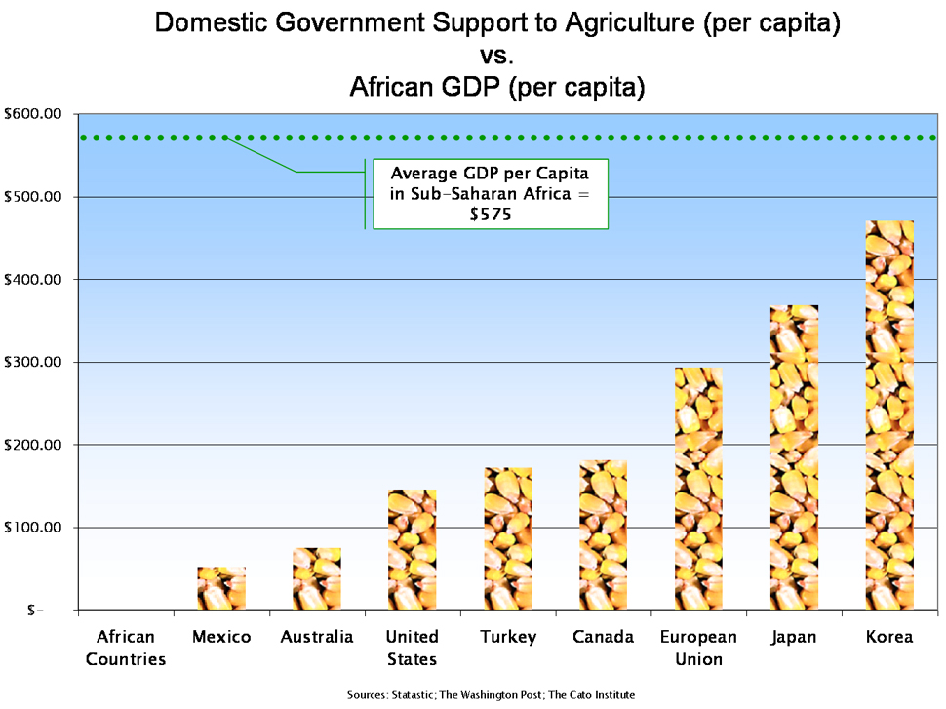
Many countries subsidize agriculture otherwise farmers couldn’t afford to do this job – why is this allowed?
Over 10 years, USA has given about 24 billion $ worth of cotton subsidies despite the fact that the World Trade Organization (WTO) ruled that United States cotton subsidies are illegal……. Does the WTO actually have real power….

Slide 9
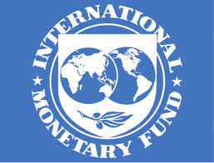
The International Monetary Fund
The IMF provides policy advice and financing to members in economic difficulties and also works with developing nations to help them achieve macroeconomic stability and reduce poverty.

Slide 10
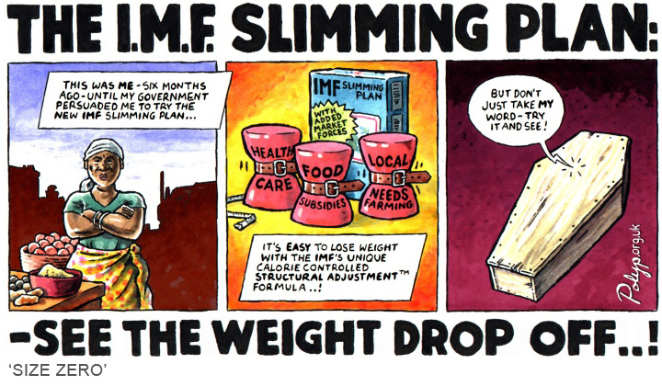
IMF

Slide 11
The World Bank
“The World Bank is a vital source of financial and technical assistance to developing countries around the world. We are not a bank in the ordinary sense but a unique partnership to reduce poverty and support development. We provide low-interest loans, zero to low-interest credits, and grants to developing countries. These support a wide array of investments in such areas as education, health, public administration, infrastructure, financial and private sector development, agriculture, and environmental and natural resource management. ”

Slide 12
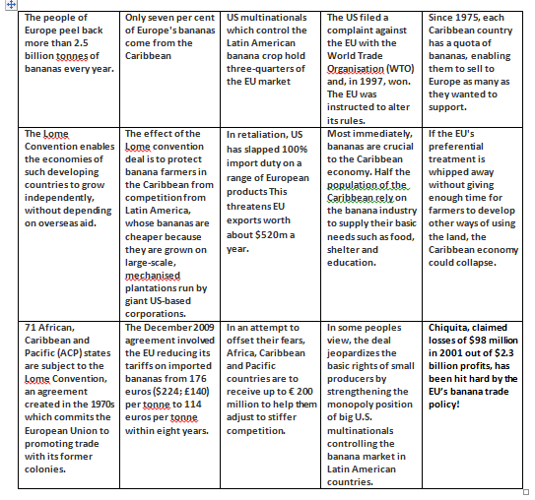
A closer look at the WTO and the Banana wars?
Put into an order…
Write a paragraph to describe the role of the WTO in the Banana Wars

Slide 13
Positives and negatives – Should Bahamas join the WTO? Bahamas – Yes we should join the WTO?
Our most prestigious asset is our strategic geographic location, which should be attractive for many firms around the world.
We will be forced to open our economy to competition from near and far, which should result in more and more aggressive companies entering the country.
Under-performing, bloated, public-sector enterprises, like Bahamasair and BEC will be negatively affected by competition but the net amount of firms should increase.
More industries means more jobs for Bahamians.
More jobs should contribute to economic growth and an increase in living standards.
More companies should also mean a wider selection of products and better products.
More companies and more products should result in lower prices for Bahamian consumers, also because firms face a higher incentive to cut costs.
We will be forced to remove all tariffs on imports which should enable us to buy cheaper imports.

Slide 14
Bahamas – No we shouldn’t join the WTO….
The increase in competition from foreign firms may force some domestic firms out of business (EG SANDS brewery?)
The enhanced opportunities for suppliers in the form of new, entrepreneurial firms is likely to challenge us severely because of the low rate of entrepreneurialism in the country (and which may mean foreign entrepreneurs filling the void).
The industry shake-out will see the end of under-performing public-sector enterprises, but this is likely to have consequences on employment.
The Bahamas is indebted to the US generally and so may be vulnerable to expoitation from nations upon which we depend.
The Bahamas possesses little in terms of negotiable assets - our most valuable asset being our location, as noted - so unless firms are after interested in exploiting this asset, trade negotiations will be one-sided.
We have very limited human and technical resources, so our bill for external expertise (consultants, advisors, etc) will increase significantly.
We do not have the personnel to cope with the heavy schedule of WTO meetings so will miss out on key negotiations.
We would be stopped from protecting any of our 'infant industries', e.g. agriculture, so they are likely to suffer from competition.
WTO favours larger powerful nations and our interests will be less important.
Conflict may also arise because we have a limited workforce with limited skills and capabilities so firms may want to import
FREEPORT EXISTS BECAUSE IT GIVES TAX BREAKS TO COMPANIES - WILL THIS STILL BE ALLOWED WITH THE WTO?
In theory, yes because Freeport is not really part of the Bahamas ’government’

Slide 15
Your Mind Map: Teams
Create a ‘mind map’ or ‘capital flow map’ that illustrates: major types of flows / major players
Include:
- Core / Periphery (worldwide)
- Major flows (LDDRFC)
- WTO, WB, and IMF
- UN and IDA

Slide 16
