Slide 1
Core vs. Periphery From maps and stats of yesterday, what conclusions can we make about ODA and the “core vs. periphery”?

Slide 2
Define ‘Core’ and ‘Periphery’ Using examples
Discuss the issue of scale
Where do the BRICs go?
What about LDCs and NICs?

Slide 3
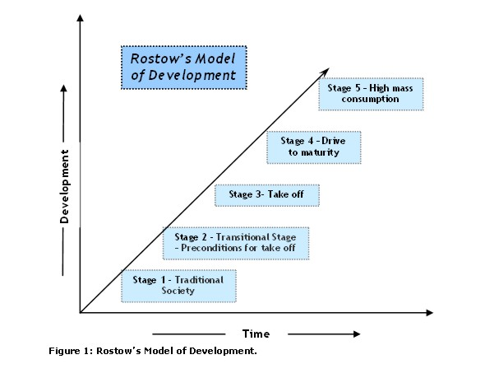
Rostow’s model of development

Slide 4
Rostow’s Model Provides a framework for thinking about development
Outdated (1960)
Oversimplified
Assumptions
Promotes neoliberal trade policies; mass consumption as integral to econ dev’pt
Not applicable to recent examples
MORE Info: Links on website.

Slide 5
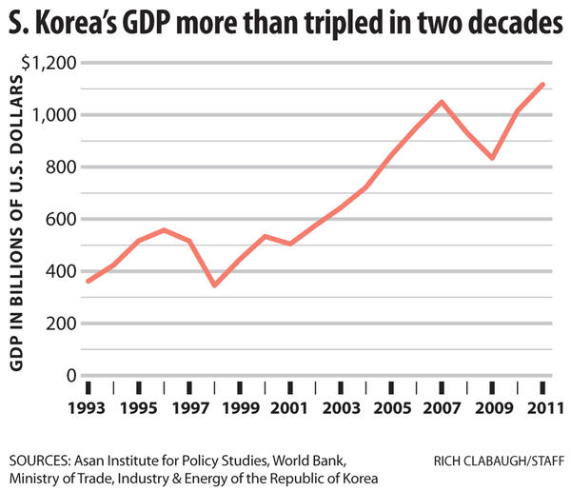
Asian Tigers shut down Rostow
The Asian Tigers or Asian Dragons is a term used in reference to the highly free/developed economies of Hong Kong, Singapore, South Korea, and Taiwan.
Unlike in Rostow’s model, rapidly industrialized in 1960s-80s by specializing in areas of competitiveness and using state intervention to help economy along

