Slide 1
How can capital flows enhance or restrict countries economic options? For that matter, what is capital?
The term capital suggests financial or physical assets which can generate income, such as property or investments. Capital is one of the factors of production, it is the man-made resources used in the production of goods and services. The other factors of production are land, labour and entrepreneurs.

Slide 2
Where does the money flow?
Types of economic interaction between countries:
Loans
Debt repayment
Development aid
Remittances
Foreign direct investment
Repatriation of profits

Slide 3
Official Development Assistance
Development aid or development cooperation (also development assistance, Official Development Assistance (ODA) or foreign aid) is aid given by governments and other agencies to support the economic, environmental, social and political development of developing countries. It is distinguished from humanitarian aid by focusing on alleviating poverty in the long term, rather than a short term response. There tends to be a grant element to distinguish from a loan.
Paraphrase this definition: 20 words or less.

Slide 4
OECD
The Organization for Economic Cooperation and Development (OECD) is a unique forum where the governments of 34 democracies with market economies work with each other, as well as with more than 70 non-member economies to promote economic growth, prosperity, and sustainable development.

Slide 5
ODA by sector: what areas receive development assistance?
Social Infrastructure
Humanitarian Aid
Economic Infrastructure
Admin Costs of Donors
Production
Debt Relief
Multi-Sector

Slide 6
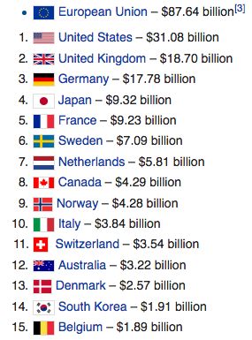
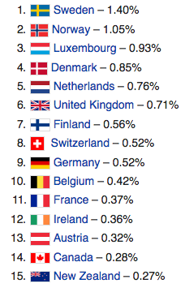
How much do countries give? Which countries give the most?
Total Amount
Percentage of GDP

Slide 7
Choose 3 countries
Decide whether each country is most likely to be a ‘donor’ or ‘recipient’
Predict the top three countries it receives ODA from or gives ODA to…
Predict the top three sectors which your country gives aid to or receives aid from….
Providejustification for your choices

Slide 8
OECD website
RESEARCH:
Record the top three countries it receives ODA from or gives ODA to (and the amounts)
Record the top three sectors which your country gives aid to or receives aid from….
http://www.oecd.org/statistics/compare-your-country.htm

Slide 9
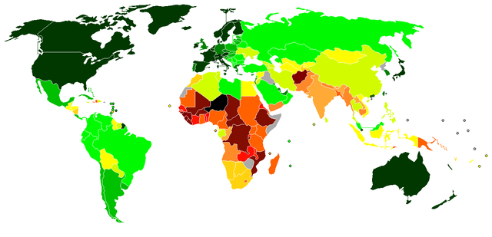
Predictions vs. Reality
What was the discrepancy between your predictions and the reality?
Do some research online, come up with reasons for the connections you see in the reality of capital flows.
Finish off your notes with this reasoning in one paragraph.

Slide 10
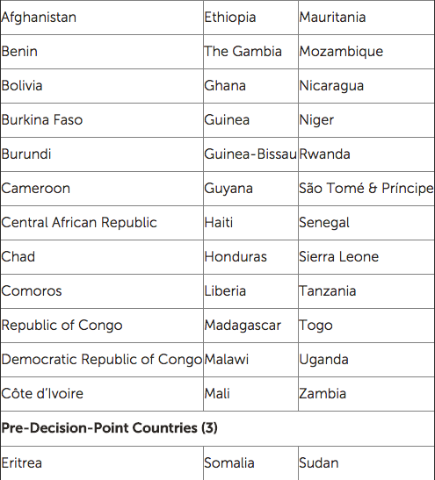
HIDCs: Heavily Indebted Countries

Slide 11
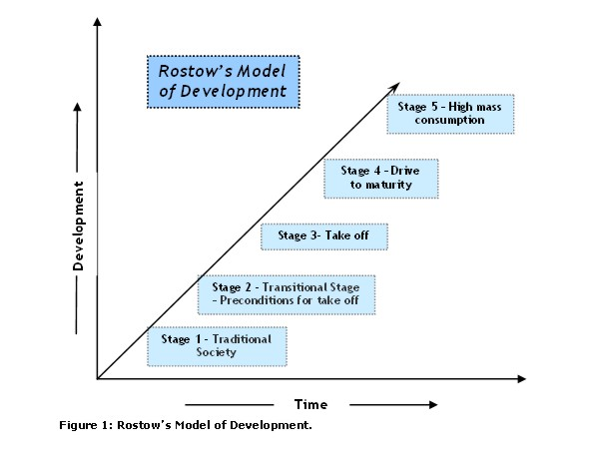
Rostow’s model of development
http://www.youtube.com/watch?v=lAXladJwbOI
Use stage one and stage two of this video to write about Rostows model in your own words.

Slide 12
http://www.youtube.com/watch?v=lAXladJwbOI Watch the rest of the stages…………….
Loans
Debt repayment
Development aid
Remittances
Foreign direct investment
Repatriation of profits
If a question says economic then you should remember these6 things to discuss………
Task 2
Fill in the table using this website:
http://www.geographyalltheway.com/in/ib-global-interactions/transfer-capital.htm
Task 3
Consolidate your knowledge using the textbook….

Slide 13
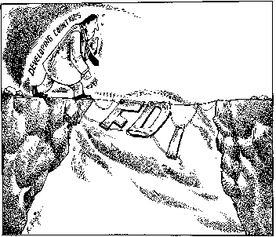
A little more detail on FDI………….

Slide 14
Why this pattern?
Highest investments in rich countries and emerging countries –
companies want to be successful so they invest in successful (rich) places!!!
Lowest investment is in poor (periphery) countries
-no market, poorly skilled workers, no infastructure
and countries that politically isolate themselves! (NK)
Follows core periphery model of globalisation

Slide 15
Disadvantages of FDI for semi periphery and countries
http://www.simsweatshop.com/
Take advantage of cheap labour – workers poorly paid
No union organisation so conditions are poor such as no breaks
Take advantage of lack of pollution laws so often have negative impact on the environment

