Slide 1
Random Facts:
More Chinese people live outside China than French people live in France
If ‘migrants’ were a country they would be the fifth largest in the world.
As previously discussed, culture is diffused through various traits… can you name some?
Depending on the culture, it can be preserved (usually with concentrated numbers) in a host country.

Slide 2
What is a diaspora?
A population of a country who have migrated abroad and keep strong identity ties with the homeland.
A permanently displaced and relocated collective.
The forced or voluntary dispersal of any population sharing common racial, ethnic or cultural identity, after leaving their settled territory and migrating to new areas.

Slide 3
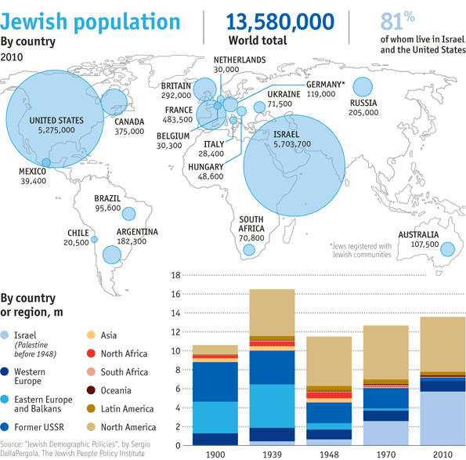
Can you think of any diasporas? Present or historical…

Slide 4
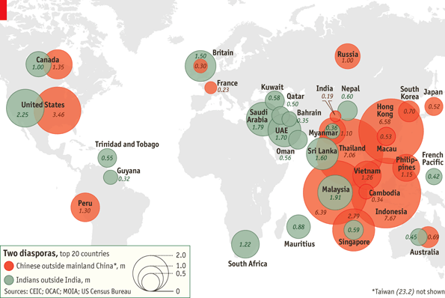
Chinese and Indian diaspora

Slide 5
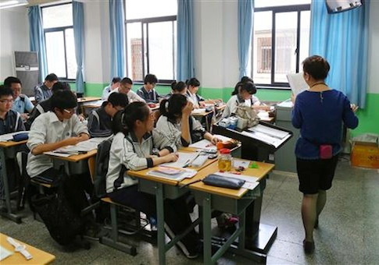
How are diasporas preserved? (and adopted…)
Education – in Canada, many children of Chinese descent (whether first, second or third generation) attend ‘Chinese schools’ on weekends or after regular school hours. Ouch!
Here they learn mandarin and have lessons on Chinese culture.

Slide 6
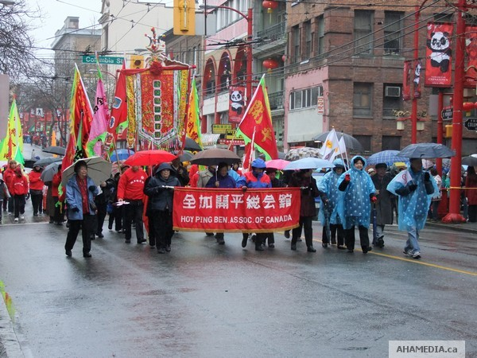
Diasporas form social institutions
This helps in the preservation of culture. Many social services in Chinatown, Vancouver, CAN

Slide 7
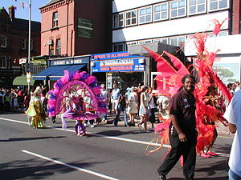
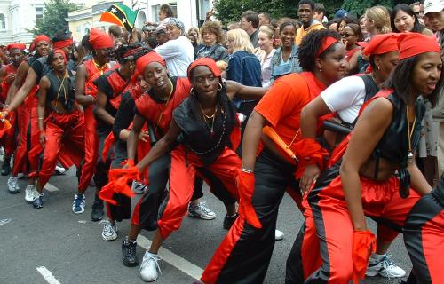
Caribbean Culture in UK: Dress, Celebration
Notting Hill carnival similar to Junkanoo
Began as a positive response from Caribbean people to racism in London
Attracts up to 1.5 million people from Britain and around the world, making it the largest street festival in Europe.

Slide 8
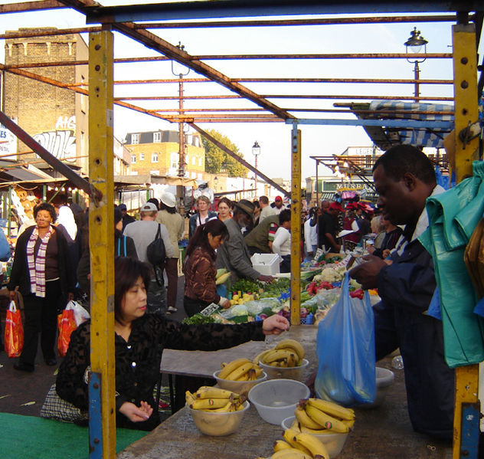
Ridly road Market: Food
London
Sells African-Caribbean music, textiles, and food including goat meat, yams, mangos and spices

Slide 9
Title: Diasporas in the USA
Create two columns in your notes
One entitled ‘Preservation of Culture’
One entitled ‘Adoption of Minority Traits’
Use the two worksheets posted on the website to choose 4 ways culture is preserved by your chosen diaspora in the USA and 4 ways the host country (USA) adopts minority traits
Use news articles to research Recent, Specific and Relevant facts on your diaspora of choice:
Irish, Chinese, Indian, Mexican, Italian, Polish, German, Cuban

