Slide 1
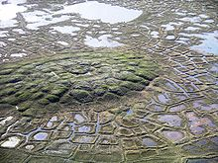
What are periglacial processes?
Learning destination: understand what permafrost, frost heave, groundwater freezing, nivation and solifluction are and what landforms they create
Routes: Identify, describe and explain the formation of nivation hollows, ice wedges, patterned ground, pingos and solifluction lobes

Slide 2
What are periglacial areas?
Areas that experience a cold climate, with intense frost action and the development of permafrost
Aka tundra areas
20-25% of the Earth’s surface is periglacial, e.g. northern North America and Russia above the Arctic Circle
Experience conditions close to glacial (near an ice sheet e.g. Greenland). Peri = near. Consistently below 0 degrees celsius.
Temporally close to glacials (e.g. Highland Scotland)
Very cold climate with distinctive landforms
May exhibit temperate climates today

Slide 3
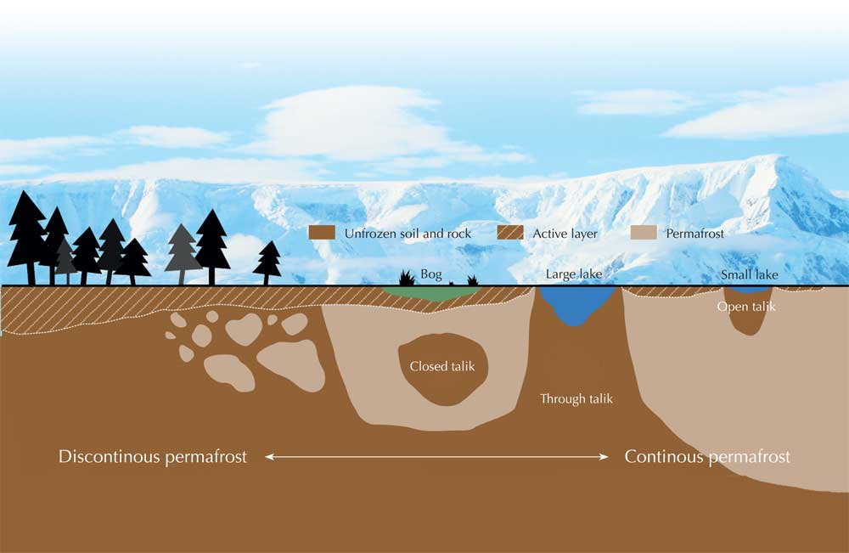

Slide 4
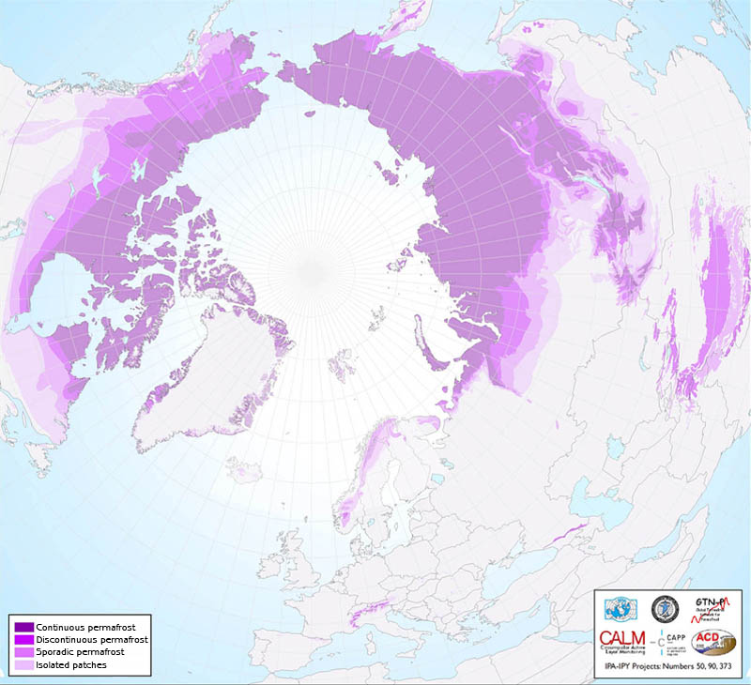

Slide 5
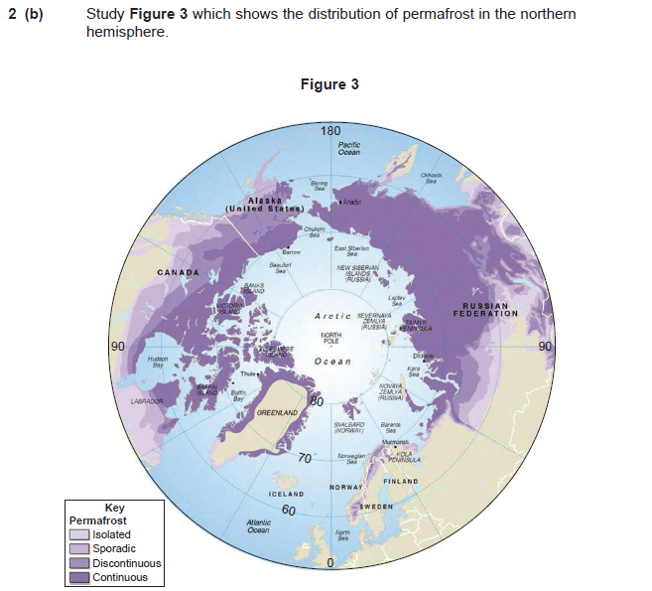
Describe the distribution of permafrost shown in Figure 3 – 4 marks
June 2012

Slide 6
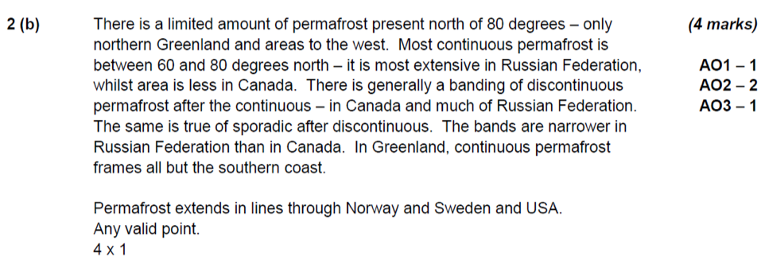
Mark scheme june 2012

Slide 7
Periglacial processes

Slide 8
Freeze-thaw action (frost shattering)
Blockfield
Felsenmeer

Slide 9
Freeze-thaw action (frost shattering)
In periglacial areas, screes develop at the foot of slopes due to frost shattering
On relatively flat areas, extensive spreads of angular boulders are left, known as blockfield or felsenmeer (sea of rocks)
E.g. the Glyders, North Wales

Slide 10
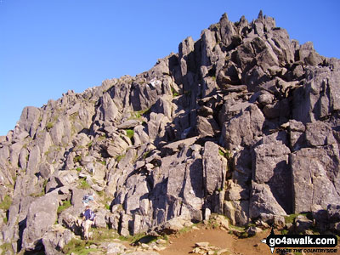

Slide 11
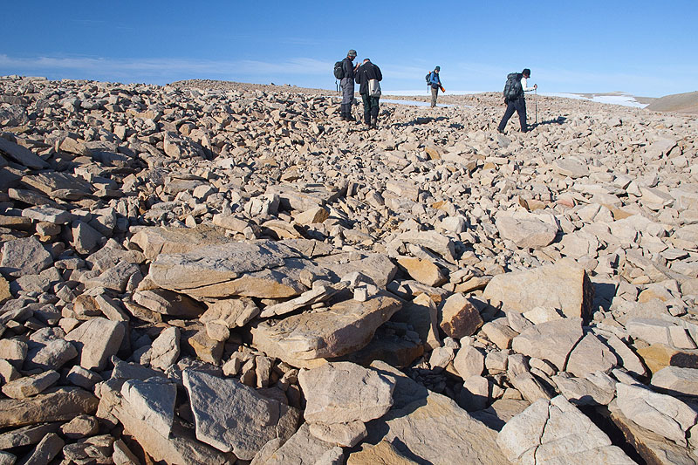

Slide 12
Frost heave
Patterned ground
Stone polygons
Stone stripes

Slide 13
Frost heave
Results from the direct formation of ice crystals in the soil as it starts to refreeze
On freezing, fine-grained soils expand unevenly upwards to form domes.
As stones cool down faster than the surrounding soil, small amounts of moisture in the soil beneath the stones freeze and turn to ice, expanding by 9% as they do so.
By repeatedly freezing and thawing over time, these ice crystals and lenses heave stones upwards in the soil.

Slide 14
Frost heave cont…
In areas where temperatures fluctuate between 0 degrees and -4 degrees C, the frost heaving and subsequent thawing is able to sort material to form patterned ground.
The larger stones move outwards down to the very low slopes of smaller domes because of their weight.
On gentler slopes stone polygons are created, but where the ground is steeper (greater than 6 ̊) the stones are dragged downhill by gravity into more linear arrangements known as stone stripes.

Slide 15
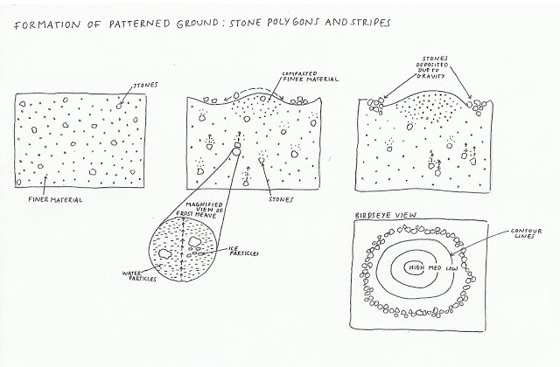

Slide 16
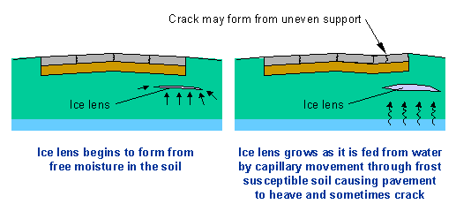

Slide 17
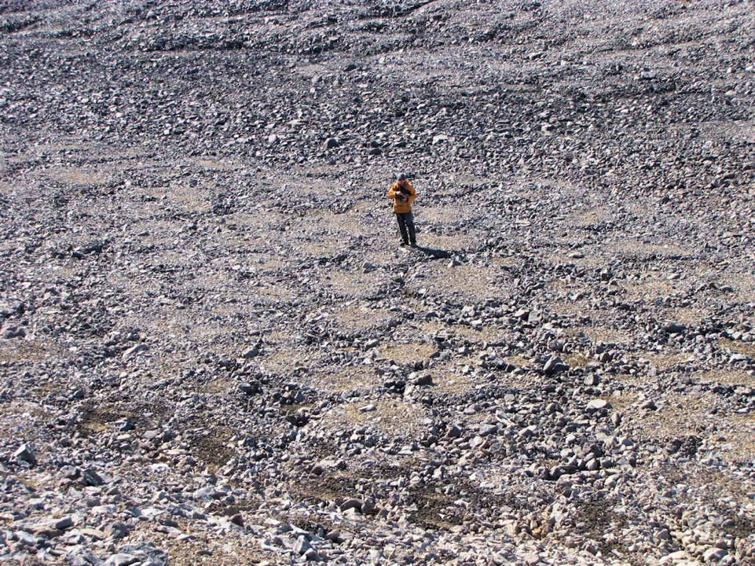

Slide 18
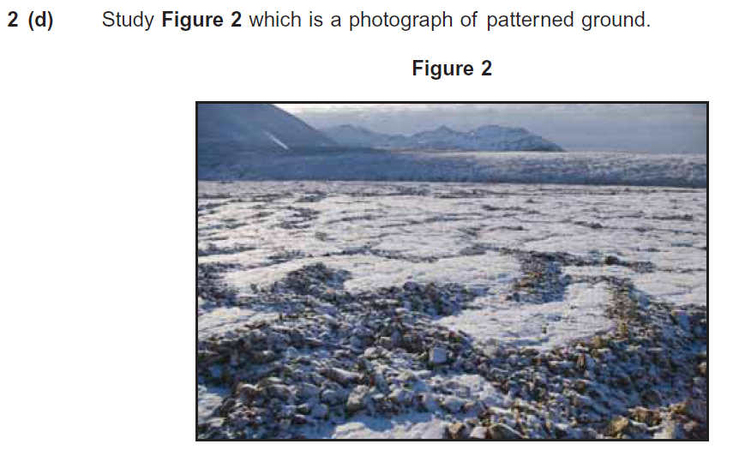
Describe the patterned ground shown in Figure 2 and explain its formation – 6 marks

Slide 19
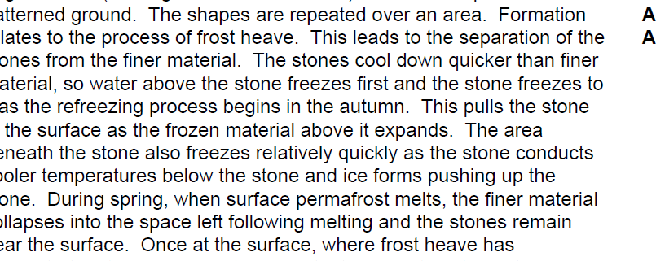
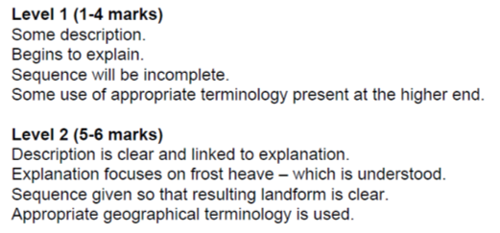
Mark scheme…

Slide 20
Ground contraction: patterned ground
Ice wedges
Ice wedge polygons

Slide 21
Ground contraction
Refreezing of active layer during winter causes the soil to contract - cracks open on the surface
During melting the following summer, the cracks open fill with meltwater and its associated fine sediment, which helps to partially fill the crack
Repetition widens and deepens the crack to form an ice wedge up to 1m wide and 3m deep
A near polygonal pattern is produced on the surface, similar to frost heave polygons
Forms ice wedge polygons

Slide 22
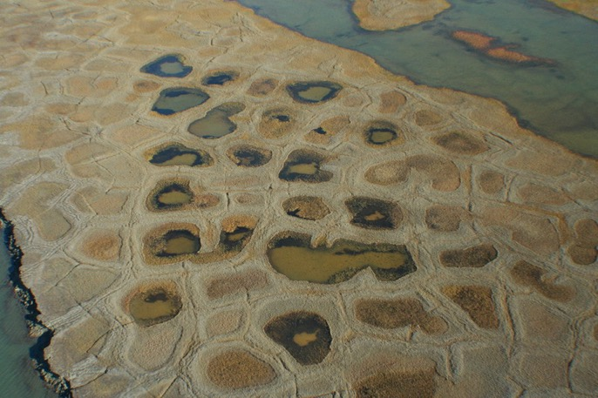
Ice wedge polygons

Slide 23
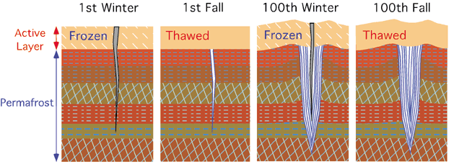
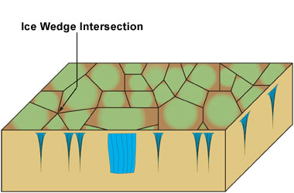
Ice wedge development

Slide 24
THERMOKARST
Forming hollows:
Lakes and drying lakes, fens and bogs, gullies and slumps

Slide 25
Thermokarst
refers to an area of land surface that forms as the permafrost melts
This can be a frost heave of a previous winter (dome formed by ice crystals)
As ice melts, landscape shaped into small surface depression(s)
Melting can be extremely localised and short term caused by for example forest fires or in the longer term, climate change.

Slide 26
Thermokarst: Permafrost thaws in Hudson Bay, Canada 2008

Slide 27
Groundwater freezing
Pingos

Slide 28
Groundwater freezing
Freezing of water in upper layer of soil where permafrost is thin or discontinuous leads to the expansion of ice within the soil
This causes the overlying sediments to heave upwards into a dome-shaped feature known as a pingo
Less than 50m in height, 0.5km across, found in sandier soils = open-system or East Greenland type

Slide 29
Pingos
Closed-system pingos or Mackenzie type pingos are more typical of low-lying areas with continuous permafrost
On the site of small lakes, groundwater can be trapped by freezing from above and by the permafrost beneath as it moves in from the lakeside
Subsequent freezing and expansion of trapped water pushes the overlying sediments into a pingo form
If the centre collapses it may infill with water to form a small lake
Over a thousand of these pingos have been recorded in the Mackenzie delta (Canada)

Slide 30
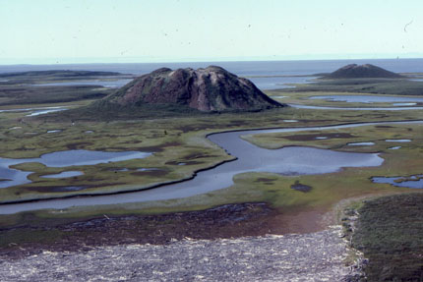

Slide 31
task
Draw 3 diagrams:
Formation of an open-system (East Greenland) type pingo
Formation of a closed-system (Mackenzie) type pingo
A ruptured pingo

Slide 32
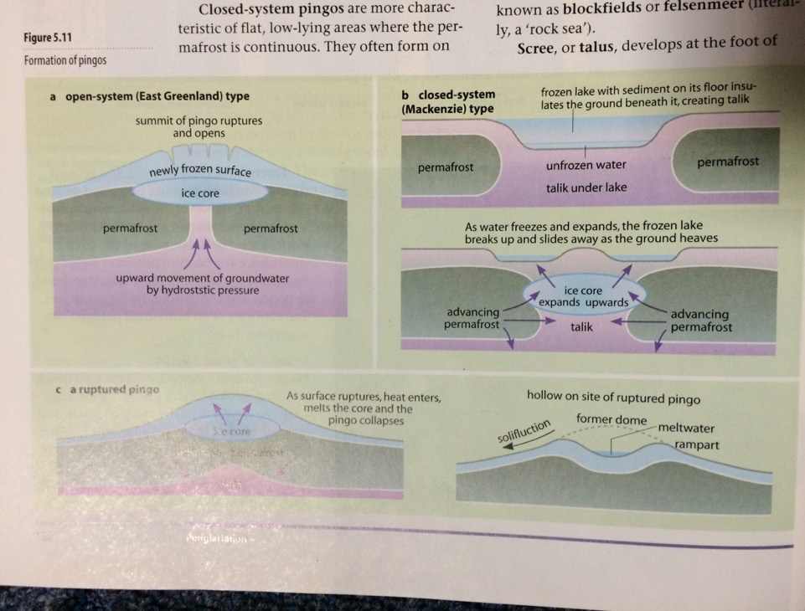

Slide 33
Exam question – jan 2012
Draw a labelled sketch to show characteristics of a pingo and suggest an explanation for its formation – 7 marks

Slide 34
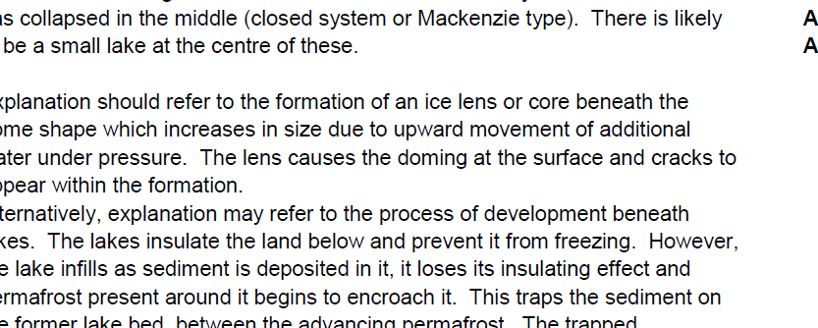
Mark scheme

Slide 35
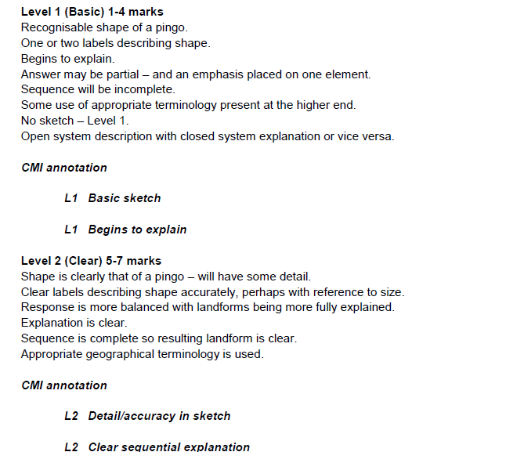

Slide 36
solifluction
Solifluction lobes

Slide 37
solifluction
Summer thaw in the active layer releases a lot of meltwater
Water cannot percolate downwards due to frozen ground so it saturates the soil
It reduces internal friction between particles making the soil mobile
The soil flows even on slopes of only a few degrees (mass movement)
Leaves behind rounded tongue-like features forming terraces on the side of valleys – solifluction lobes

Slide 38
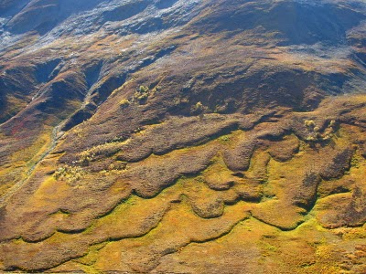

Slide 39
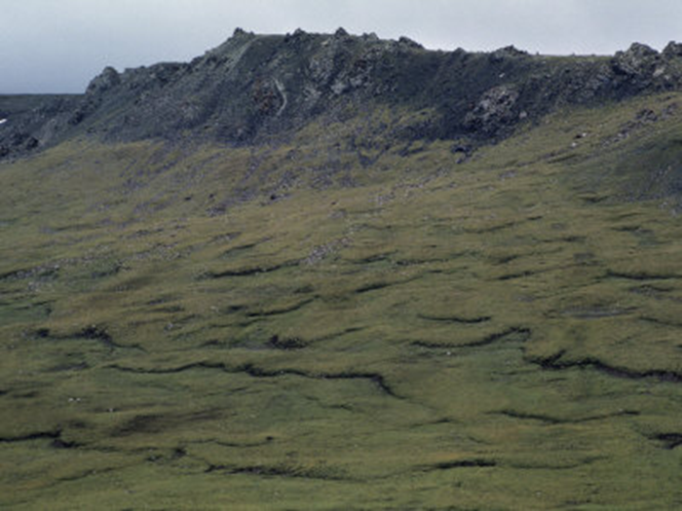

Slide 40
Solifluction lobes
Stepped features below vegetation, pushed forward and rolled under like Caterpillar truck
Where vegetation is sparse, stones heaved to the surface are pushed to the front of the advancing lobe and form a small stone bank at the front of the lobe
Many parts of southern Britain experienced these conditions during the Quaternary ice age and these deposits, which filled in valleys are known locally as head (coombe in chalky areas)

