Slide 1
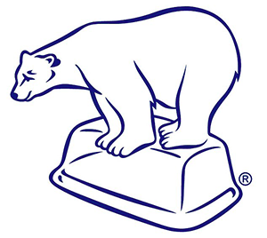
Glaciation
What creates glaciers and the process of glaciation (being covered by glaciers)?

Slide 2
Sunlight, or, lack of.

Slide 3
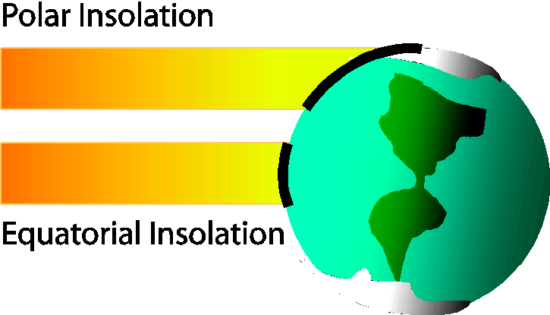
Insolation
The quantity and intensity of solar radiation upon an object.
In this case, the Earth’s surface.
Assuming the output of energy is constant from the sun, the rays will be spread over a larger area, the nearer you get to the poles.

Slide 4
Insolation
Factors that affect it on Earth are:
Angle of approach in relation to the Earth’s surface i.e.
Equator:0⁰ latitude = 90º
Arctic circle:66º latitude= 30º
Cloud, dust and other particles in the air.
Time of day

Slide 5
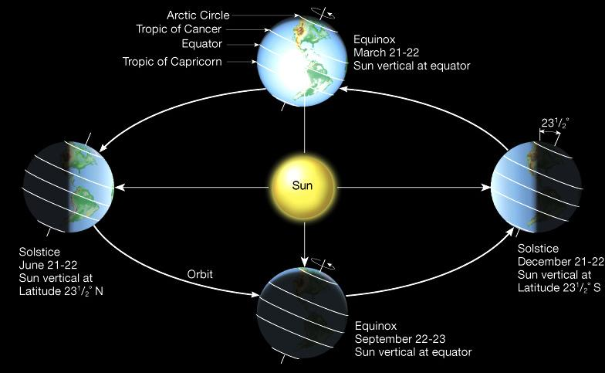
Seasonal variation - northern hemisphere
June:
North Pole stays in full sunlight all day long throughout the entire summer
September:
Sun sinks below the horizon, North Pole is in twilight until early October, then it is in full darkness for the Winter.
December:
The darkest time of year. There has been no sunlight or even twilight since early October. The darkness lasts until early March.
March:
Sun rises at the North Pole on approximately 21st March. Sun rises higher in the sky with each day; maximum height at on approximately 21st June

Slide 6
Ground conditions

Slide 8
What is permafrost?
Permafrost: Permanently frozen ground where soil temperatures have remained below 0 °C for at least 2 years
Continuous Permafrost: Summers so cold that there is only a very superficial surface melting of the ground. It has been estimated to reach up to a depth of 1500 metres. Mean annual air temperatures of below -5 °C all year, and as low as -50 °C.
Discontinuous Permafrost: Found is slightly warmer areas so there are islands of permanently frozen ground separated by small pockets of unfrozen less cold areas. Slightly warmer zones due to proximity of surface water (rivers, lakes, and the sea). Mean annual temps of between -1 °C and -5 °C

Slide 9
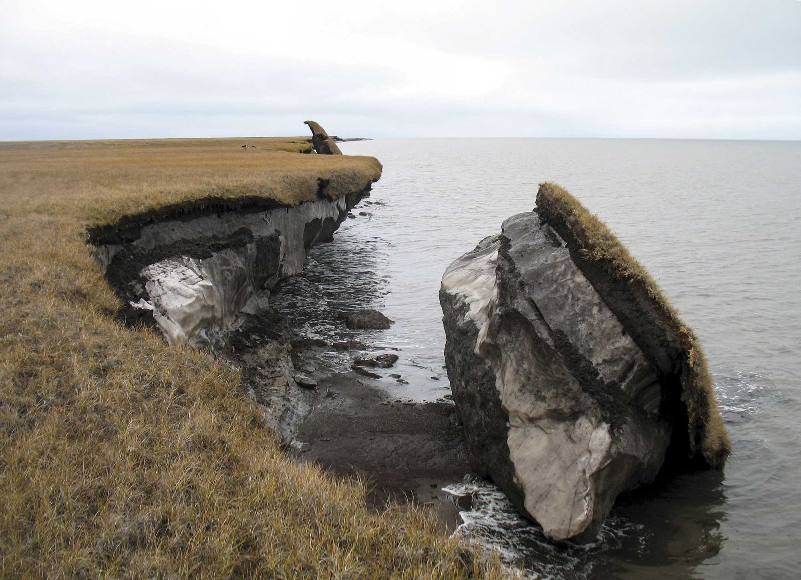
A nice, convenient picture:
Coastal, Tundra grasslands
Active layer
Permafrost
Source: Alaska.ugs.gov

Slide 10
What is permafrost?
Sporadic Permafrost: Found when mean annual temperature is just below 0ºC and the summer temperatures reach several degrees above but isolated pockets of permanently frozen ground remain below the surface.
Active Layer: summer temperatures sufficient to melt the surface layer of permafrost. This layer can be very mobile. It varies in thickness depending on latitude and vegetation cover.
Talik: Any unfrozen material within the permafrost zone.

Slide 11
A transect showing the changes in the permafrost layer in northern canada
Source: Rob Gamesby - coolgeography.com

Slide 12
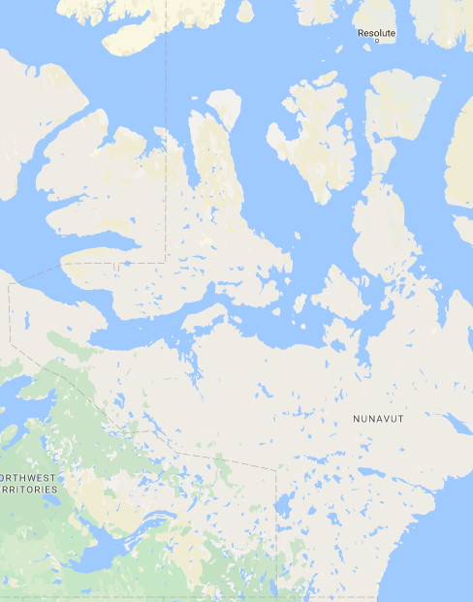
A transect showing the changes in the permafrost layer in northern canada
Source: Google Maps

Slide 13
Tasks: Soil Profiles
Create a new entry in your sketchbook
List the keywords in this presentation so far
Create annotated diagrams of:
a glacial area, with continuous permafrost
a periglacial area, with discontinuous permafrost
a periglacial area with sporadic permafrost
4. Label the appropriate temperature, depth, and vocab words

