Slide 1
Internal Assessment Overview:
In geography, we traditionally plan, perform, and collect fieldwork together HOWEVER EVERYONE WILL WRITE THEIR OWN REPORT!
Worth 20% of your total grade (HL), marked by Ms. S. and then audited externally (selected few chosen and regraded by examiners).
Rough Draft Due June 13th, Final Copy due September 12th 2015 (one month after return to school). Final Copy due to Mrs. Purvis

Slide 2
IA Overview: Geography
2500 words maximum (get as close as possible)
Neat and well structured, with sub-headings (not included in word count)
Front page, contents page, numbered pages
Referenced in proper Chicago format (footnotes and bibliography)
Includes maps (hand drawn), pictures, tables and graphs in the main body of the essay (as well as your appendix materials)

Slide 3
Word Count Overview
Section A: introduction 300 words
Section B: methods of investigation 300 words
Section C/D: information collection and written analysis 1350 words
Section E: Conclusion 200 words
Section F: Evaluation 300 words

Slide 4
Not included in word count:
Title page
Acknowledgments
Contents page
Titles and subtitles
References
Footnotes—up to a maximum of 15 words each
Map legends and/or keys
Labels—of 10 words or less
Tables—of statistical or numerical data, or categories, classes or group names
Calculations
Appendices—containing only raw data and/or calculations

Slide 5
Introduction: (CRITERION A) 300 words
Devise an aim /key question which has a theoretical and locational context. I will provide you with the fieldwork question, although we may as a class decide to alter it..
Devise two or three TESTABLE hypothesis to prove or disprove your question. Remember that setting appropriate hypotheses to test is probably the most important factor in ensuring that you can go on to produce an effective piece of coursework.
- Secondary data can supplement the IA but cannot form the BASIS. (ie: you can answer one hypothesis with secondary data but no more) The majority must be primary data we have collected ourselves.

Slide 6
Intro: Criterion A (cont’d):
3. In your introduction you must justify your hypotheses; in other words – predict the results you expect to find in your hypothesese
4. The introduction should also explain the main theoretical ideas behind your project (ie: Butler’s model). You should comment briefly on the geographical context, explaining where the fieldwork is being carried out and the fieldwork is being carried out there. This can include relevant spatial, physical, human conditions and other background information.
5. You must state the area of the syllabus to which your study relates e.g Option F: Leisure and Tourism. Put this in when you are talking about the theoretical background

Slide 7
Your IA must include a spatial element, which means it must be obvious you are approaching this problem from a geographic perspective. NOT a historical (ie: tracing the history of tourism in Grand Bahama) or economic one (ie: focusing on revenues)
Keep this in mind when writing your IAs – particularly in the introduction, when you establish the basis for writing this IA

Slide 8
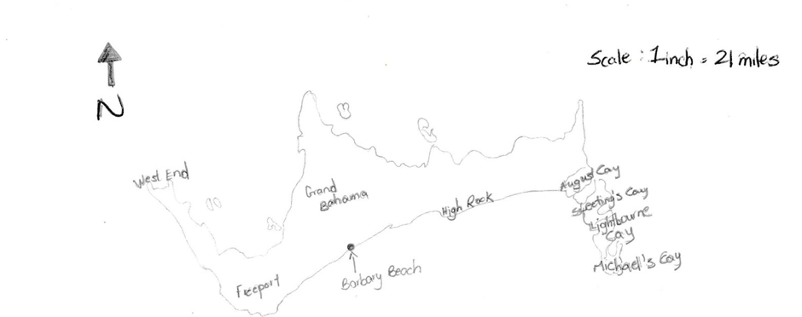
Maps:
A general location map/maps of GB in relation to USA/Caribbean (annotated) is essential, together with a smaller scale map showing specific survey sites are required.
The maps must be annotated / labelled to highlight their relevance (ie: location of GB to USA for tourism traffic)
Make sure all maps have a Title, Scale, North arrow and key. Gridlines can also be helpful.
A LAND USE MAP?? (ie: sketch of area)

Slide 9
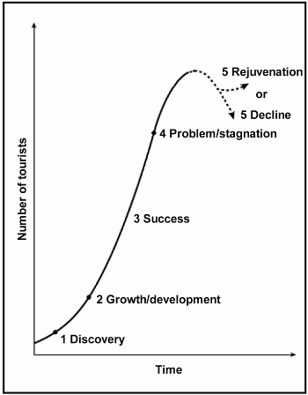
Our Topic; Grand Bahama and Butler’s Model
Review:
Debate on Tourism in Grand Bahama
Two Sides:
Decline or Rejuvenation
SHARE your docs with eachother….

Slide 10
Is Port Lucaya, Grand Bahama in the ‘decline’ or ‘rejuvenation’ stage of Butler’s Model?

Slide 11
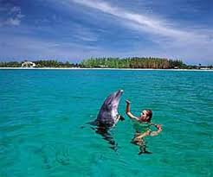
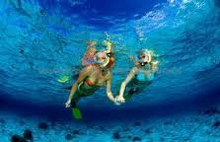
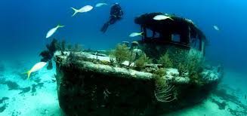
The Premise:
The historical stagnation and fall in traditional tourism to Grand Bahama has led the island to try and develop more sustainable strategies for tourism (ie: bonefishing, birding, kayaking, environmentalism, diving, etc) as well as catering to the cruise ship tourists
Often this can lead to a rejuvenation of areasas per Butler’s Model as a new type of tourism and a new type of tourist flock to area
Has this diversification moved Grand Bahama toward a stage of rejuvenation after so many years of decline?

Slide 12
What information would we want to know to be able to answer this question? Brainstorm What type of information would we expect to find if GB were experiencing a resurgence in tourism? Brainstorm (either primary or secondary data)

Slide 13
Possible Hypotheses:

Slide 14
Investigations:
Your Tasks:
- Look at your three hypothesis: how will you prove or disprove each one? Discuss in class Thursday. These are your methods.
- Look at your methods; how will you interpret the results after you gather the data? Do you know of any statistical calculations?

