Slide 1
In YOUR introduction, decide whether Grand Bahama (and PL) is in decline phase or rejuvenation phase, and state why you think this may be the case. Then you can construct your hypotheses accordingly.

Slide 2
Potential Hypothesis
Over time, there will be an increasing/decreasing amount of tourists to Freeport, Grand Bahama
Over time, there will be an increasing/decreasing amount of cruise ship tourists
Over time, there will be an increasing/decreasing amount of businesses being open in Port Lucaya
The majority of tourists will/will not be on ‘package plans’
The majority of tourists surveyed will/will not have taken or plan to undertake sustainable activities
The majority of tourists surveyed will/will not have positive experiences

Slide 3
Methods Section (Criterion B)
This is where you describe how and why we carried out the methods we did to prove/disprove our hypotheses.
(300 words)

Slide 4
What type of DATA can we realistically collect?
Primary:
Land Use Survey / Sketch of Port Lucaya Businesses
Questionnaire/Survey
(BOTH businesses and tourists!)
Secondary
Statistics from GB Tourism website
(tourist arrivals and cruise ship arrivals)

Slide 5
Designing a questionnaire

Slide 6
A questionnaire will collect different types of data
Background information such as age or sex
Behavioral information such as where they are staying and why
Attitudinal information such as what people think about a particular issue

Slide 7
How should I Construct a questionnaire?
You should know how each question relates to the aims of your investigation
How many questions do you want? – not too many or it will put people off
How long should it be? – no more than 1 side of paper
What type of people do you want to fill it in? – young people, tourists, residents, good selection of people in the community?
Easy to read layout

Slide 8
Types of question
Open questions
Allow space to write a longer answer
Difficult to analyse and get data from
Closed questions – easier to analyse and get data from
Yes or no answers
Multiple choice options
Asked to rate something on a scale

Slide 9
Closed questions
1.Would you recommend Grand Bahama to a friend?
Yes No
2. Do you think that Port Lucaya is an attractive place to spend time?
a) I really like Port Lucaya b) port Lucaya is OK but I have been to better places c)I don’t like Port lucaya
Using the scale, 1 – strongly agree to 5 strongly disagree, rate your opinion on tourism on Grand Bahama
I think the quality of shops for touists is good
1 2 3 4 5
I think the quality of restaurants is good
1 2 3 4 5

Slide 10
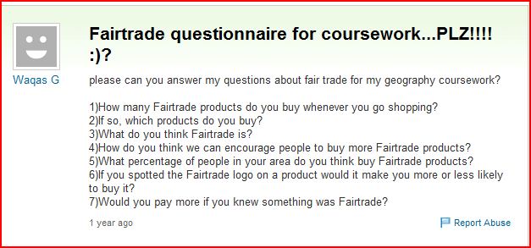

Slide 11
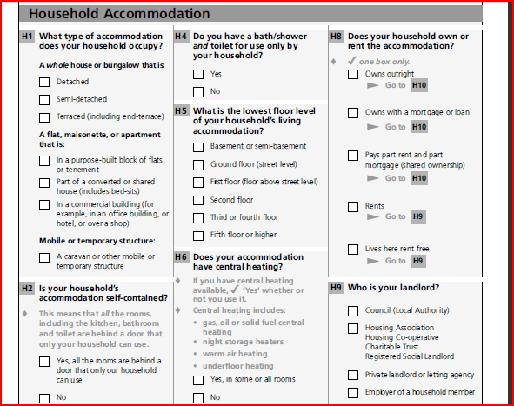

Slide 12
Things to think about?
Avoiding bias - Who do you want to answer the questionnaire
Type of sampling – how can you make it fully representative of tourists? Random- systematic
How will the weather, day or time of day affect your survey
How many surveys do you need?
Avoid personal questions – people won’t answer them
Where will you conduct the surveys?

Slide 13
Method section
Describe areas you have chosen to survey – why did you pick them ( a map may be useful)
Justify the time of day and day of week
(this can be as simple as ‘it was the day we had scheduled’ – as long as your understand bias)
For each hypothesis describe your method so someone else could follow it.
Justify your method – why is it good? Explain your sample technique. If you have used a questionnaire, annotate a copy of it to show why it is good.

Slide 14
Methods Section
This is a good place to put any annotated pictures, any sketches (annotated) and the sample questionnaire or survey

Slide 15
What questions will we need?
Questions about:
Perceptual carrying capacity
Package plans
Sustainable activities
Where/how many nights they are staying

