Slide 1
What aid for what situation?
To help after hurricane Sandy
To prevent the deaths of children after they are born
After an earthquake
To improve the quality of life in a rural area
To make sure people get clean drinking water
To help develop a poor country such as Congo

Slide 2

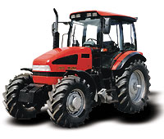
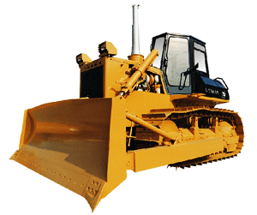



Long or short term?
Decide whether these are long or short term aid

Slide 3

Short
Long

Slide 4
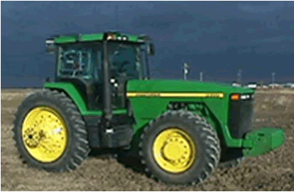
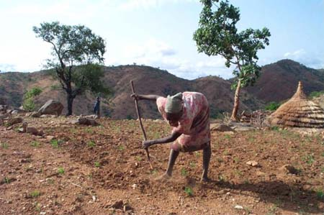
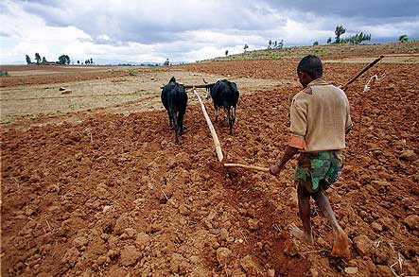
Is aid appropriate?
How can we help a village in Africa?
Which one would you choose and why?

Slide 5
Aim: To understand appropriate aid – how can we help a village in Africa

Slide 6
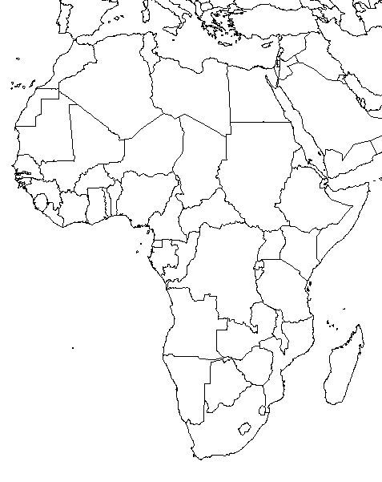
Where is Ghana?
Ghana

Slide 7
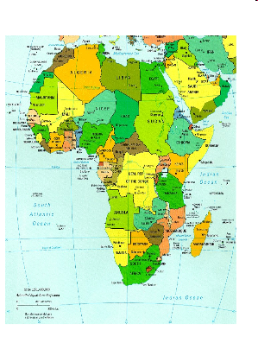
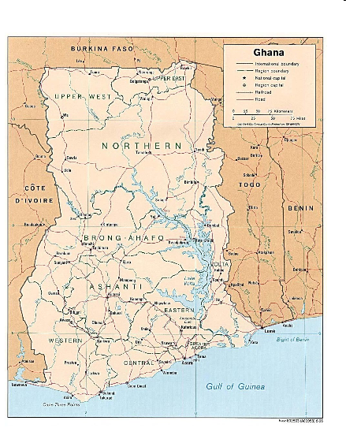

Slide 8
What is bimma village, in Ashanti region of Ghana like?
1. Describe life in Ashanti.
        Natural factors
        Economic factors
        Social factors
        Cultural factors

Slide 9

What problems does Ashanti have?
1. Identify all the problems that you think the people of Ashanti face in their daily lives. INCLUDE those problems identified by villagers themselves.
Choose what your pair thinks are the 5 most important problems and rank them.
1 – most important problem
5 – least important problem

