Slide 2
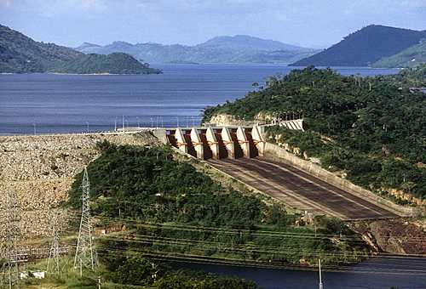
Aim: To evaluate an example of aid
Who gained from the Akosombo dam?

Slide 3
Tied or conditional aid definition
LIC’s often receive aid in different forms from other countries but it often comes with conditions attached that benefit the donor country and its business.

Slide 4
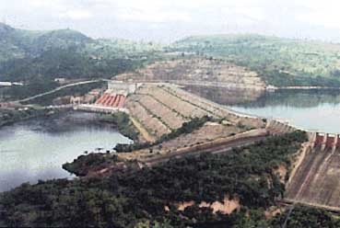
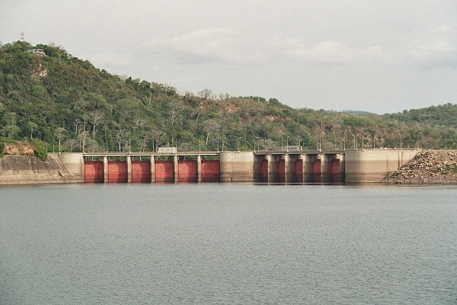
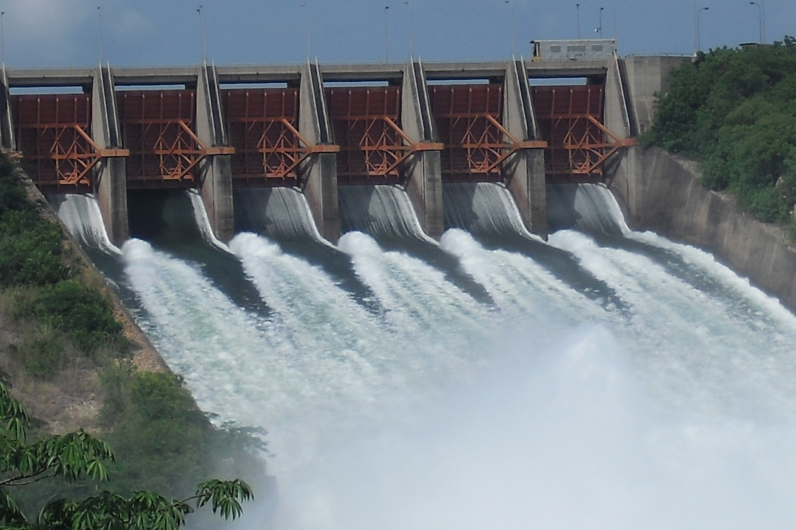
Do you think the Akosombo dam is an example of effective development aid? http://www.youtube.com/watch?v=KXbQxxgp_pI

Slide 5
Use pg 24 and 25
Task 1 – Use the information on pg 24 to explain why Ghana wanted to borrow money for the dam
Task 2 – Draw a table in your book and fill it in using pg. 25
Good points about the dam for Ghana | Bad points about the dam for Ghana
Task 3 - Do you think the Akosombo dam is an example of effective development aid? Explain your answer

Slide 6
The Akosombo Dam Deal or No Deal
1
5
You are President John Agyekum Kufuor of Ghana. The USA have offered a deal to pay for a dam to be built in your country.
8 boxes will be opened during the course of the game. As each box is opened, you need to decide whether to say deal or no deal!
2
6
3
7
4
8

Slide 7
Ready?...
1
5
2
6
3
7
4
8

Slide 8
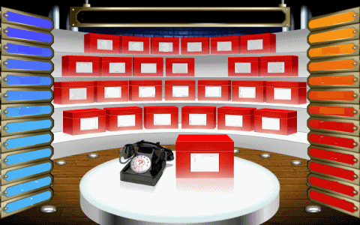
Box 1: The World Bank, USA, UK will pay for your new dam.

Slide 9
The USA and UK will pay for your new dam.
1
5
2
6
3
7
4
8

Slide 10
Box 2: You will get a reliable supply of cheap electricity and clean water for drinking and growing crops.

Slide 11
The USA and UK will pay for your new dam.
1
5
Reliable supply of cheap electricity and clean water.
2
6
3
7
4
8

Slide 12
Box 3: Thousands of people will be displaced.

Slide 13
The USA and UK will pay for your new dam.
1
5
Reliable supply of cheap electricity and clean water.
2
6
Thousands of people will be displaced.
3
7
4
8

Slide 14
Box 4: Valco make aluminium using Bauxite. They will set up a factory at the side of your dam. Your country sells Bauxite!

Slide 15
The USA and UK will pay for your new dam.
1
5
Reliable supply of cheap electricity and clean water.
2
6
Thousands of people will be displaced.
3
7
Valco will make Aluminium beside your dam.
4
8

Slide 16
Box 5: You will be able to fish in the new lake that is made.

Slide 17
The USA and uk will pay for your new dam.
You will get a new lake to fish in.
1
5
Reliable supply of cheap electricity and clean water.
2
6
Thousands of people will be displaced.
3
7
Valco will make Aluminium beside your dam.
4
8

Slide 18
Box 6: Valco will buy their Bauxite from Jamaica because it’s cheaper than yours!

Slide 19
The USA and UK will pay for your new dam.
You will get a new lake to fish in.
1
5
Reliable supply of cheap electricity and clean water.
Valco will buy their Bauxite from Jamaica not from you.
2
6
Thousands of people will be displaced.
3
7
Valco will make Aluminium beside your dam.
4
8

Slide 20
Box 7: Valco will use so much electricity that there will be none left for your people.

Slide 21
The USA and UK will pay for your new dam.
You will get a new lake to fish in.
1
5
Reliable supply of cheap electricity and clean water.
Valco will buy their Bauxite from Jamaica not from you.
2
6
Valco will use all of the electricity so there is none left for your people.
Thousands of people will be displaced.
3
7
Valco will make Aluminium beside your dam.
4
8

Slide 22
Box 8: The water levels are so low that there is not enough in the lake to irrigate the fields or provide clean drinking water.

Slide 23
The USA and UK will pay for your new dam.
You will get a new lake to fish in.
1
5
Reliable supply of cheap electricity and clean water.
Valco will buy their Bauxite from Jamaica not from you.
2
6
Valco will use all of the electricity so there is none left for your people.
Thousands of people will be displaced.
3
7
Valco will make Aluminium beside your dam.
Water levels in the lake are low so there is not enough water.
4
8

Slide 24
Do you think the Akosombo dam benefited the people of Ghana or HIC’s? Should Ghana have done the deal?
EXTENSION: If it was such a bad deal, why did Ghana agree to it?

Slide 25
Do you think the Akosombo dam benefited the people of Ghana or HIC’s?
Negative Points:
Valco bought bauxite from Jamaica, rather than Ghana (loss of $)
Ghana went into more debt to build dam
Lower lake levels meant dam unable to provide as much power
Soil beside lake lost fertility due to floodings
Swampy marshland created by the dam meant more water-borne illnesses such as malaria and bilharzia
80 000 people were displaced

