Slide 1
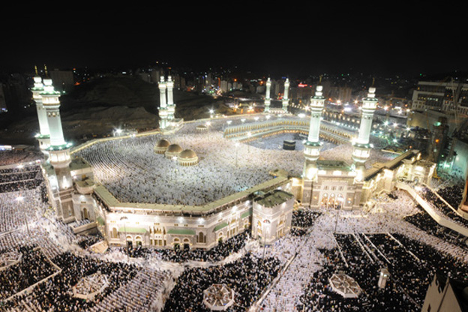
Urban Tourism Management: Mecca, Islam’s Holiest City
Population: 1.3million (roughly)
Location: desert valley Western Saudi Arabia
Tourist Draw: birthplace of Muhammmad and site of the revelation of the Quran
Tourists: Muslims only
Grand Mosque

Slide 2
The Hajj
Annual pilgrimage to Mecca (Makkah) in Saudi Arabia (September – Dhu al-Hijjah)
Largest religious ceremony in the world
5 days – one of five tenants of the religion of Islam if able and can afford
Nearly 1, 400 year old practice has outlasted the Abbasids, Ottomans, and British Empires (whose first religion was Islam)
(supervision of the Hajj was legitimizing force for these empires)
States have always been concerned with their citizens safety here:
Pilgrimage has grown from 300 000 late 19th century to 4 million in 2013…

Slide 3
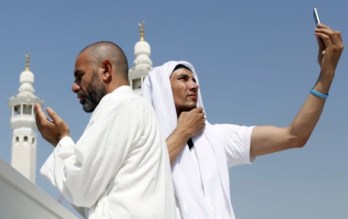
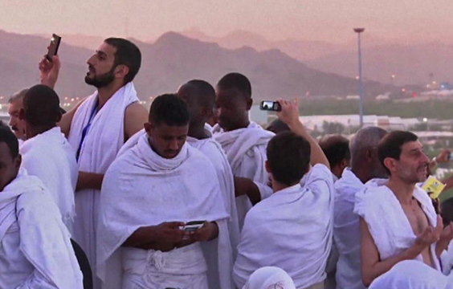
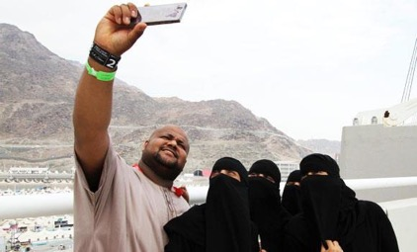

Slide 4
How have demand, supply, and technology drive this growth?

Slide 5
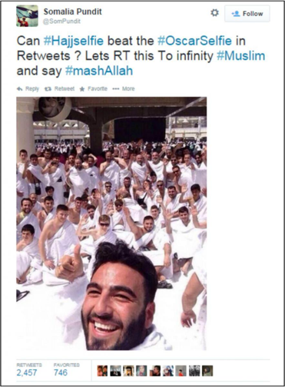
“The largest mass gathering in the world.”
The spread of low-cost aviation in the 21st century means that fulfilling the Hajj to Mecca is now feasible for hundreds of millions of people.
Demand is resilient: Islam is not going anywhere, pilgrimage a religious duty #hajjselfie
People willing to endure hardship to be there and Islamic faith = peaceful gatherings – from 2-4million people
Supply is strong: Many of Mecca’s inhabitants earn their livelihood from activities associated with the Hajj, the main driver of the city’s economy

Slide 6
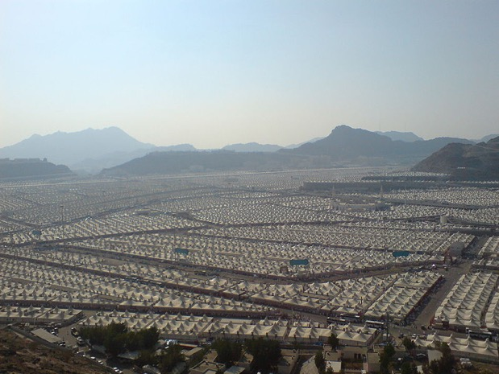
Mina: Tent City
Over 100 000 air conditioned tents set up and taken down every year
Also location of the Jamarat Bridge
5000 people have died in stampedes in Mina and Mecca in past 3 decades
“Performing Hajj is physically demanding and requires patience and thought to safeguard your and others’ safety,” British Hajj Board “Be extra careful particularly at the stoning of the Satans at Mina”

Slide 7
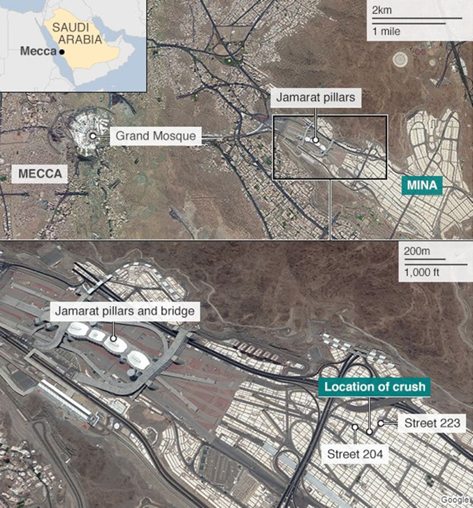

Slide 8
Has Mecca reached its ‘carrying capacity’?
If so, is this physical, perceptual or environmental? Why?
Now estimated over 2 000 people died in a 2015 stampede, while over 1400 in 1996, 700+ between 1995 and 2005 and 346 in 2006
Exacerbated existing geopolitical tensions in the region between Iraq and Saudi Arabia; including interpretations of Islam, fight for oil supremacy in region, leadership in Islamic world

Slide 9
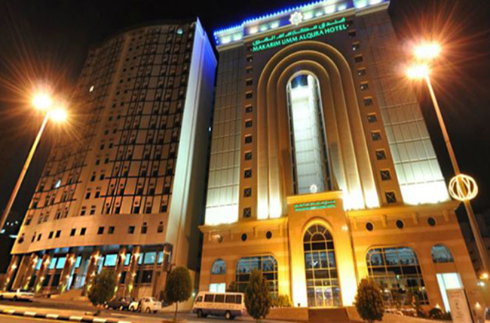
Mecca Transformation
“religious travel” has transformed Mecca past few decades…
The Jabal Omar development, adjacent to the Ka’aba (Islam’s holiest site and final destination of pilgrims) is the largest-ever development in Saudi Arabia
$3.2-billion project to be finished in 2017
40 hotel towers
Accommodations for 160,000
international partners such as Hyatt Hotels Corporation, Marriott International, Starwood Hotels & Resorts Worldwide, Best Western International

Slide 10
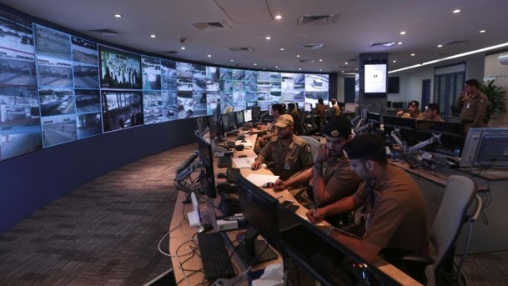
How to manage? Recent measures…
Millions of dollars spent on 5,000 CCTV cameras installed throughout Mecca and Mina…
In 2004 authorities replaced pillars with a wall because people were accidentally hitting each other with rocks…

Slide 11
Recent Measures: Are they enough?
Focus on building infrastructure to match swell of visitors
Stricter regulations on how accommodations can be built
Extension of Umrah, Islam’s second most important pilgrimage, from 2mos – whole year, so visitors can come outside of Hajj
Quotas of pilgrims from each country (1/1000 in one country)
Strict schedule for groups moving in between sites
100,000 security personnel, including members of the counter-terrorism and the emergency civil defence units

Slide 12
Complete Following Using Resources from Website
Find a “Hajj Map” to put in your notes that includes the Plain of Arafat, The Grand Mosque (Al-Haram), Muzdalifa Mina and the Jamrat
2) Name and describe x5 primary and secondary resources in Mecca and Mina
(Use ‘Hajj Tracker’ from the website)
3) Describe the journey taken by the two Muslim men in the ‘New York Times Hajj Stampede Interactive;’ highlighting the areas which show carrying capacity has been reached/poor mismanagement of urban tourism

