Slide 1
Carrying Capacity in Rural Areas
Carrying capacity is….
The maximum number of visitors/participants that a site/event can satisfy at one time

Slide 2
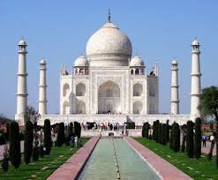
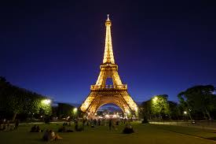
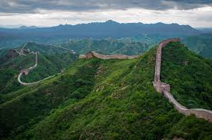
Types of carrying capacity:
Physical carrying capacity
Environmental carrying capacity
Perceptual carrying capacity
a honeypot site – biggest attraction in an area - attracts tourists like bees to honey

Slide 3
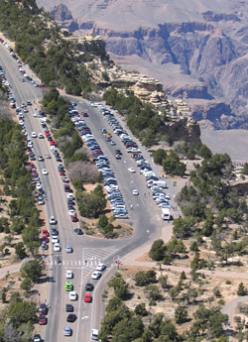
Traffic congestion and overcrowding
If the car park is full then physical carrying capacity has been reached – no more visitors can be accommodated
Notes:
3

Slide 4
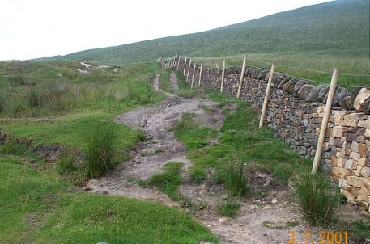
Footpath erosion – The environmental carrying capacity been exceeded (the maximum number ppl before the local environment becomes damaged) where vegetation can no longer grow due to excessive hiking on most popular trails
Notes:
4

Slide 5
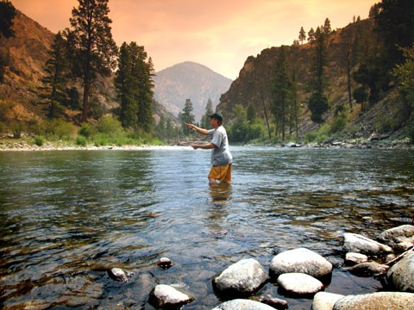
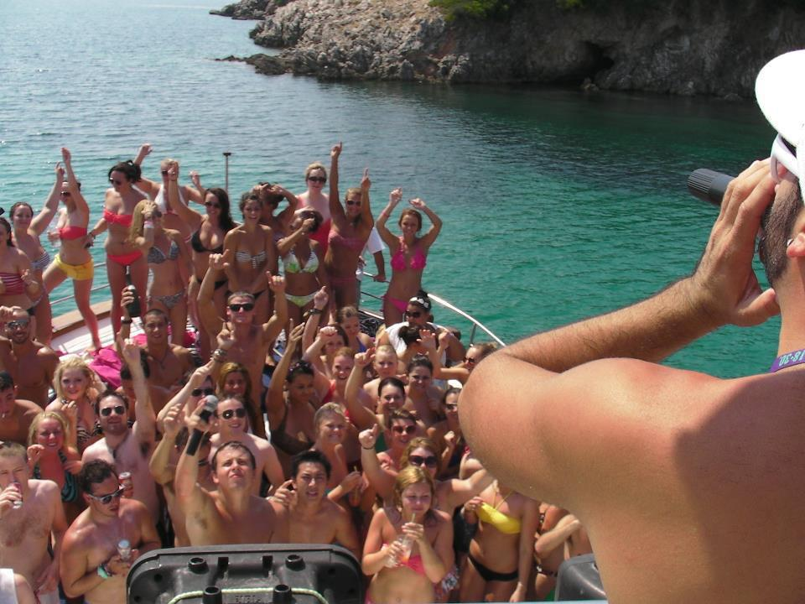
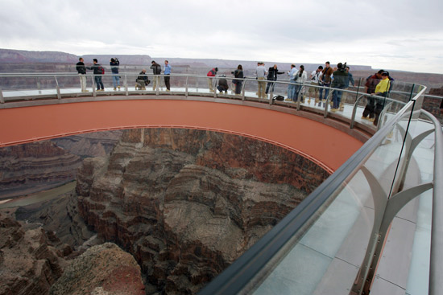
Perceptual carrying capacity………
The maximum number before a specific group of visitors considers the level of impact, such as noise, to be excessive
Notes:
5

Slide 6
Problems if a destination exceeds its carrying capacity include:
Tensions between locals and tourists
Deforestation
Congestion
Water pollution from increased waste
Water shortages from increased demand
Air pollution from increased cars and flights
Footpath erosion
Damage to archaeological sites
Power black-outs
Visual and noise pollution
Disturbance of wildlife
Reduction in visitor numbers

Slide 7
What about Everest?
Physical
Environmental
Perceptual
Has the rural honeypot site Mt. Everest reached its carrying capacity?

Slide 8
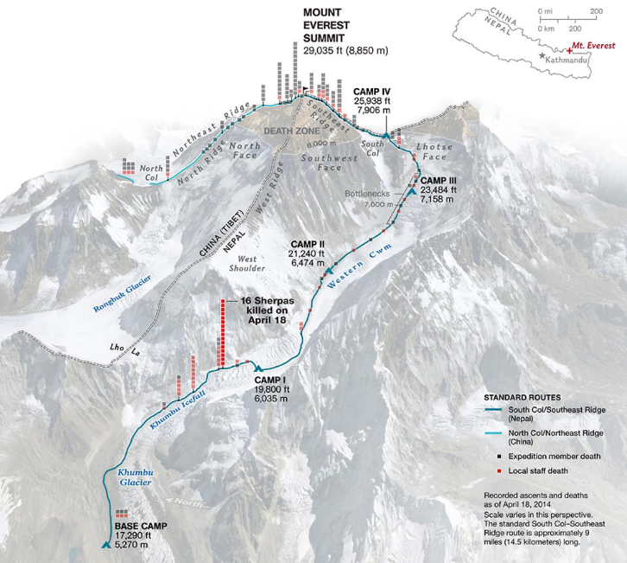

Slide 9
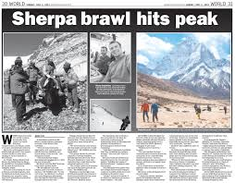
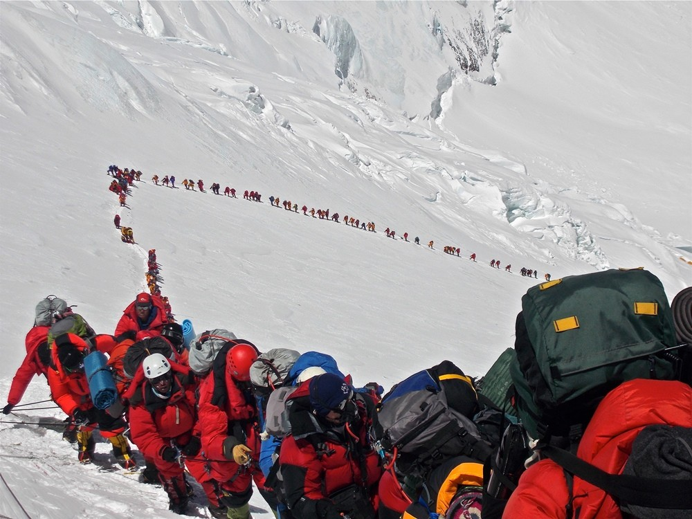
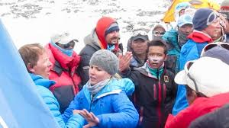
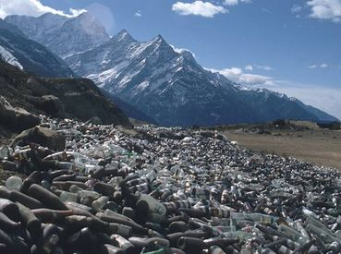
Alpine Tourism: how to..?
Maximize capacity?
- Avoid environmental damage
Minimize conflict?
- Between residents vs visitors

Slide 10
Watch: Sherpa Brawl on Everest (videos linked below)
- Ensure you look at both videos before copying notes below.
Vid#1 - https://www.youtube.com/watch?v=rE71pZbkCDI
Vid#2 - https://www.youtube.com/watch?v=pAaVK8eJsfo

Slide 11
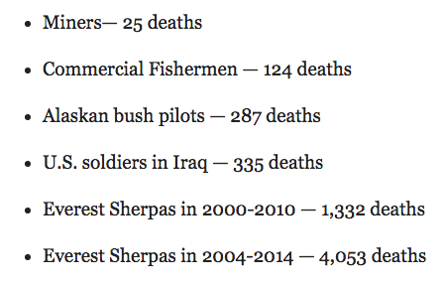
Social Impact
April 27, 2013 Everest brawl between Swiss climbers and sherpas when foreign climbers try to climb Lhotse face when sherpas working on the ropes
April 18, 2014 avalanche in Khumbu Icefall kills 16 sherpas, causing others to go on strike as many work without insurance

Slide 12
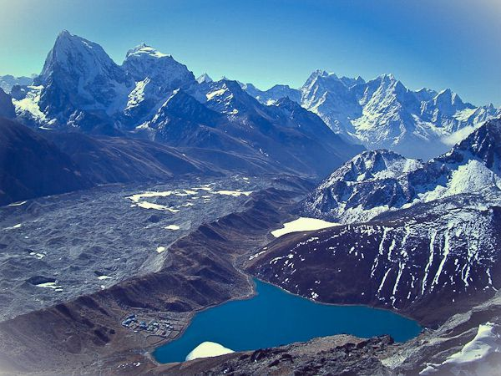
Environmental Impact
Sagarmatha National Park
Aka: Mt. Everest
Catering to the needs of the crowds translates into an increase in rubbish, further deforestation due to lodges’ construction and heating, and erosion of mountain paths
Water scarcity is present in Nepal, the result of receding glaciers due to global warming, as well as water pollution induced by contamination of freshwater with human and animal waste, have led many environmentalists to raise the alarm.

Slide 13
Rural Tourism Management:
What changes would you make to establish sustainable management strategies?

Slide 14
The best tourist strategies will maximize visitor numbers but not at them expense of local people or the environment. ie. They are sustainable
‘Meeting the needs of the present without compromising the ability of future generations to meet their own needs using the same resources.’

Slide 15
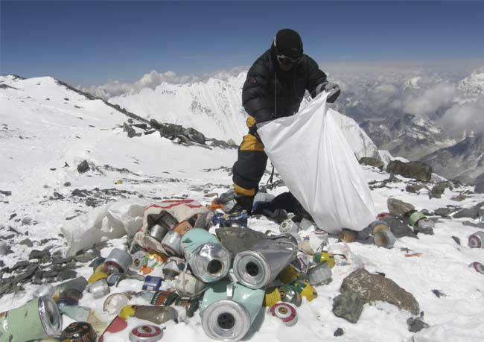
So….after 2013 “Everest Brawl”
1. Climbers on Everest now must bring back 8kg (17.6lbs) of garbage under new rules instituted by Nepalese officials! (2014)
2. New office set up to collect trash (or lose $4000 deposit), resolve conflicts (local soldiers and police), and provide medical aid
“Alpine Tourism” – Enforcement is an Issue!

Slide 16
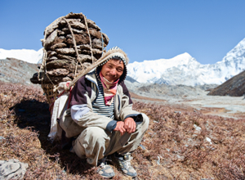
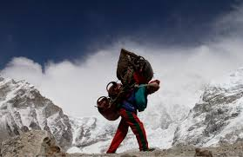
3. Slowly acquiring labour rights to Nepali and Sherpas
Although death rate has fallen for western climbers, for Sherpas is 12x higher than death rate of US soldiers in Iraq
After devastating avalanche in 2014 killed 16 Sherpas, rest of native climbers went on strike for remainder of climbing season
Sherpas demanded higher compensation for families of perished climbers ($1000), or disabled climbers ($10 000), establish monument to deceased Sherpas, raise insurance rates

Slide 17
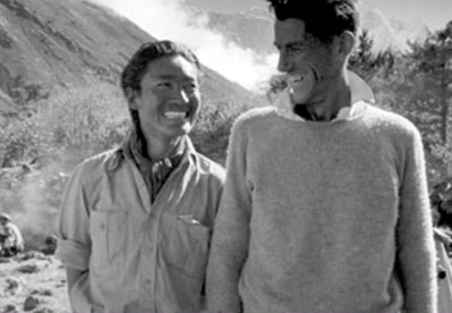
Other Suggested Sustainable Strategies
Many suggest transfer of ownership of foreign-owned climbing companies to local ownership
Limits and caps on number of companies operating and number of climbers in each company.

