Slide 1
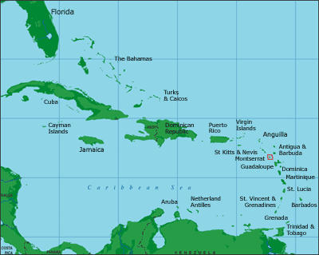
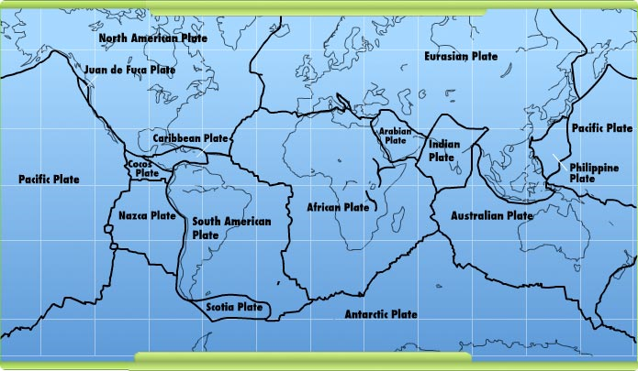
Where is Montserrat?
Aim: To know how an eruption can be managed

Slide 2
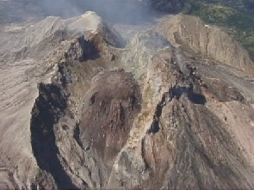
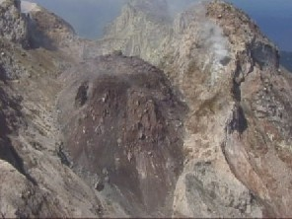
Helicopter report 29/6/97
The dome on the eastern side of Chances Peak is growing larger.
All images used by permission of MVO

Slide 3
Lava, ash and rocks pour down the Tar River valley, producing huge clouds of steam.

Slide 4
Most vegetation in the south side of the island is dead, buried beneath hot ash.

Slide 5
An ash cloud blown westwards, has buried Plymouth beneath centimetres of ash

Slide 6
Pyroclastic flows along Paradise Ghaut have reached Harris’s village.

Slide 7
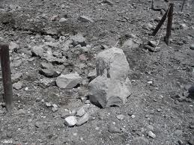
Ash and pebbles fell on Salem causing minor injuries.

Slide 8
There is a danger of mudflows along many of the valleys around the Soufriere Hills if it rains.

Slide 9
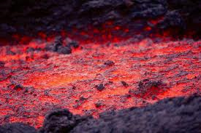
A lava flow passed within metres of the school in Cork Hill.

Slide 10
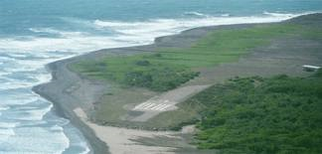
The airport has been closed until further notice.

Slide 11
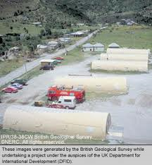
A temporary port has been opened at Little Bay near Davy Hill, for people to leave the island.
Message from Governor: Please complete your decisions and work out your total score.
Stand by for further instructions…

Slide 12
Hazard Map
The governor has requested that the team work together to prepare a map that divides the island into three zones:
Red zone: Too dangerous for anyone to enter. Immediate evacuation.
Amber zone: Elderly people and children must be evacuated. Other residents must be ready to leave at short notice.
Green zone: This area is considered to be safe. People evacuated from other zones will move here.

Slide 13
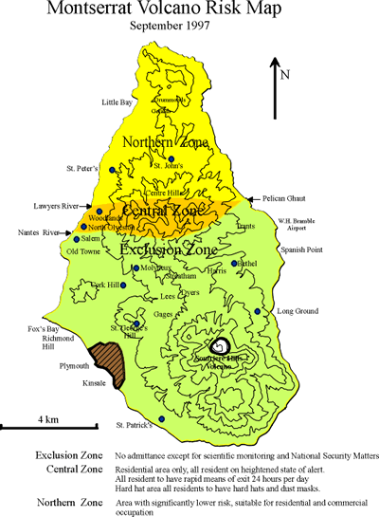

Slide 14
Questions:
1 Out of all the hazards which one do you think was the most dangerous and why?
2. Describe at least 5 ways that people were warned about or protected from the eruption
3. Only 19 people died – can you explain why these actions saved lives

