Slide 1
Sustainable Tourism and Eco Tourism

Slide 2
What is the difference between ecotourism and sustainable tourism?
Ecotourism:
responsible travel to fragile, pristine, and usually protected areas that strive to be low impact and (often) small scale
Sustainable tourism:
attempting to make a low impact on the environment and local culture, while helping to generate future employment for local people.
Ecotourism is a type of tourism that is included under the umbrella of sustainable tourism; difference is that all ecotourism is sustainable but not all sustainable tourism is ecotourism… get it?

Slide 3
Ecotourism, sustainable tourism or both………..
Both attempt to minimise the impact on the environment
Both attempt to minimise the impact on local populations.
Both aim to create a unique and enjoyable experience for tourists and educate tourists about responsible travel
Both hope to be sustainable over the long-term.
Ecotourism is usually on a smaller scale, whereas sustainable tourism can be on a much larger scale
Sustainable tourism also focuses on the economic needs of areas
Ecotourism is usually to remote areas of natural beauty, where sustainable tourism can be to any location e.g. cities or beaches
Ecotourism usually involves physical activity.

Slide 5
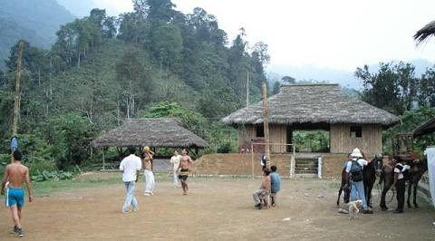
Which one is more sustainable?

Slide 6
Which is more sustainable?

Slide 7
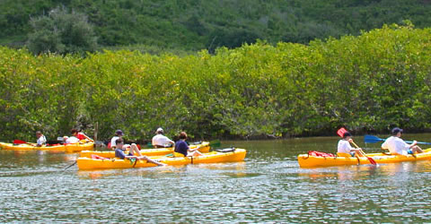
Which is more sustainable?

Slide 8
Complete
Under ‘Leisure, Sport & Tourism’ section of website, scroll to number 9:
Tourism in Rural Areas : Sustainable Tourism vs. Ecotourism / Carrying Capacity
9b. Use the Sustainable Tourism Student Worksheet - Zimbabwe to explore a sustainable tourism development strategy CAMPFIRE in a rural area of Zimbabwe.

