Slide 1
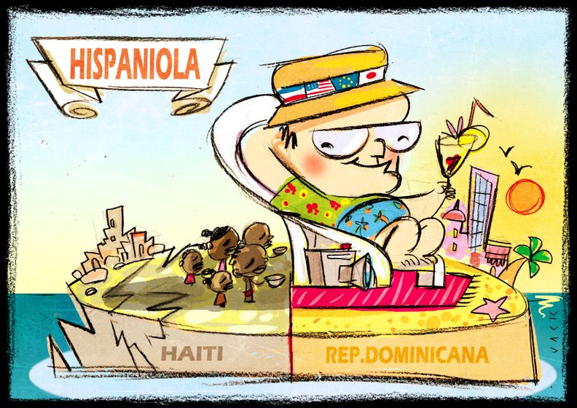
Tourism as a development strategy in LEDC’s

Slide 2
Why would you use tourism to ‘develop’?
Lack manufacturing base or raw materials
Small land area with natural attractions (S.I.Ds)
Effective way to build infrastructure
Brings wealth (foreign currency) to country
Labour-intensive industry, which helps with issues of unemployment (directly/indirectly)
Technically an ‘export’ but not subject to price fluctuations on world market

Slide 3
Is tourism a good development strategy?
…Growing importance of the tourist industry in LEDC’s
Economic benefits of tourism
increases in GDP to improve development level
Jobs - the multiplier effect – “wealth creates wealth”
Social Benefits of tourism
cultural understanding
language learning
Improved infrastructure and better medical facilities
Environmental benefits of tourism
Some areas may be offered environmental protection to preserve them for tourists (MPAs on Bimini)

Slide 4
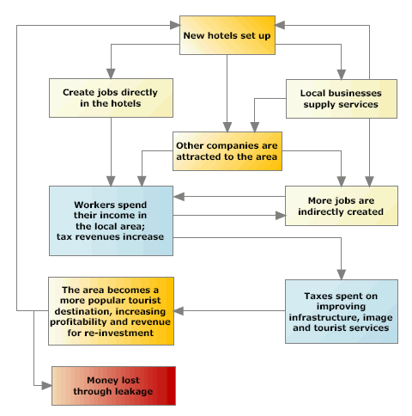
The multiplier effect
This is how the success of tourism in a community benefits many people, not just those directly employed.
Task
Describe the multiplier effect in your own words….

Slide 5
The Multiplier Effect
“The fiscal multiplier effect occurs when an initial injection into the economy causes a bigger final increase in national income.”
Investment breeds investment
Money supply is expanded as wealth is generated within the country, spending increases and taxes generate revenue for government.
Tourism is an industry ’job-creator’

Slide 6
Negatives of tourism as a development strategy
Economic
Jobs may be seasonal
Poorly paid and low skilled jobs
Leakage – foreign companies manage the business and ‘repatriate’ profits to their own country
Social
Traditional way of life lost
Culture clash eg. bikini clad women in Muslim areas
Environmental
Destruction of environment for building new facilities
Water shortages
Waste disposal

Slide 7
Questions from Video: (be specific)
Which sectors benefit from tourism?
How did tourism benefit Sub-Saharan Africa?
What is the economic impact of tourism?
What are ‘leakages’? Provide a definition and specific example (Thailand?).
List some additional positive impacts of tourism. Use examples from the video.
List some additional negative impacts of tourism. Use examples from the video.
What is the long-term impact of tourism? In your own words, is it essentially positive or negative?

Slide 8
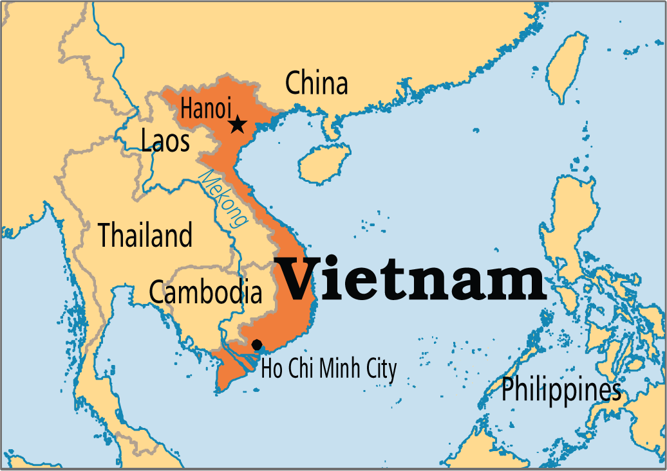
Our Case Study: Vietnam – Worksheet 7b online

Slide 9
Brief History…
People have been living there for over 25 000 years!!
HOWEVER
Vietnam only recently unified as a country in 1975 after decades-long struggle between outside forces (British, French, American) and the nationalists, then communists, the Viet Cong
Viet Cong were a communist guerilla group concentrated in northern Vietnam, led by Ho Chi Minh
First French then American forces fought the Viet Cong for control of Vietnam in first televised war (1955-75)

Slide 10
These were the images they saw…
In June of 1963, Vietnamese Mahayan Thic Quang Doc burned himself to death in protest of the treatment of monks by South Vietnamese government

Slide 11
Napalm: another aerial chemical weapon

Slide 12
South Vietnamese General Nguyen Ngoc Loan, chief of the national police, seconds before shooting Vietcong soldier Nguyen Van Lem, 1698

Slide 13
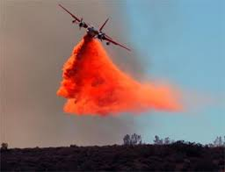
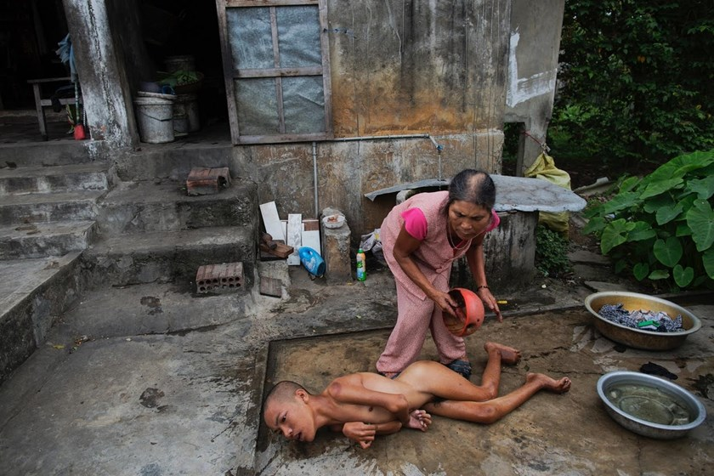
Agent Orange: an herbicide and defoliant used by the United States in an attempt to wage war against the guerilla jungle tactics used by the Viet Cong

Slide 14
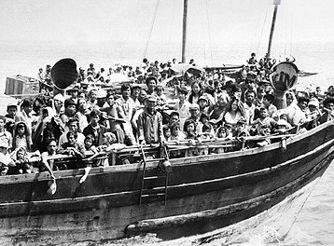
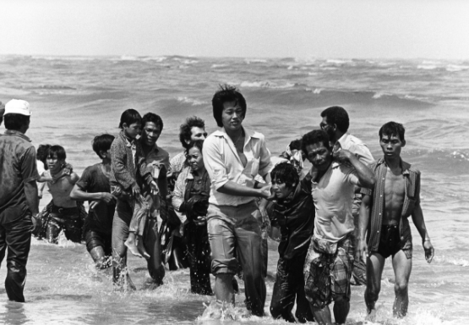
‘Vietnam’ emerged from the war unified but with lasting scars; a divided population (north/south), destroyed countryside, little economic earnings potential and refugees streaming out of the country
The next 20 years were spent in state control; with no politics, commercial goods and forced labour in control of a communist government

Slide 15
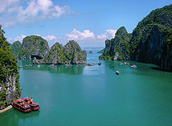
Beginning in the 1990s, Vietnam began to relax its policies towards capitalism and ‘opened up’ to the world….
The Vietnam National Administration of Tourism is following a long-term plan to diversify the tourism industry, which brings foreign exchange into the country…
Tourism has increased to 10 million tourists in 2016, up from 2 million in 2000...

Slide 16
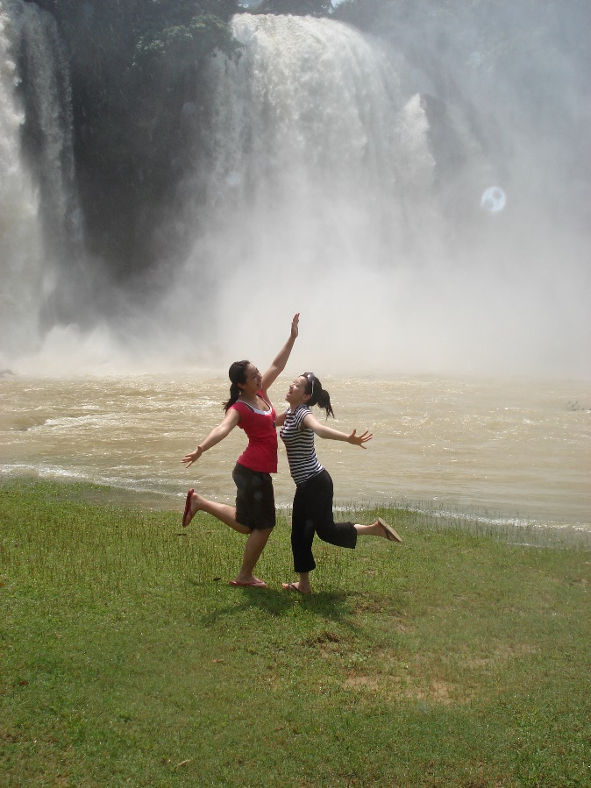
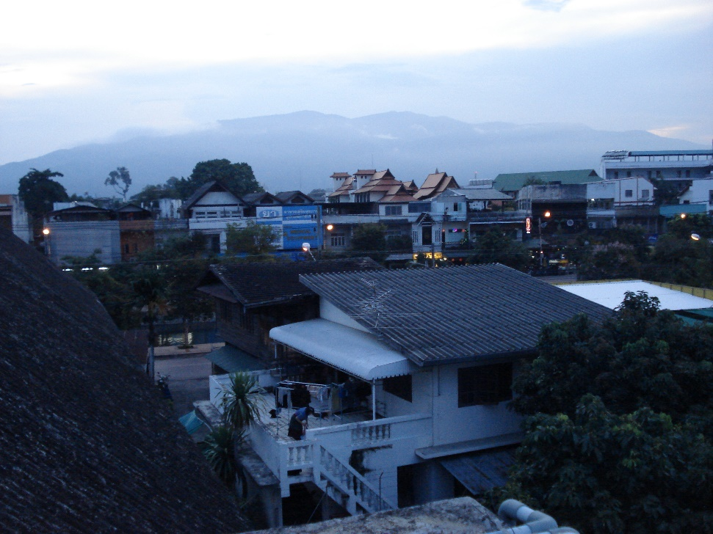
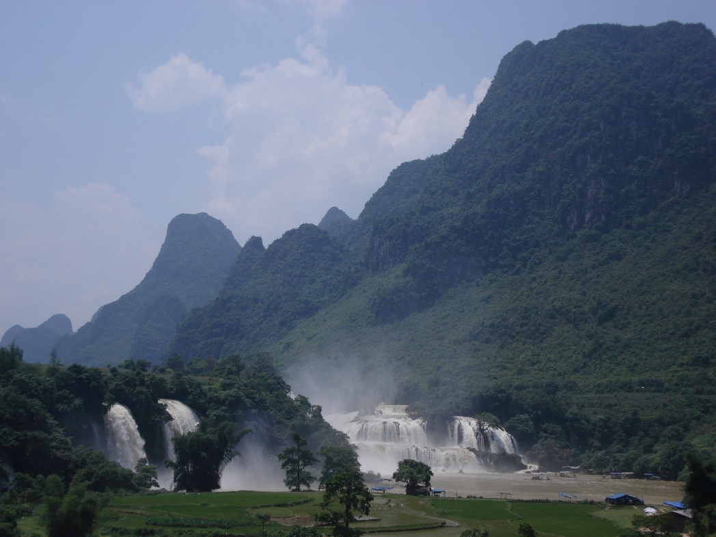
Vietnam: Tourism as Development

