Slide 1
Aim: To understand dependency ratio and youthful vs. ageing populations

Slide 2
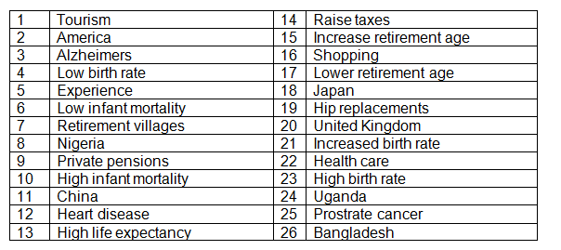
Odd one out
Each of the numbers in the sets of four below relates to a word to do with ageing populations. Can you work out which one is the odd one out and what connects the other three. Explain your choices.
Set A 1 16 22 7
Set B 4 17 13 23
Set C 5 19 3 12
Set D 14 21 17 9
Set E 18 24 2 11

Slide 3
How do you work out how many dependents in a population?
The dependency ratio tells you how many economically inactive people (0-15 and 65+) are dependent upon the economically active population (16 to 64).
Patterns;
In the _______________ world there is a high proportion of elderly
In the ________________world there is a high proportion of youth

Slide 4
Pros and cons points of a youthful population
Large potential workforce – attractive to new investors | High cost of supporting schools and clinics
Need to provide sufficient food, housing and water to growing population | High rates of unemployment
Development of services such as schools and clinics | Large potential market for goods
Source of innovation and ideas | Large numbers living in shanty type housing
High rates of population growth | High crime rate

Slide 5
Impact of youthful population
Task 1 - Notes from Video – examples of issues caused by too many young people

Slide 6
https://www.youtube.com/watch?v=59tvl6mJGrQ
http://www.youtube.com/watch?v=zqfFrCUrEbY

Slide 7
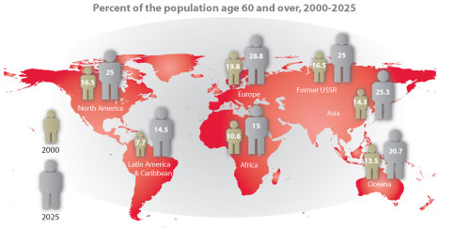
Patterns and trends…..
What is the global pattern?
What is the global trend?

Slide 8
Pros and cons of ageing population
Large pool of volunteer workers | Increase in pension costs
High economic savings from children that ‘might have been’ | Increase in costs of health care. The ‘health care scare’
Possibility of increased social harmony, law-abiding citizens | Fewer tax contributions by smaler economically active workers
Tend to have smaller carbon footprint (travel less) | Can increase competition for jobs if reitrement age is increased
Creation of more jobs as high levels of retirement | Potential for increased taxes on economically active population

Slide 9
Use pg. 12-14 (study notes)
Describe the difference between Europe and Africa in terms of aging population – use figures as examples.
Explain why some areas of the world have an aging population?
What does the term ‘grey pound/dollar’ mean?
Describe 3 other positives of an aging population
Using Japan as an example, what are the negatives of aging population?
How does attitude towards elderly people in Japan contribute to their care?

