Slide 1
The Demographic Transition Model download student worksheet 4b), take notes for this class there…

Slide 2
The DTM
A model based on 200 years of development history and data from ‘developed’ western countries
Looks at changes in birth rate, death rate and total population
Argues that all countries will follow a similar pattern
Created in 1929 by American demographer W. Thompson
Does not include migration as contributing factor to changing populations in its analysis

Slide 3
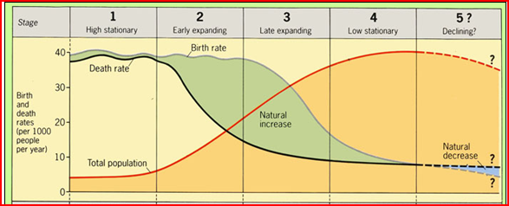
Demographic Transition Model
Model shows how population changes with development

Slide 4
Weaknesses of the DTM
Model is Eurocentric and assumes all countries will develop in similar ways – some countries have not become ‘industrialised’ but may skip this phase (ie: The Bahamas?) or not achieve industrialization at all (ie: Somalia?)
Timescale was 200 years for Europe but much less time for Newly Industrialised Countries such as Singapore, S. Korea, Thailand and Malaysia
Religion, culture or politics can influence birth rates so they do not fall as rapidly as the model suggests

Slide 5
Recently data suggests that at advanced levels of development (think Scandinavia) there is actually a reversal of the so-called ‘fertility decline’ – woooaaaaahhhHH!
SO Stage 5 may not happen as originally predicted…..
http://www.un.org/esa/population/meetings/EGM-Fertility2009/Kohler.pdf

Slide 6
Population Pyramids
Tells us about age and sex structure of a population
Help planners decide on extent of ‘services’ for future such as healthcare and education
Illustrate trends in migration or baby booms (ie: bulges in males of working age)
Illustrate trends in epidemics/wars (ie: deficits in slope show out-migration or death)

Slide 7
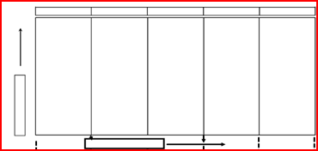
Shows how the population changes over time

Slide 8
Population structure: the composition of a population based on age, gender and other identifying factors
Population Momentum: tendency for a population to grow despite fall in birth rate; when high concentration of population are located in the reproductive years so even though births rate is falling, population growing
Population projections: predictions about future population based on trends in fertility, mortality, and migration

Slide 9
Dependency Ratio:
Measures the dependent population and the working population to find ratio!
Ppl <15 + Ppl >64 (dependents)
_________________________
Ppl aged 16-64 (economically active)

Slide 10
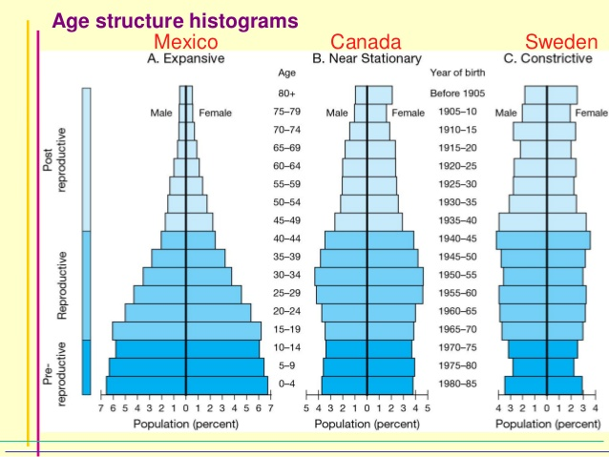
Differing Levels of Development

Slide 11
