Slide 1
Using Data to Analyze Trends: Spearman’s Rank
Factors Affecting Birth Rate?

Slide 2
Factors that may affect the birth rate:
Status of women
Level of education
Type of residence (rural or urban area)
Religion
Health of the mother
Economic prosperity
Infant Mortality and the need for children

Slide 3
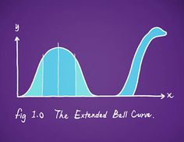
Does One Indicator Affect Birth Rate More Than the Other?
How would you find out??
STATISTICS!!!
YAAAAAAAAY!

Slide 4
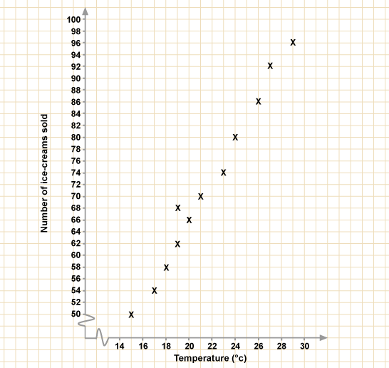
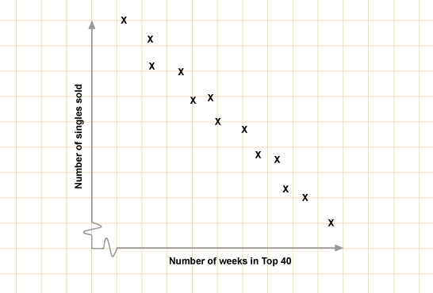
A scatter graph shows us the relationship between two sets of data.
Negative correlation
As one set of data increases, the other decreases
Positive correlation
As one set of data increases,
the other also increases

Slide 5
Download the Student Sheet to begin the journey…..
Top of the spreadsheet you will see variables for Birth Rate and Life Expectancy in 10 countries
FIRST we will graph them to hypothesize a correlation
(also to visually display, helps the reader to understand
THEN we will test, statistically, whether there is indeed a correlation, that can be extrapolated worldwide.

Slide 6
What is the relationship between birth rate and life expectancy?
To draw a scatter graph in excel:
1. Highlight the columns of data you are interested in – use Ctrl if the columns are not next to each other
2. Click on the graph buttons – choose XY scatter with no line or curve
3. Add axis labels, the first column is along the X axis
4. Draw the graph, add a trend line by clicking on the data points and right click with the mouse button.
How to use a scatter graph
Does the line of best fit show a negative or positive correlation
Is the correlation strong or not?
Try to explain the pattern

Slide 7
How strong is my correlation……….
Spearmans rank is a statistical measure to show the STRENGTH of a relationship between two variables (copy formula below into your notes)
The closer R is to +1 or -1 the stronger the likely correlation

Slide 8
Declare your hypothesis and the null hypothesis
“there is no significant relationship between birth rate and life expectancy”
2) What other factors may influence your data?
You should write these down next
3) RANK the data sets (set up for you in excel)
give the highest values 1 and the lowest a 10 (or whatever number you are working with)
4) Record the d (difference) between the ranked data
5) Square the d for each data point
6) Calculate the Rs (rho) using the equation

Slide 10
Remember: The closer to 1 the stronger the positive correlation, the closer to -1 the stronger the negative correlation
To be certain, let’s test the significance
Work out the ‘degrees of freedom’ (n-2)
(the number of pairs in your sample minus 2)
NOW plot your result on EITHER the 2c) table or the inset graph from website to determine how significant your result is…
(ie: considers your result in relation to how much data you had to test from – sample size)

Slide 11
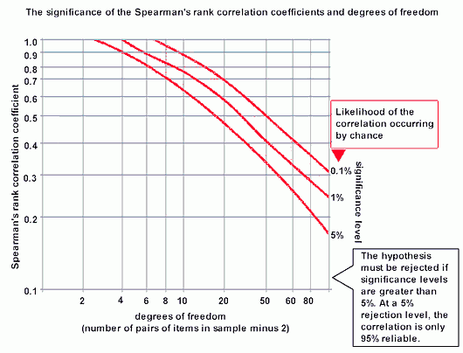
Spearmans rank
Gives you a value of significance

Slide 12
Task
Use a scattergraph and spearmans rank to work out the relationship between birth rate and one other set of data
Urban population
Life expectancy
Maternal mortality rate
Infant mortality rate
Physician density
School life expectancy
GDP per Capita
% of seats held by women in parliament
What does spearmans rank tell you about the relationship?
Type your conclusion into the google doc…

