Slide 1
Desertification in Arid & Semi-Arid Areas

Slide 2
TOO MUCH SOIL EROSION… Turns into Desertification.
Desertification… the process by which productive land turns into a desert-like landscape, often through loss of top two productive layers of soil (by soil erosion/drought)…

Slide 3
Agriculture in Arid Areas:
CHARACTERIZED BY:
Negative water balance (inputs of precipitation exceed output)
Low levels organic matter (biomass – dead & rotting material)
Thin top layers of soil (which contain nutrients)
Affected by salinization: when surface runoff (water) evaporates, leaving behind biocarbonate (salt) and leaving vegetation dehydrated.

Slide 4
Almost half of the world’s earth surface is made up of drylands or arid regions
Why are ARID regions at higher risk of desertification?

Slide 5
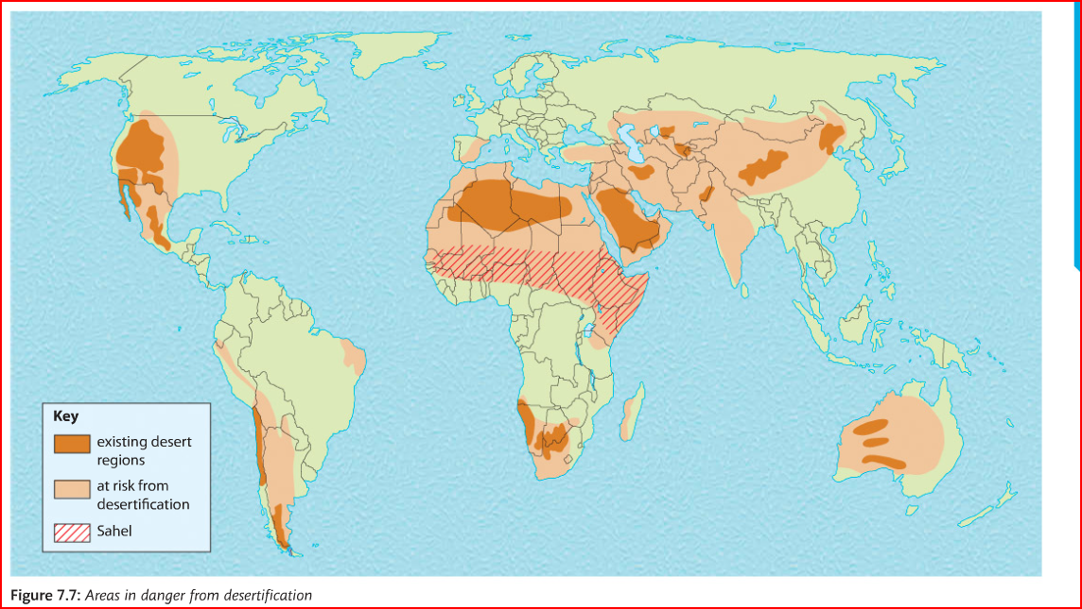
In your notes, describe the pattern of areas at risk from desertification

Slide 6
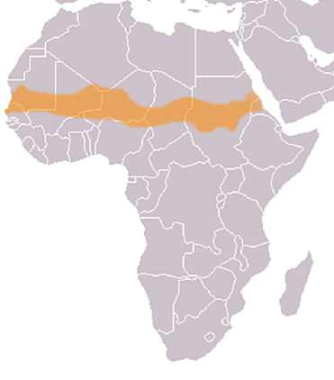
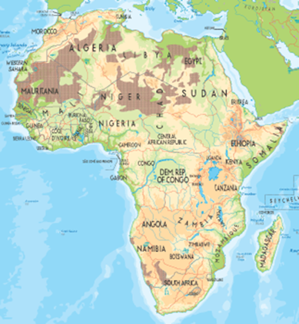
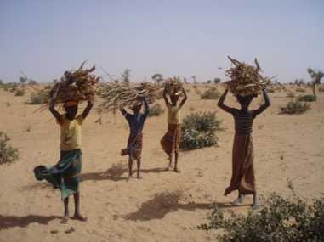
Desertification: Sahel region of Africa
The Sahel is the “zone of transition’ in Africa between the arid Sahara Desert to the north and the humid Savanna to the south. It is a semi-arid region and stretches through 12 countries from the Atlantic to the Red Sea. Receives between 100-600mm rain annually

Slide 7
What are human causes of desertification?
Population growth (war, migration)
Overgrazing
Overcultivation/poor irrigation processes
Deforestation
Urbanization (expanding cities
Which happens first?

Slide 8
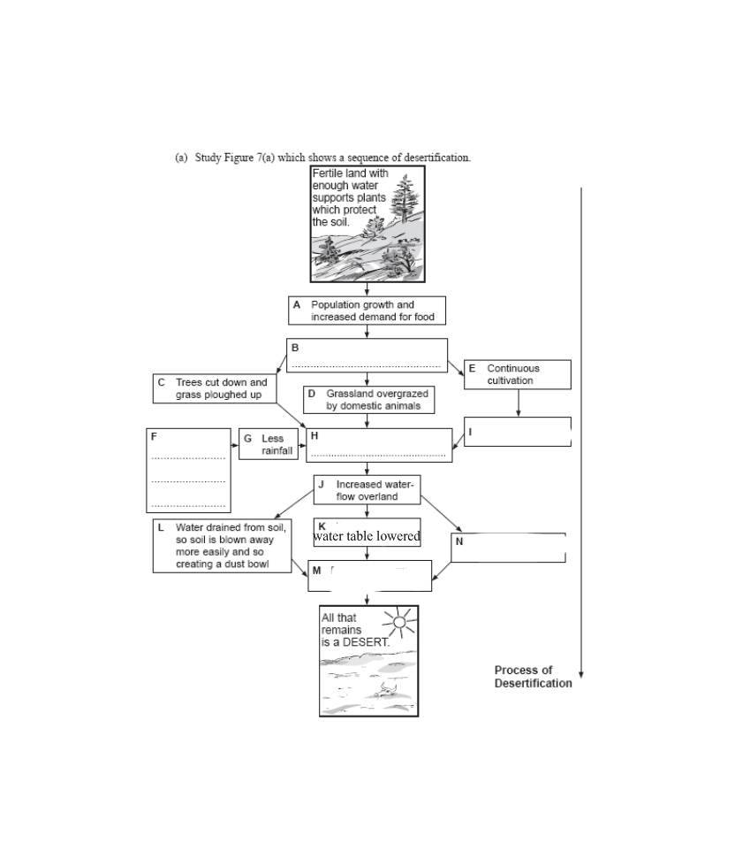
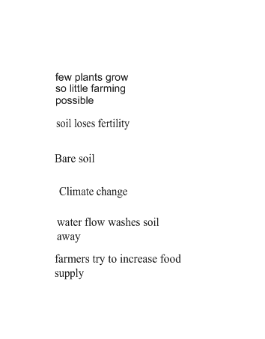

Slide 9
Consequences of desertification:
ECONOMIC
Reduced agricultural output – fewer crops can be grown
Malnutrition – people don’t have enough to eat
Famine – people starve
Refugees – people move to new areas
Food Aid – sent by other countries to help

Slide 10
Consequences of Desertification
ENVIRONMENTAL:
Reduced soil nutrients through wind and water erosion
Loss of biodiversity
Reduced arable land available for farming
Expanding areas of sand dunes

