Slide 1
Aim: To know how caves, arches and stacks are formed

Slide 2
Geography bingo……
weathering | attrition | abrasion | corrosion
Hydraulic action | exfoliation | headland | bay
Destructive wave | swash | backwash | Freeze thaw
Constructive wave | fetch | erosion | Tree roots
Concordant coastline | Discordant coastline | wind | solution
Draw a 5 by 5 table in your notes and place the words shown randomly throughout your table. Once I read a definition, cross out the appropriate word or phrase

Slide 3
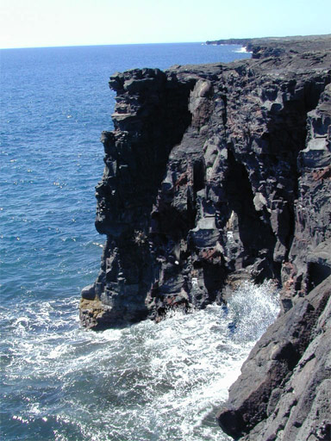

Slide 5
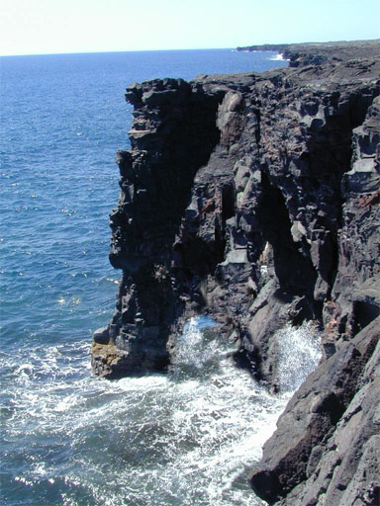

Slide 6
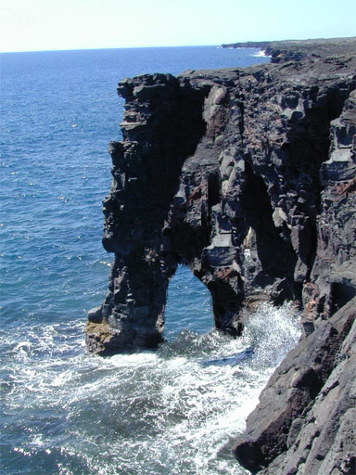

Slide 7
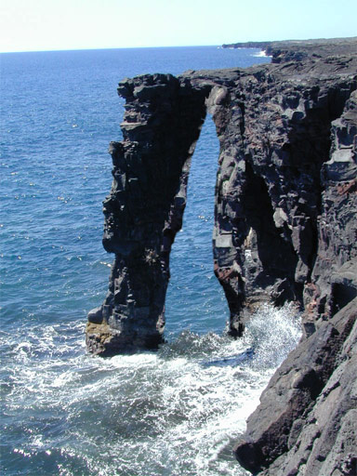

Slide 8
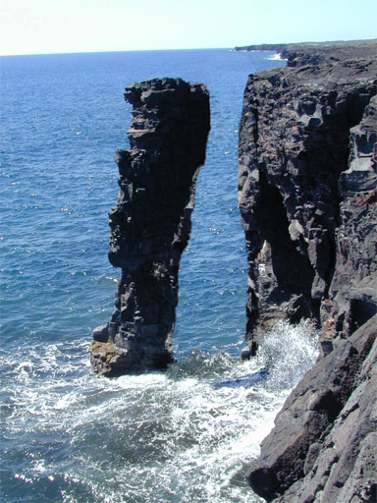

Slide 9
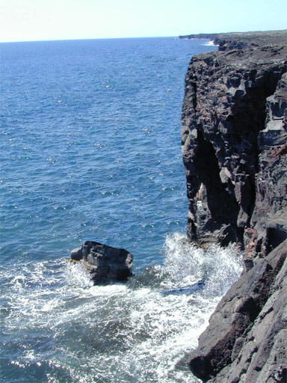

Slide 10
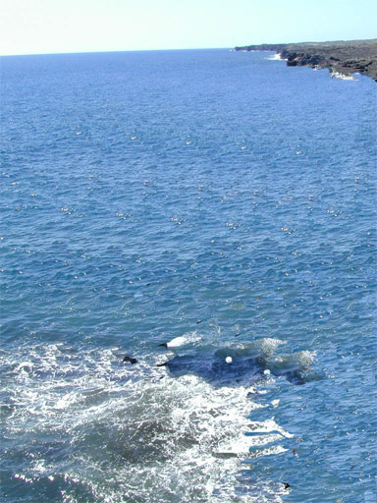

Slide 11
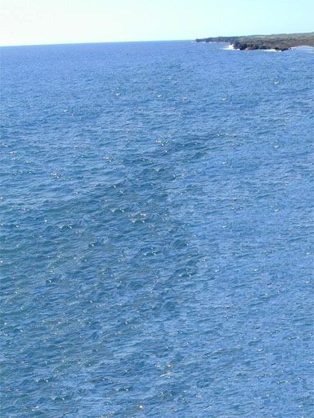

Slide 12
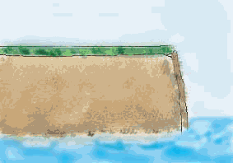
How does a cliff become an arch?

Slide 13
How does a stack become a stump?

Slide 14
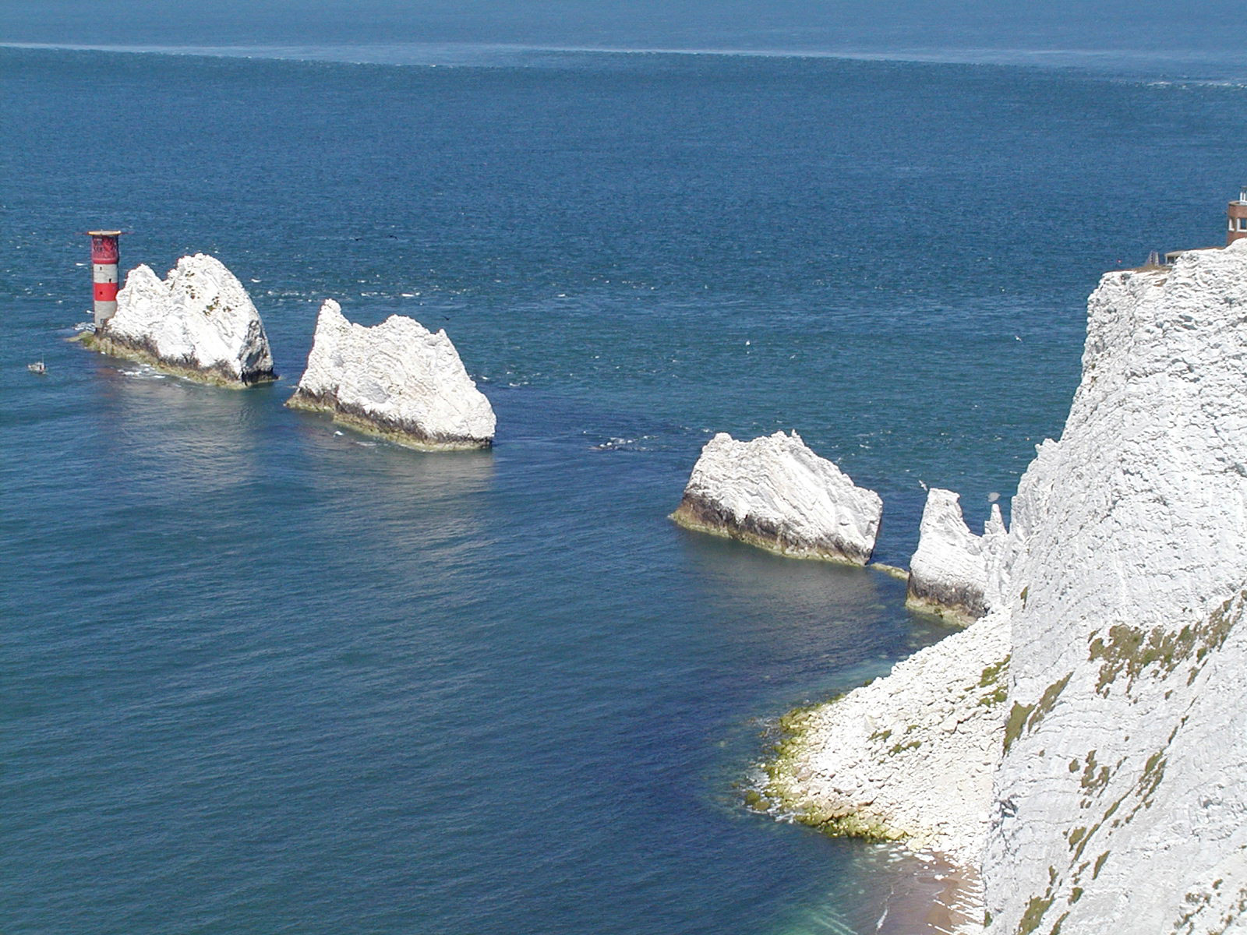
How does a stump become nothing at all….

Slide 15
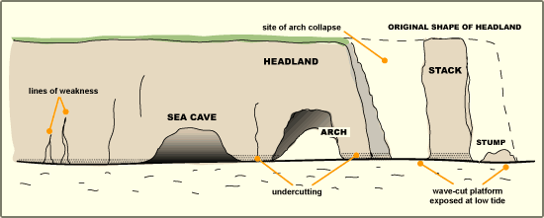

Slide 16
Task Use pg. 301 (ww) to help you.
Draw a diagram to show formation of cave, arch and stack on headland.
Write a paragraph underneath which explains your diagram
Make sure you include these words:
Crack
Weakness in rock
Cave
Arch
Stack
Waves
Headland
Extension – question 1a-d on pg. 315 using map
Stump
Hydraulic action
Abrasion
Corrosion
Weathering

