Slide 1
Mind maps:
Issue: Inequality
People involved: Wealthy and Poor
Areas Involved: City (urban) & Country (rural) / In cities
Consequences: What is life like?
Solutions: What is life like?

Slide 2
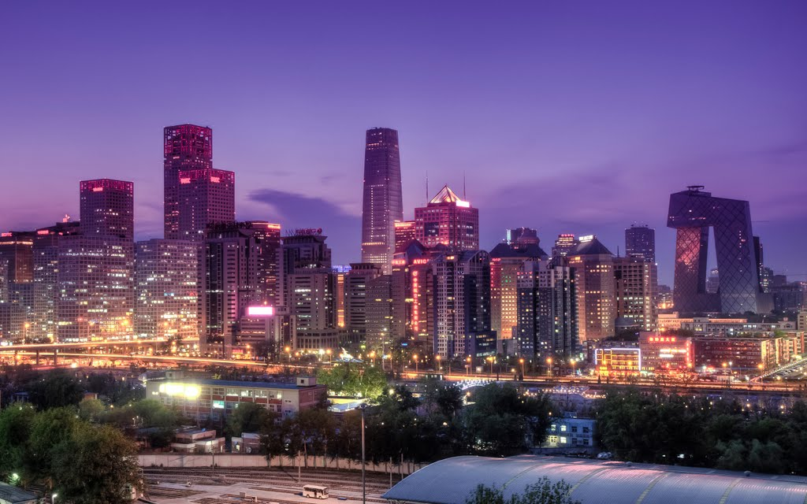

Slide 3
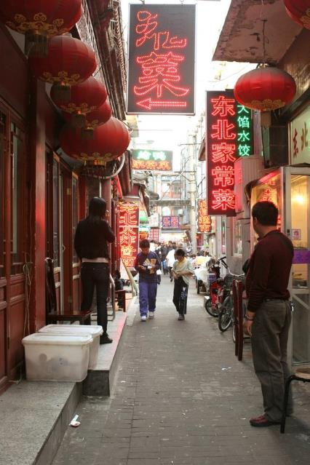
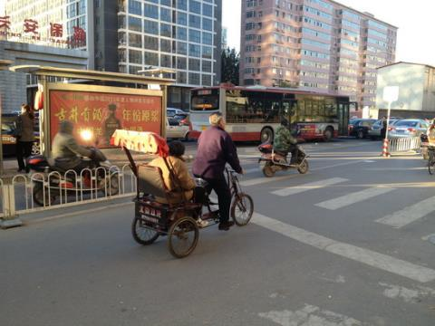
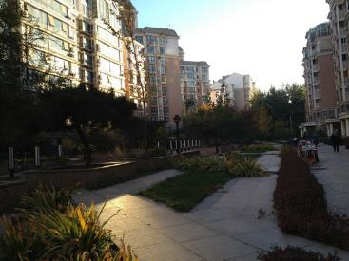
Daily
life

Slide 4
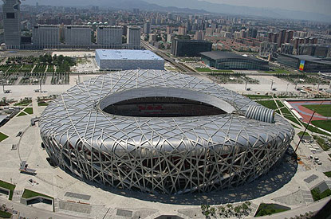
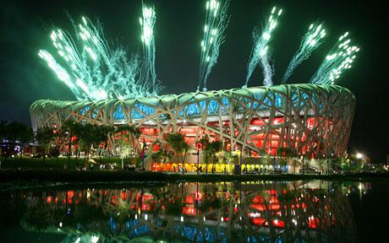

Slide 5
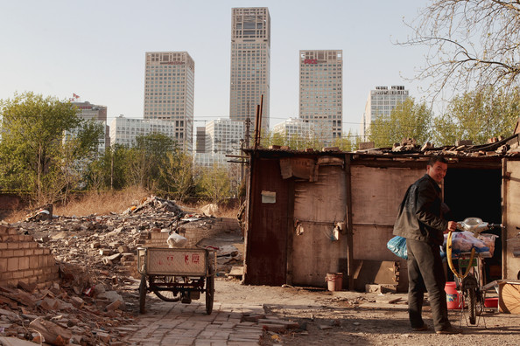
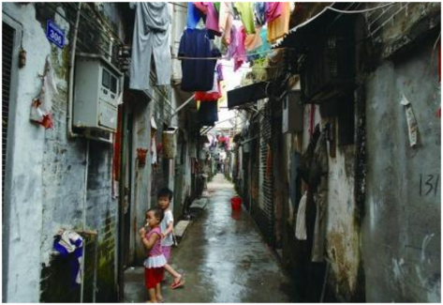
As in any country, there are always areas of wealth and areas of poverty……

Slide 6
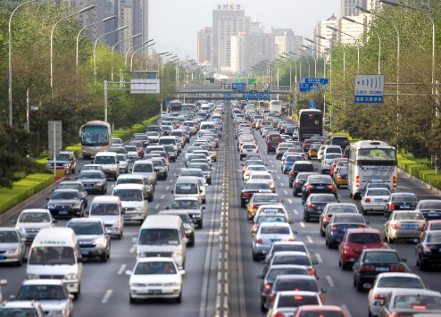
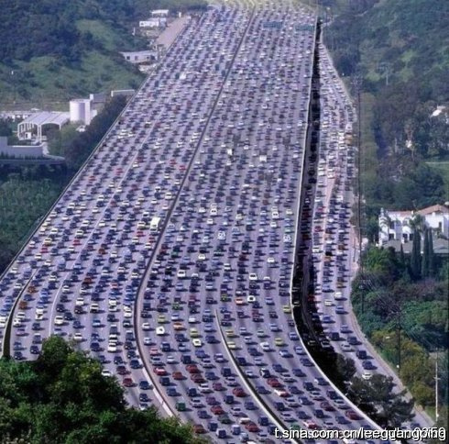
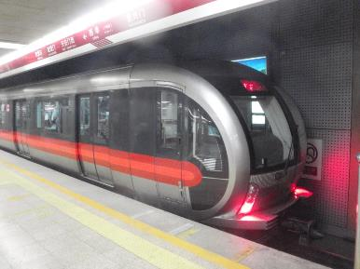

Slide 7
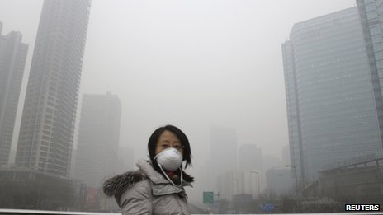
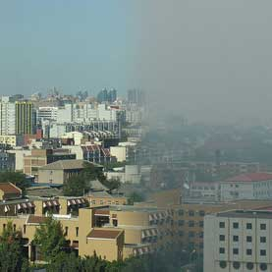
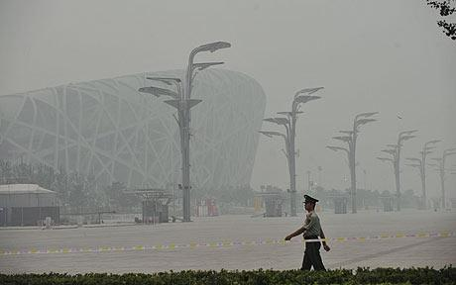

Slide 8
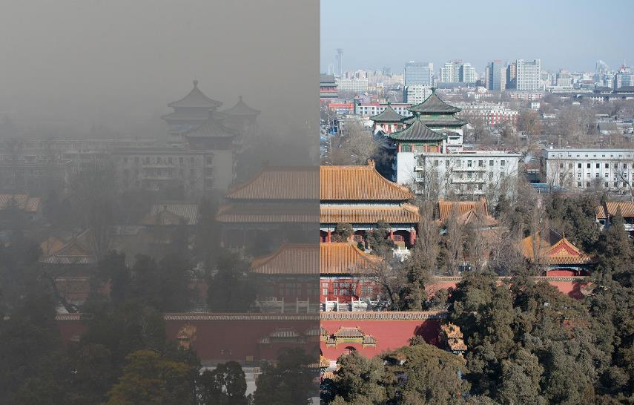
http://www.marketplace.org/topics/sustainability/what-would-your-city-look-beijings-air-smog-simulator

Slide 9
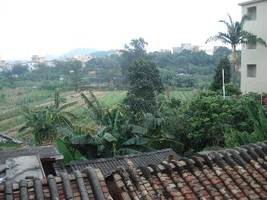
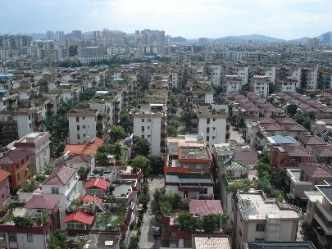
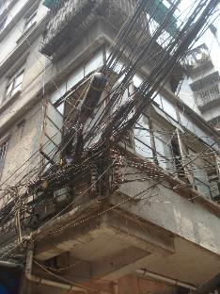
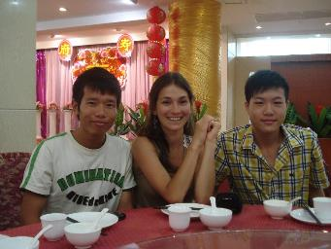
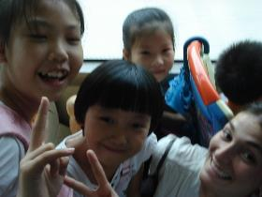
My time in china

Slide 10
ALONE:
Underline the main points of your article
Highlight the words you don’t know
IN PAIRS:
Get in your groups; discuss the words you don’t know
List the most important main points from article
Do some research and decide whether China can “change course” from its current actions.
Make a list of all the steps China has taken to fix the issue with specific statistics

Slide 11
Task: Create an infographic Outlining one of the 6 Major Environmental Concerns FOR China AND THE WORLD

Slide 12
Infographics…

Slide 13
WHAT IS AN INFOGRAPHIC?

Slide 14
Task: Create an infographic Poster Outlining one of the 6 Major Environmental Concerns in China
Place your issue as a title somewhere on your poster.
Decide where you will put the rest of the info
Description of the type of pollution
Where does it happen in China? And the world
Why does it happen?
Consequences for the wider world?
What has China done to ‘change course’? How?
What does the world need to do?

Slide 15
CATEGORY | 7-8 | 5-6 | 3-4 | 1-2
Graphics - Relevance | All graphics are related to the topic and make it easier to understand. Detail is evident.. At least 5 graphics are evident from the poster | All graphics are related to the topic and most make it easier to understand. Some detail has been shown. Four graphics are evident, | All graphics relate to the topic. Some detail has been taken. Less than 3 graphics are evident | Graphics do not relate to the topic. Very little detail is present. Graphics are unrelated to poster topic.
Content - Accuracy | At least 6 accurate facts are displayed on the poster. Students show exceptional understanding of their chosen issue. | 4-5 accurate facts are displayed on the poster. Students show solid understanding of their issue. | 3-4 accurate facts are displayed on the poster. Students show understanding of their chosen issue. | Less than 3 accurate facts are displayed on the poster. Students do not seem to understand their issue.
Style - Originality | The poster is exceptionally attractive in terms of design, layout, and neatness. Multiple colours are used but not too many as to overwhelm picture. | The poster is attractive in terms of design, layout and neatness. | The poster is acceptably attractive though it may be a bit messy and/or unorganized. | The poster is distractingly messy or very poorly designed.
Use of Class Time | Used time well during each class period. Focused on getting the project done. Never distracted others. | Used time well during each class period. Usually focused on getting the project done and never distracted others. | Used some of the time well during each class period. There was some focus on getting the project done but occasionally distracted others. | Did not use class time to focus on the project OR often distracted others.

