Slide 1
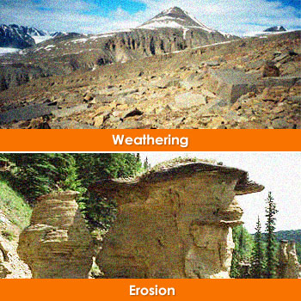
Aim: To know processes of erosion and weathering
Erosion and Weathering Processes

Slide 2
Erosion: removal of material caused by wind and water Weathering: breakdown of rocks caused by other processes such as weather and energy
What is the difference between erosion and weathering?

Slide 3
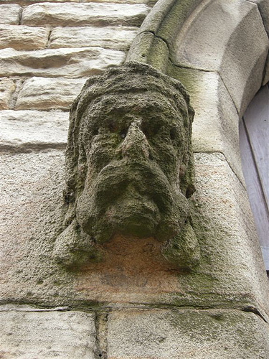
Erosion

Slide 4
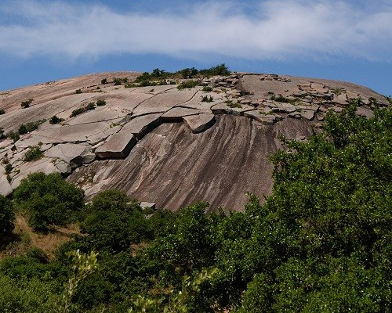
Weathering

Slide 5
Erosion

Slide 6
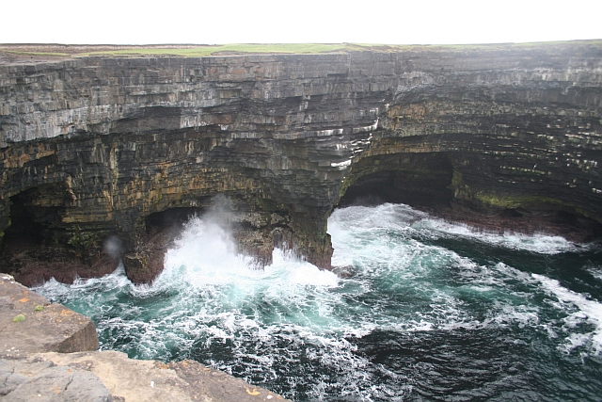
Erosion

Slide 7
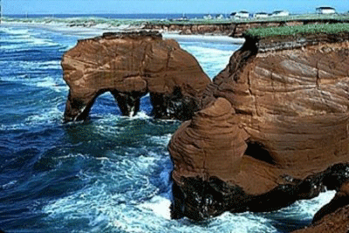
Both!

Slide 8
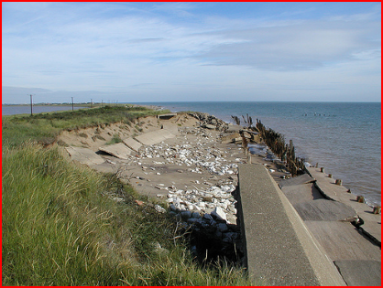
Types of erosion
Destructive waves do much of erosion on coasts. They cut away at the coastline through hydraulic action, abrasion, corrosion and attrition
Ensure you have these terms defined!

Slide 9
Weathering
On the land part of a cliff or beach,
WEATHERING
EROSION
MASS MOVEMENT
Can occur without the help of the ocean. Ensure you have these definitions in your book! (p35)
Once finished, complete the crossword (can use your book or notes to help)

