Slide 1
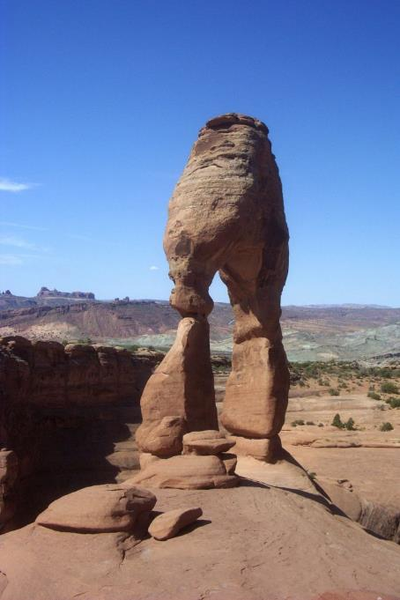
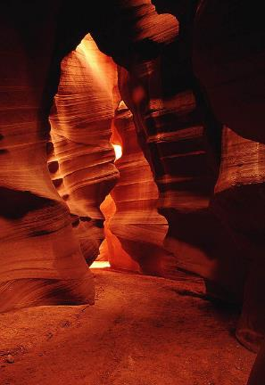
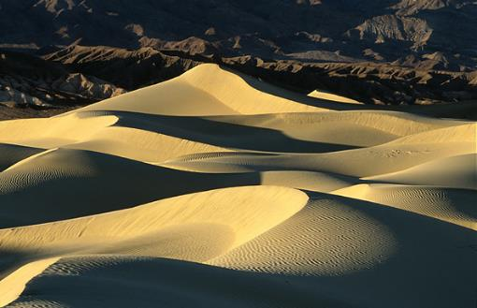
Arid Landforms

Slide 2
Basic Concepts
I. Most deserts exhibit highly angular landscapes.
mechanical weathering dominates (freeze-thaw)
angular particles of weathered rock; bedrock outcrops
little soil or vegetation to soften landscape/hold soil
II. Softer, more rounded landscapes appear where deposition (WIND deposits material) is predominant.
dunes
III. Desert rainfall is infrequent, intense, and unreliable.
intense flash flooding, intense erosion
ephemeral streams (flow seasonally or after storms)
IV. DESERT LANDFORMS are shaped by EROSION and DEPOSITION:
WIND – only lifts material about a metre above ground
WATER – responsible for higher features from surface

Slide 3
Weathering, Erosion (Fluvial or Aeolian), & Deposition
Destructive processes break down landforms through weathering, erosion, and mass wasting.
Weathering is the disintegration of rocks by mechanical, chemical, and biological agents.
Erosion is the removal and transportation of weathered material by water, wind, ice, or gravity.
WADIS and YARDANGS
Constructive processes build landforms through tectonic and depositional processes.
Deposition is the accumulation or accretion of weathered and eroded materials.
DUNES and ALLUVIAL FANS

Slide 4
DESERT FLUVIAL (OF A RIVER) PROCESSES/LANDFORMS
Fluvial Erosion - rare, intense flash floods.
steep slopes; steep-walled canyons; washes, wadis, arroyos, canyons, decreases in discharge downstream
Fluvial Deposition – where water slows on flat playas, material is deposited and sorted by size.
alluvial fans
rock debris in piedmont region

Slide 5
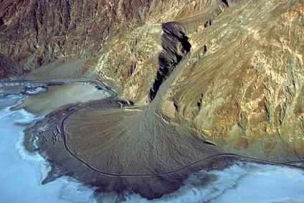
Alluvial Fans
Alluvial fans are fan-shaped fluvial (of a river) deposits that accumulate at the base of stream where it flows out from a steep gradient and enters into a lower-gradient flood plain or valley setting.
The stream enters the valley carrying a higher capacity sediment load than it can continue to carry, and as a result it deposits the sediments as an alluvial fan.
Alluvial fans generally form in arid environments with a high sediment load and where there is minimal vegetation to disrupt the fan formation.
Alluvial fans may form from a single high-flow event or from the accumulation of multiple events.
This alluvial fan is carrying a high sediment load from material weathered from the mountains. The dark line along the edge of the fan is a road. Because the road is not buried by recent deposits it suggest that this fan is not currently as active as it was in the past.
Copyright © Marli Miller, University of Oregon

Slide 6
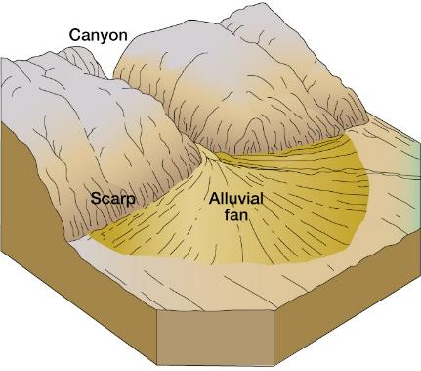
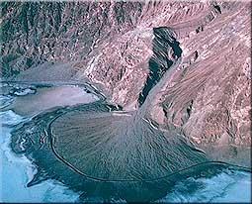
Badwater, Death Valley, CA

Slide 7
WADIS: (In certain Arabic-speaking countries) a valley, ravine, or channel that is dry except in the rainy season.
Notes:
https://www.youtube.com/watch?v=mHJmfySkgMw

Slide 8
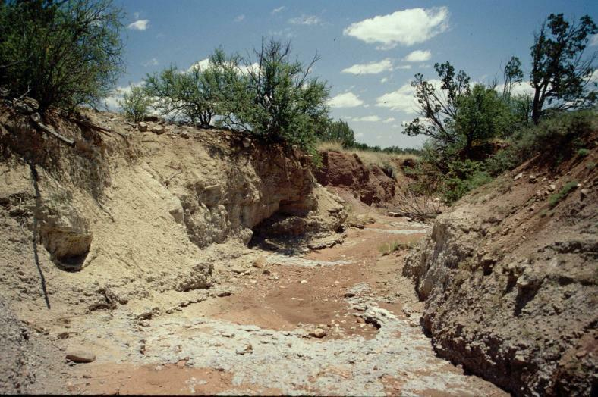
Arroyo

Slide 9
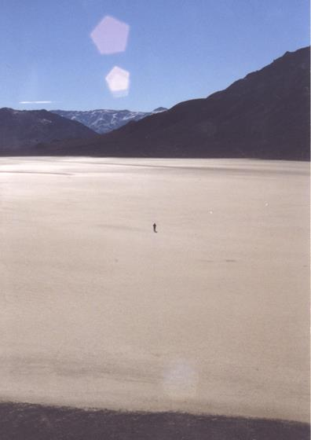
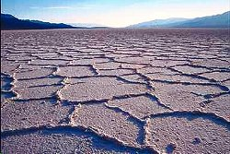
Playas

Slide 10
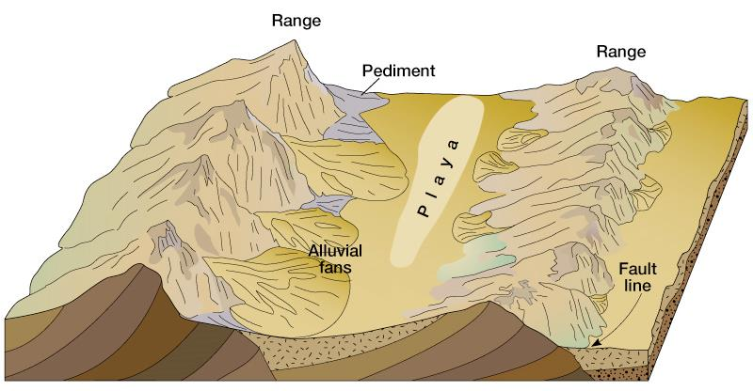
Piedmont - gently sloping land that extends out from base of mountains.
Pediment - sloping bedrock at base that develops.

Slide 11
Wind erosion
Differs from that of running water in two ways
Wind is less capable of picking up and transporting coarse materials
Wind is not confined to channels and can spread sediment over large areas

Slide 12
AEOLIAN (of WIND) PROCESSES/LANDFORMS
Aeolian Erosion - much less effective than fluvial
deflation - movement of only small particles (leaving large ones)
abrasion - polishes and etches exposed surfaces
Aeolian Deposition - dunes form and shift where winds and terrain combine to slow the winds or block the movement of dunes.

Slide 13
Wind erosion
Mechanisms of transport (aolian transportation)
Bedload
Saltation – skipping and bouncing along the surface
Suspended load
In the air as duststorms

Slide 14
Wind erosion
Mechanisms of wind erosion
Deflation
Lifting of loose material produces blowouts
Desert pavement

Slide 15
Deflation (Erosion)

Slide 16
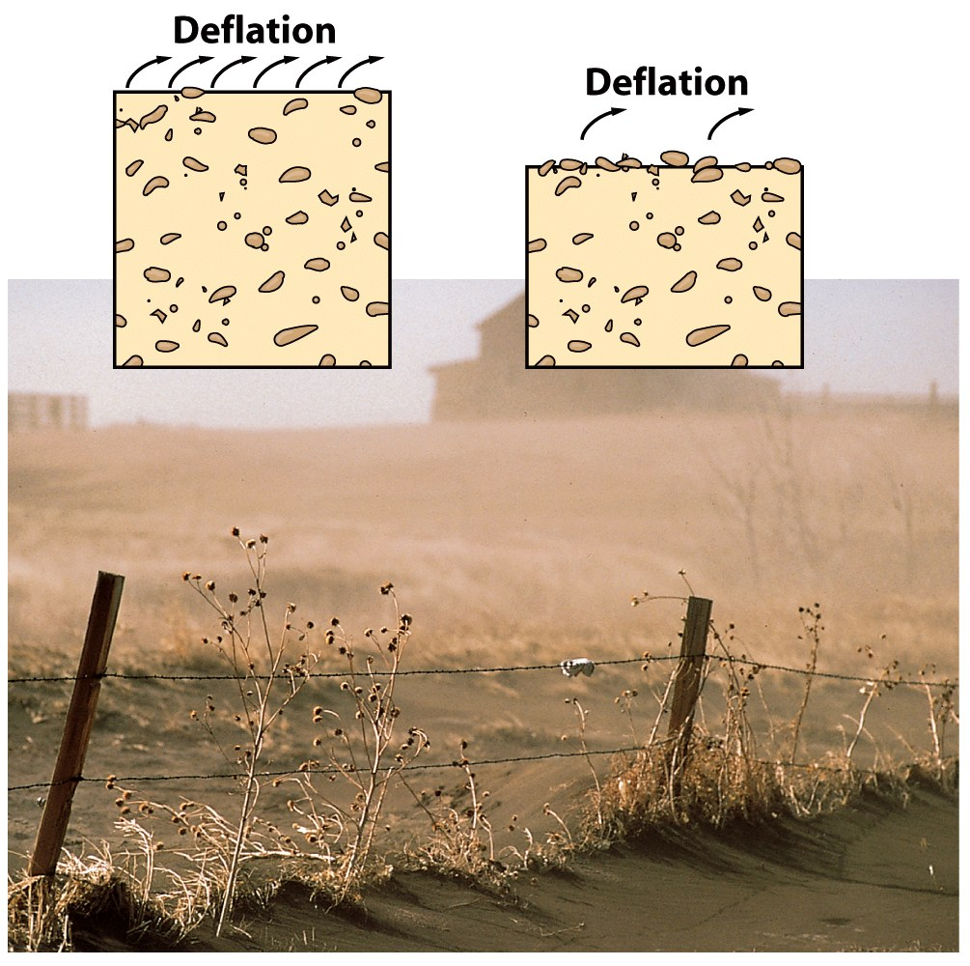
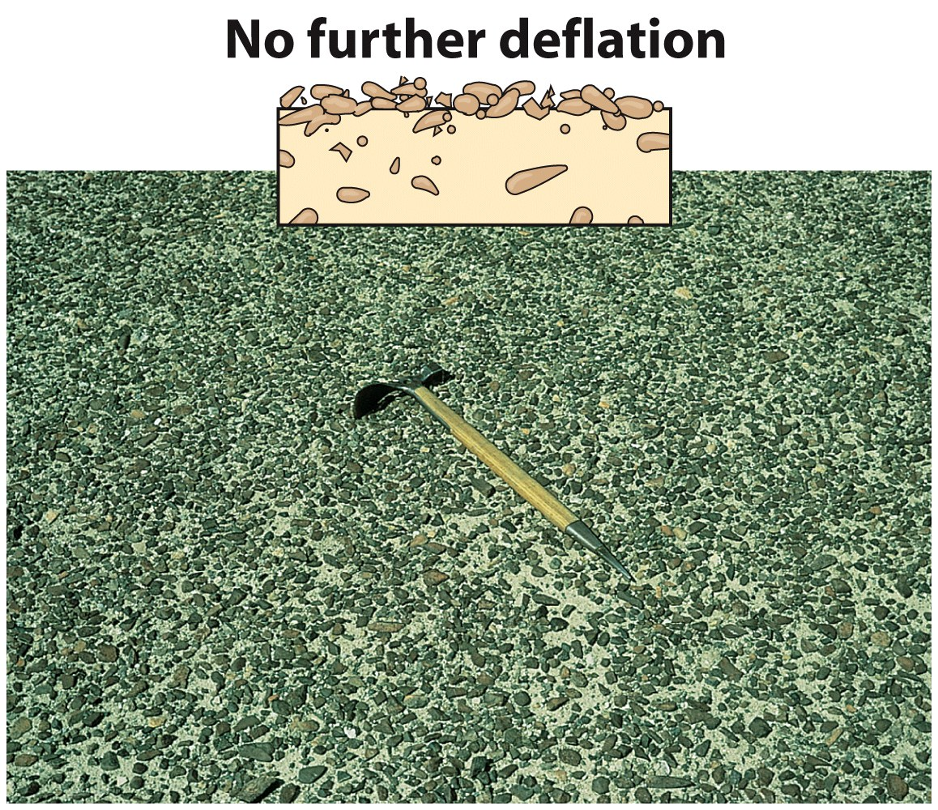
Deflation & Desert Pavement

Slide 17
Wind erosion
Mechanisms of wind erosion
Abrasion
Produces inselbergs, yardangs (wind sculpted ridges)
Limited in vertical extent

Slide 18
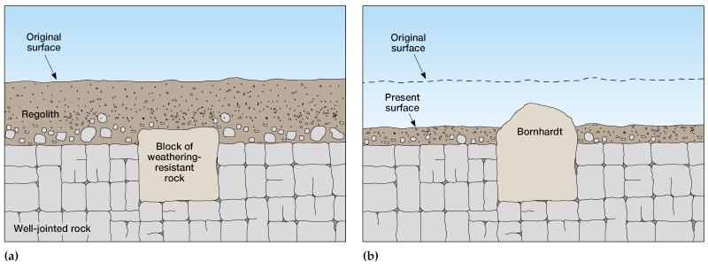
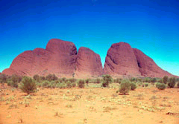
Inselberg - “island mountains” rise abruptly out of desert landscapes,
Made of hard rock which is more resistant to weathering….
Kata Tjuta (The Olgas), Australia

Slide 19
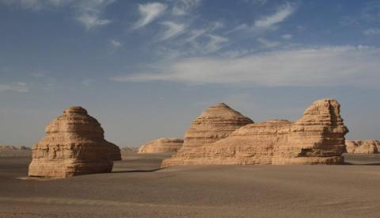
Yardang
A yardang is an elongate ridge or remnant rock feature sculpted by abrasive wind erosion.
Yardangs occur in arid environments where prevailing winds come from a single direction. The winds must be strong, steady, and carry a coarse-sediment load that weathers the exposed face of the yardang.
Yardangs are sculpted into a variety of forms, and some may resemble common objects or human-like forms.
Yardangs are eroded over long time periods and occur in a variety of sizes and forms. The Egyptians would often sculpt yardangs into animal and human forms. Some ancient cultures also carved caves into yardangs and used them for dwellings or sacred religious places.

Slide 20
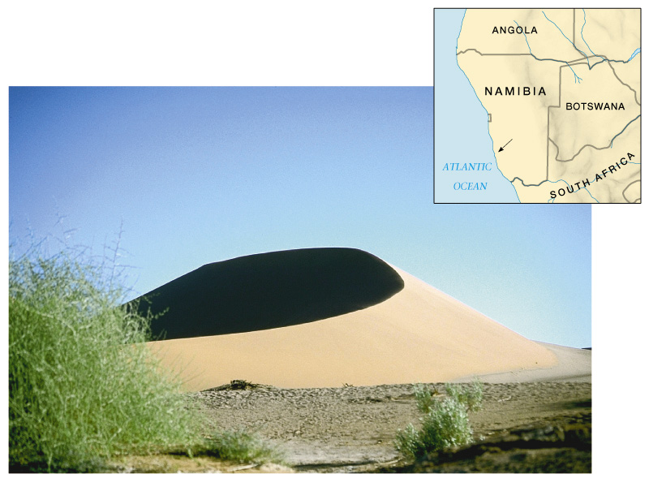
Types of Dunes
Barchans - migrating crescent dune with horns pointing downwind; form where strong winds blow in a consistent direction. Move fast. Common in central Asia and Sahara. Can reach hundreds of feet in height.

Slide 21
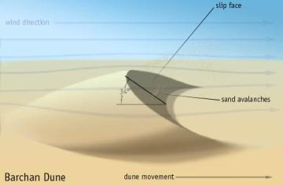
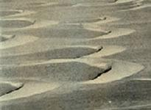
Dunes
Dunes are formed as mounds or ridges of aeolian sand deposits and are then sculpted by near- surface wind processes, such as saltation. Saltation transports sediment up slope on the windward side and once the sediments reach the crest they fall over and accumulate as a steeper slope on the leeward side of the dune. An area covered by many dunes is an erg.
Barchan dunes are solitary, crescent shaped dunes with their tips pointing downwind. They form where sand source is limited, wind direction is constant, and the ground is void of vegetation. They can reach heights of 30 meters and spread nearly 300 meters.
slip face
Wind direction
Wind
Barchan
Dunes
Sand avalanche
Dune movement

Slide 22
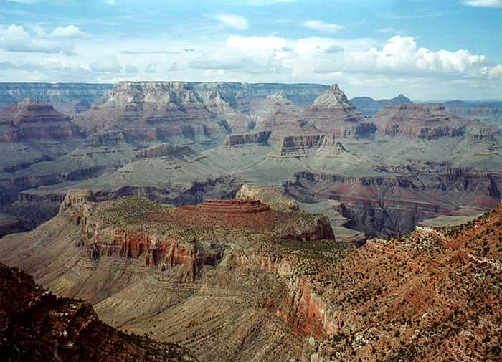
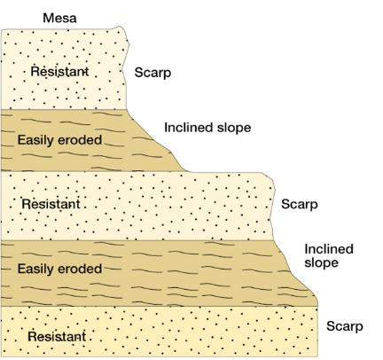
Differential Erosion

Slide 23
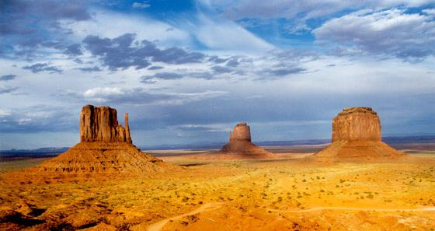

Slide 24
Important: read pages 123-127 IN FULL
Complete worksheet #3 – Arid Landforms

