Slide 1
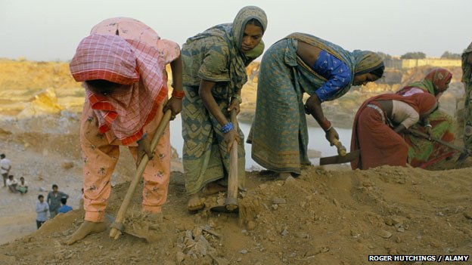
Modern Slavery and Globalization
How Many ‘Slaves’ Work For You?

Slide 2
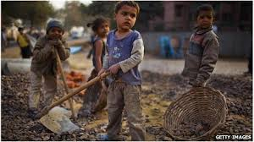
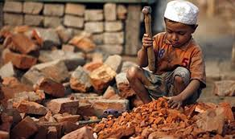
Modern Slavery:
Legal or economic system where people are treated as property. They are held against their will, forced to work and paid nothing.
20 to 35 million slaves (many children) today, but slavery is illegal in all countries!!

Slide 3
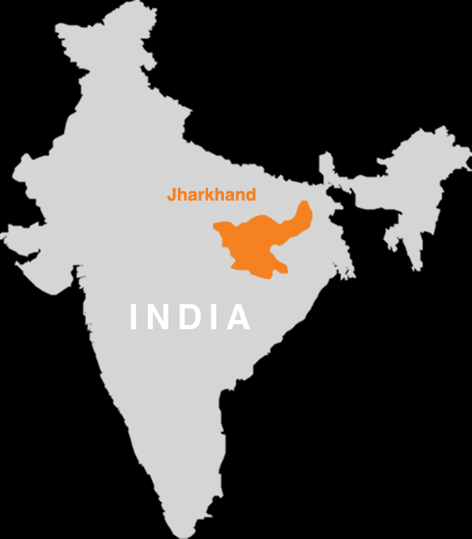
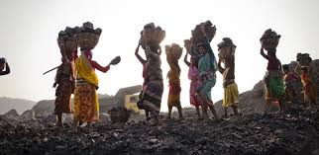
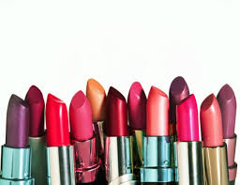
Makeup & slavery
Mica is a common ingredient in makeup
60 % of the world’s Mica comes from India
This Mica is produced by children in dangerous mines
US, UK and Japan are the largest buyers of Mica from India

Slide 4
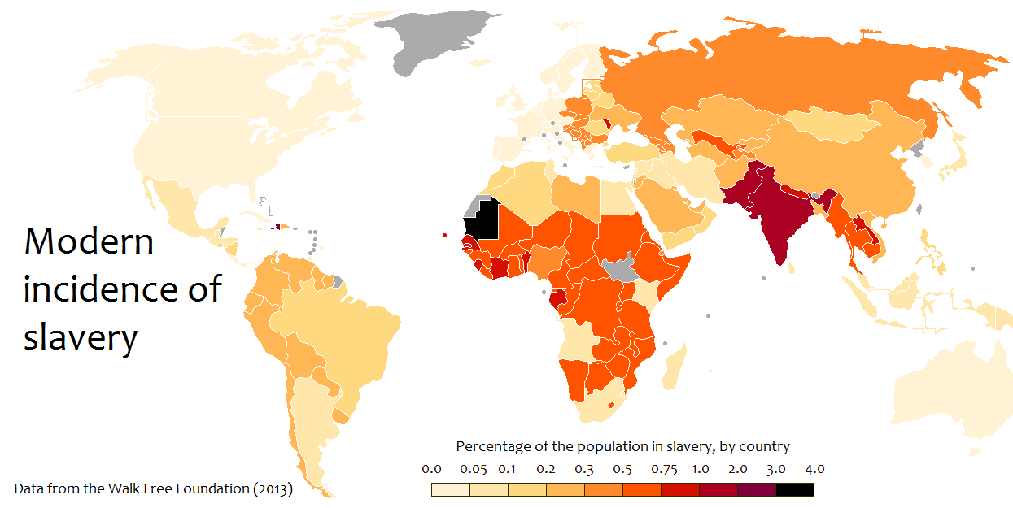

Slide 5
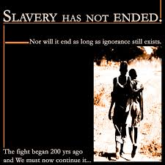
How does globalization contribute to slavery?
Consumers demand goods and companies want to keep costs low
Companies who run factories or mines can use slaves for labour
Consumers do not know or understand they are helping slavery continue by their choices

Slide 6
NEW TITLE: THE MOVEMENT OF LABOUR: Where in the world do we find most low income labour?
Just like with slavery, many JOBS are now located in LIC countries due to low wages (pay) and high number of people
In fact, jobs are MOVING from HICs like UK and USA to NICs, MICs, and LICs such as Egypt or Vietnam
This affects many people…

Slide 7
Read Page 82-83 of textbook, complete questions 1 and 2 before Friday!

