Slide 1
What do these products have in common?
All products from 1 TNC – procter and gamble

Slide 2
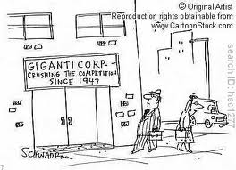
Aim: To discuss the shift of power from nation state to TNCs as a result of their economic size and dominance. To compare the wealth of TNCs with that of nation states

Slide 3
TNC
Transnational corporation- a firm that owns or controls productive operations in more than one country through foreign direct investment.
Nation State
An independent state inhabited by all the people of one nation and one nation only.

Slide 4
Can we predict any TNC’s in the top 10 richest companies? How does this compare to a nation?
http://en.wikipedia.org/wiki/List_of_companies_by_revenue
GDP of the Bahamas - $10.82 billion (2011)
http://www.businessinsider.com/25-corporations-bigger-tan-countries-2011-6?op=1

Slide 5
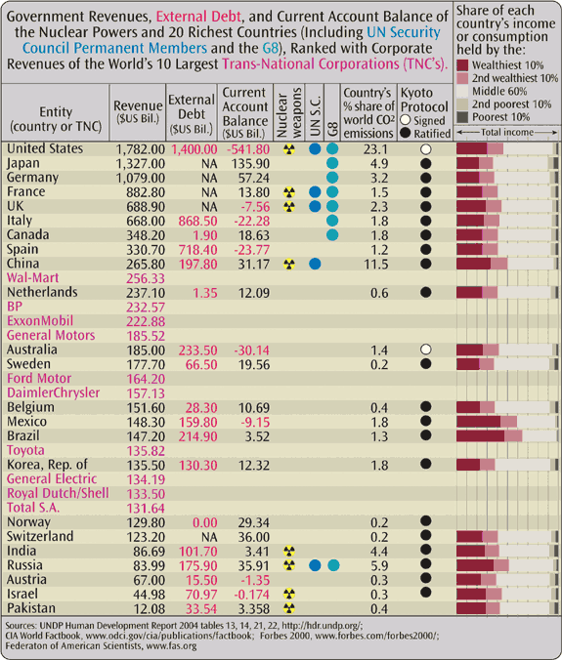
2007
Twenty-nine of the world’s 100 largest economic entities are TNCs

Slide 6
TNC power…
Up to 1/3rd of all trade is from internal transfers from TNC’s – these transfers produce money for governments through taxes
Over 50 million people employed by TNC’s wordwide
Ownership of assets such as oil gives TNC’s economic power
TNC’s control, extraction, marketing and transport of goods even though LIC governments own the resources

Slide 7
Despite the economic crisis TNC’s are still doing well…….WHY??
Rationalization – replacing people with machines (mechanisation)
Reorganisation – improve efficiency such as subcontracting production
Diversification – development of new products

Slide 8
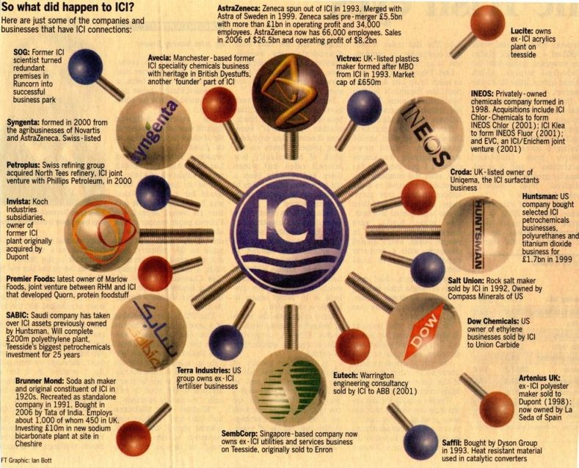
Example of a TNC pg. 379
ICI
History
Products
Global spread
Influence (GDP and employment)
Location of HQ compared to factories

Slide 9
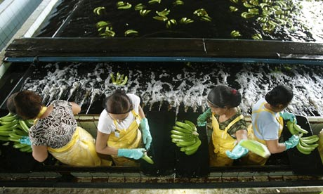
Do the Banana Wars show the loss of sovereignty of nation states?
1. UK 2. Caribbean nations 3. USA

