Slide 1
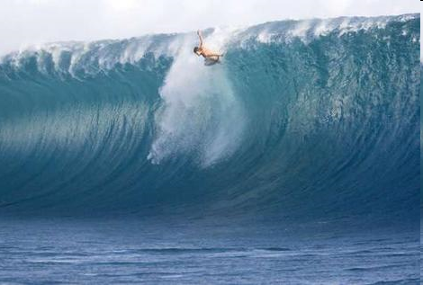
Aim: To know different types of wave
Wave Types:
Constructive vs. Destructive Waves

Slide 2
Destructive Waves
Created in storm conditions, when wind has been blowing on the wave for a long time, over a far distance (long fetch). They are high energy waves that tend to sweep beach material out to see (erode the coast). Their backwash is stronger than the swash.

Slide 3
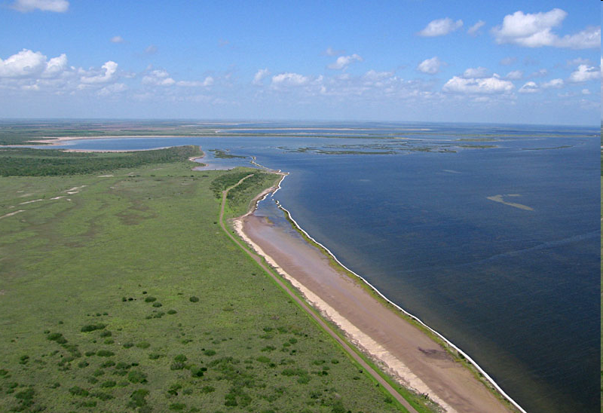
Constructive waves
Created in calm weather, low energy waves that break on shore and deposit material. They have a swash stronger than their backwash

Slide 4
Tasks
Pg 300
Name 3 differences between a high energy coastline and a low energy coastline
What is swash and backwash?
What is Fetch and why is it important?
Why do waves form?
Draw a diagram and write notes to explain the features of a constructive wave.
Draw a diagram and write notes to explain the features of a destructive wave.
Extension:
Describe the waves on Grand Bahama and explain their formation

Slide 5
Diferencias del nombre 3 de la página 300 entre una línea de la costa de la alta energía y una línea de la costa de poca energía cuál es chapoteante y turbulencia?
¿Cuál es traen y porqué es él importantes?
¿Por qué las ondas forman?
Dibuje un diagrama y escriba las notas para explicar las características de una onda constructiva. Dibuje un diagrama y escriba las notas para explicar las características de una onda destructiva.

