Slide 1
New Doc (Pop’n in Trans) Title: Patterns and Trends in Births and Mortality

Slide 2
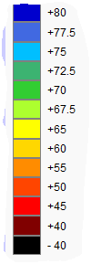
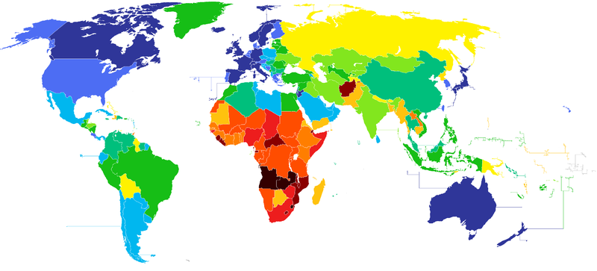
What am I a map to show?
LIFE EXPECTANCY

Slide 3
DESCRIBE the trends shown in the tables on the next few slides..
When DESCRIBING use G-A-S…
GENERAL movement (including highs and lows)
ANOMALIES (exceptions to the trend or pattern)
SPECIFIC DATA (use numbers – quantitative information to highlight your points)
USUALLY 4 pt questions on Paper One

Slide 4
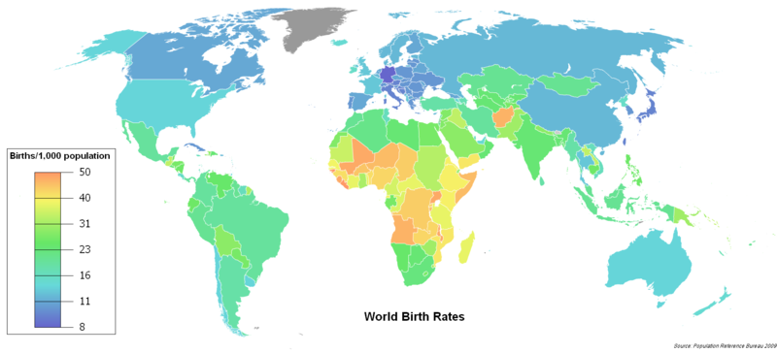
What am I a map to show?
Crude Birth rate

Slide 5
Birth rates
Patterns:
Poorer countries have higher birth rates.
Central and Sub Saharan Africa very high 31-50.
South America between 16 and 31.
Western Europe and North America 11-16.
Afghanistan/Yemen anomalies with higher birth rates

Slide 6
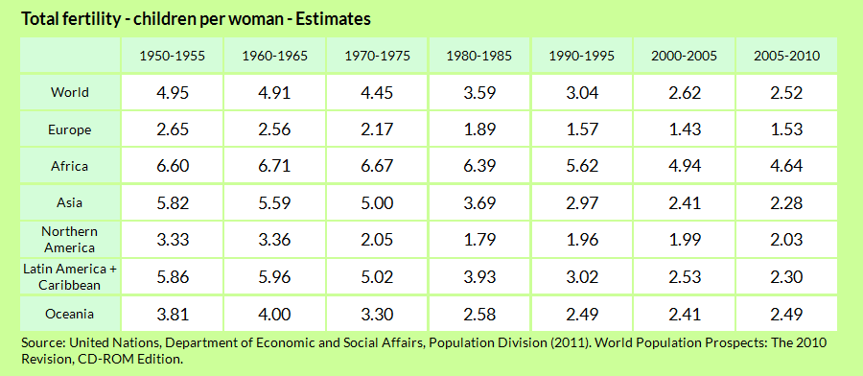

Slide 7
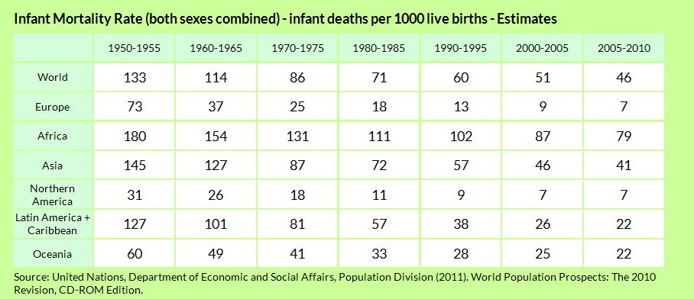

Slide 8
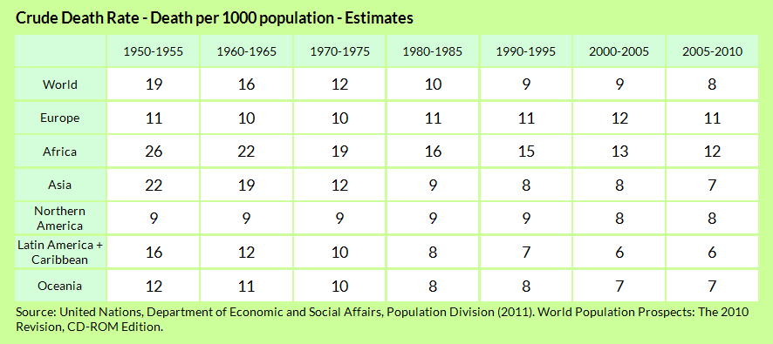

Slide 9
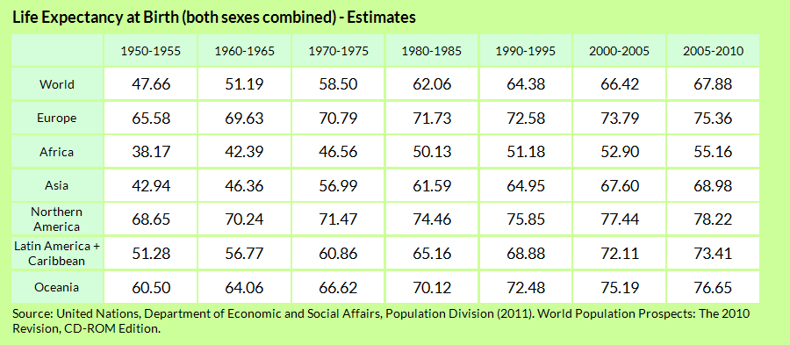

Slide 10
1. Choose three different indicators from the list 2. Use the book pg 2-9 and/or the gapminder website to describe the regional trends for each of the three indicators. Between 5-6 sentences for each indicators.

Slide 11
Population change = Birth rate - Death rate +/- Change in migration
• Green - Ethnic minorities
• Red - People aged over 65
• Purple/Black - Adult males
• Yellow - Adult females
• Pink - Female children
• Orange/White - Male children
Name your country
In your notes… describe the beginning population structure

Slide 12
Population Game:
• What was the change to your population structure?
• Which scenarios changed the birth rate?
• Which scenarios changed the death rate?
• Which population within your country was the most vulnerable?
• Which scenarios changed the migration rate?
• Which were the push factors of migration?
• Which were the pull factors?

Slide 13
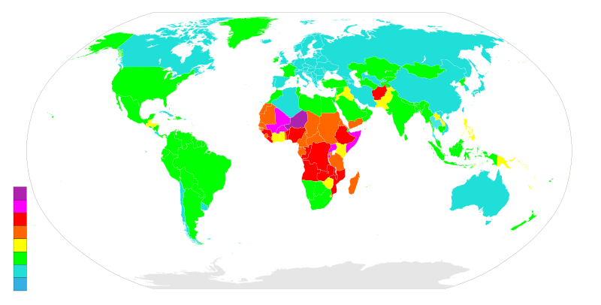
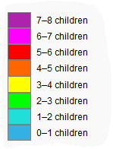
A world map showing countries by fertility rate. According to the The World FactBook (CIA), 2012 estimates.
Patterns:
Poorer countries have higher fertility rates.
Central and Sub Saharan Africa over 6 children.
South American, USA and India and South East Asia 2 and 4 children.
Canada, Australia and most of Western Europe -1 to 2 children
Yemen/Afghanistan an anomalies in the Middle East with 4-6 children

Slide 14
What factors may affect the birth rate?
Status of women
Level of education
Type of residence (rural or urban area)
Religion
Health of the mother
Economic prosperity
Infant Mortality and the need for children

Slide 15
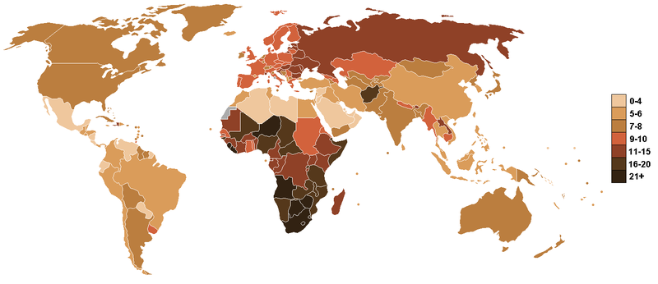
Death rate (death/1,000 population/per year) from CIA World Factbook
Pattern and trends
Death rates are generally decreasing over time.
Death rates highest in poor, rural areas such as Sub Saharan Africa at 21.
USA has a higher death rate than Mexico. UK has a higher death rate than India. Japan has a higher death rate than China

Slide 16
Mortality Rate
Is this a good measure?
No because richer countries with more old people show a higher death rate! Also factors such as war and disease play an important role.
Does not show the health nor the wealth. Don’t get confused!!

Slide 17
Ukraine: 0.8% natural decrease annually; 28% total population decrease by 2050 Russia: -0.6%; -22% Belarus -0.6%; -12% Bulgaria -0.5%; -34% Latvia -0.5%; -23% Lithuania -0.4%; -15% Hungary -0.3%; -11% Romania -0.2%; -29% Estonia -0.2%; -23% Moldova -0.2%; -21% Croatia -0.2%; -14% Germany -0.2%; -9% Czech Republic -0.1%; -8% Japan 0%; -21% Poland 0%; -17% Slovakia 0%; -12% Austria 0%; 8% increase Italy 0%; -5% Slovenia 0%; -5% Greece 0%; -4%

Slide 18
Individually, write an answer to this question:
Describe and explain the differences in fertility and mortality in two contrasting geographical locations. [15 marks]
Points to think about:
Using a PEE structure;
basic Point
Explanation of point
Example (facts from different countries)

