Slide 1
List all the hazards you can under these headings
TECTONIC | CLIMATIC
Volcano | Flooding
Earthquake | Drought
Tsunami | Tropical storms

Slide 2
Risk – why is it important…
Risk is the probability of a particular hazard happening
To know the risk we need to know:
Distribution – where it occurs on earth
Frequency – when do they occur – regularly?
Scale – do events vary in how bad they might be
Prediction – can we know when the hazard will occur
Adjustment or mitigation – can people take measures to protect themselves or prevent the hazard taking place

Slide 3
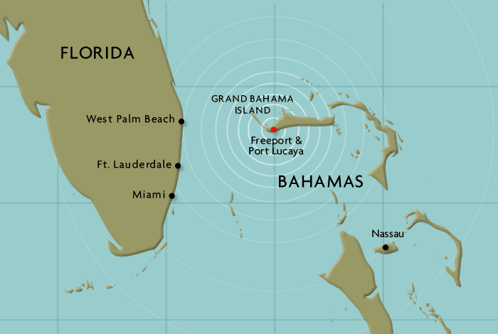
What is the risk of a natural hazard threatening you on Grand Bahama?

Slide 4
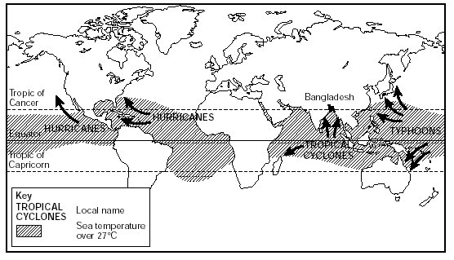
Map from memory: Location of tropical storms
23.5º N
Gulf of
Mexico
0º
Willi-willi’s
23.5º S
Madagascar

Slide 5
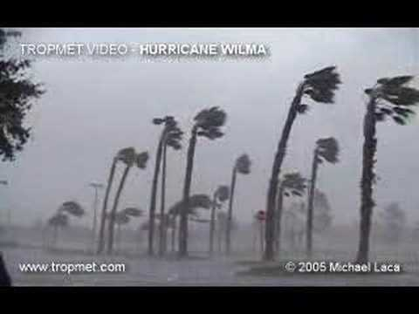
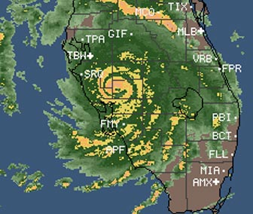
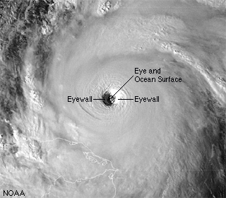
If a hurricane was to pass over you, what would it be like?

Slide 6
Website: L2 – Hazards and Risk
Complete the Interactive Map Activity and describe the global risk patterns for earthquakes and tropical cyclones
BREAK H\MWK: research…
Frequency
Distribution
Scale
of hurricanes, earthquakes or volcanic eruptions
Draw and record your research on the blank world map given to you in class. Include, title, key, scale, compass and 6 annotations

