Slide 1
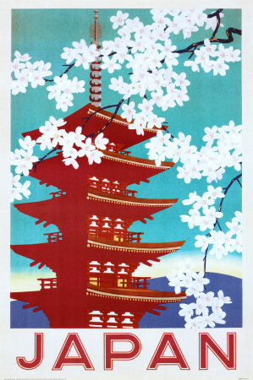
2011 Tōhoku Earthquake and Tsunami

Slide 2
Where did it happen?

Slide 3
Location
Earthquake (9.0 magnitude) was recorded in East Asia, in the Pacific Ocean.
Recorded near the east coast of Honshu, Japan
129 km away from Sendai, Japan
177km away from Fukushima and Yamagata
373 km away from Tokyo
Depth of only 32km
The tsunami was created by the earthquake
a huge wave (14 m) created
hit the coast of Honshu and flooded Japan

Slide 4
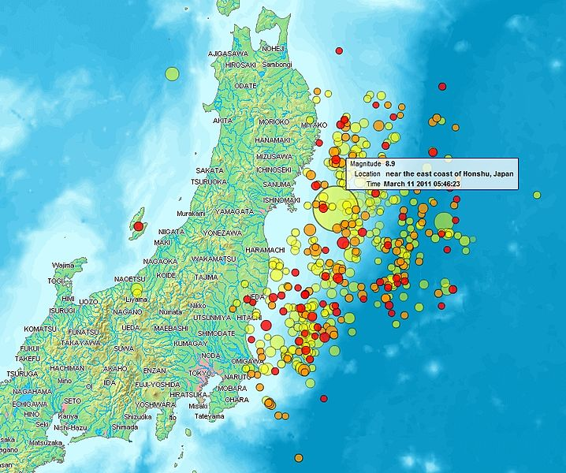
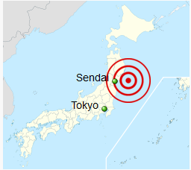

Slide 5
When did it happen?

Slide 6
The Earthquake
9.0 magnitude earthquake at 14:46 on the 11th of March 2011
The earthquake caused waves of up to 14 meters tall and some of them traveled 10km inland

Slide 7
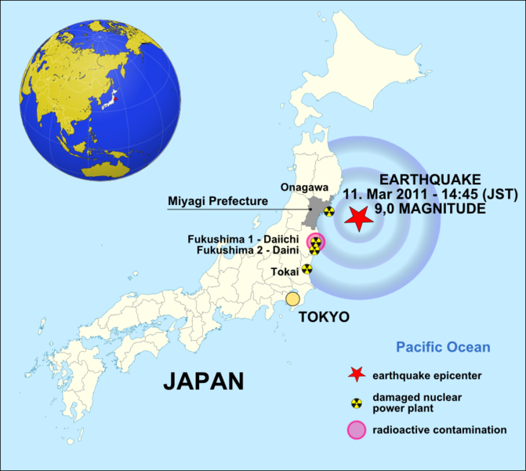

Slide 8
Timeline

Slide 9
Why did it happen?

Slide 10
Convection Currents

Slide 11
Subduction

Slide 12
The earthquake occurred where the Pacific Plate is subducting under the plate beneath northern Honshu (which moves at about 8-9 cm per year).

Slide 13
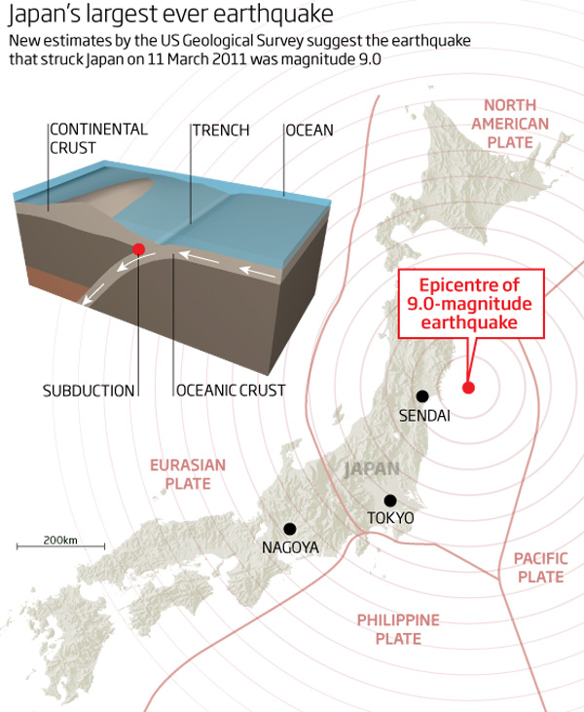

Slide 14
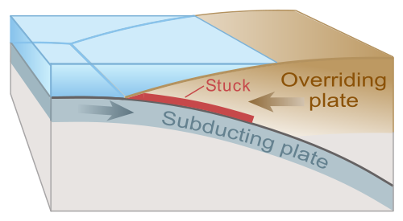
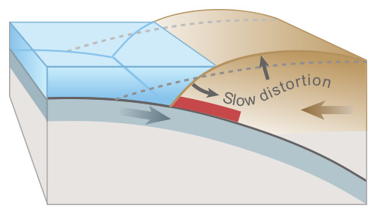
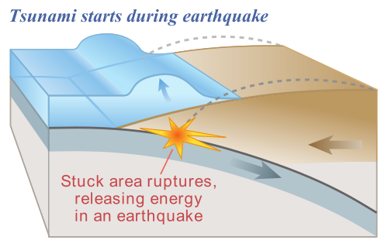
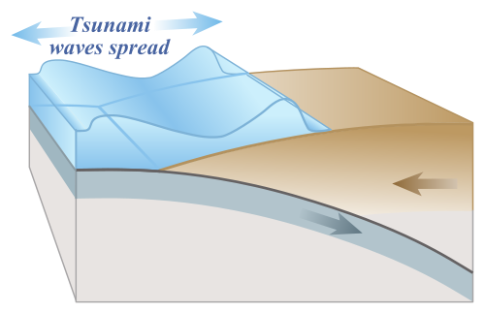

Slide 15
When the wave enters shallow water, it slows down and its amplitude (height) increases.

Slide 16
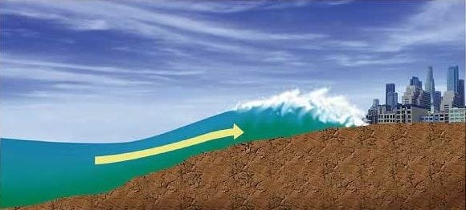

Slide 17
Why did it happen?

Slide 18
Nuclear Reactor at Fukushima
Why did it happen?

Slide 19
11th of March 2011
The plant is made up 6 different reactors
Prior to the earthquake, reactors 4,5 and 6 were shut down for
maintenance
The remaining reactors were shut down automatically as a
safety measure after the earthquake
The subsequent 14m of tsunami waves, flooded the reactors
-This took out the backup generators to run the water pumps to
keep the reactors cool
The unfortunate occurrences at the Fukushima Nuclear Plant
was a series events where many safeguards were taken out
by the unexpected tsunami and earthquake

Slide 20
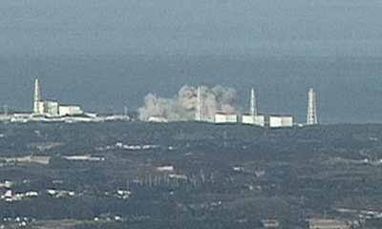

Slide 21
Inside the Plant
Partial core meltdown in reactors1, 2 and 3
Hydrogen explosions blew the capping and housing off reactors 1,3
and 4
An explosion destroyed the containment inside reactor 2
Multiple fires broke out in reactor 4
Spent fuel rods in spent fuel pools in reactors 1-4 began to overheat
as the water levels in the pools began to drop
Nuclear waste has seeped into the water system
20km around the plant was evacuated
-Nuclear cloud is expected to remain in East Asia and move across
the Pacific Ocean to the United states and Pacific Islands

Slide 22
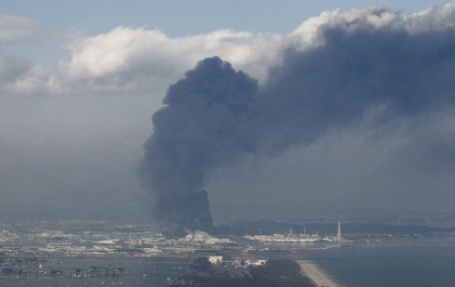

Slide 23
Who was affected by it happening?
What were the effects/consequences of the hazard event?
Categorize the effects/consequences as being [SEEP]:
Social
Economic
Environmental
Political

Slide 24
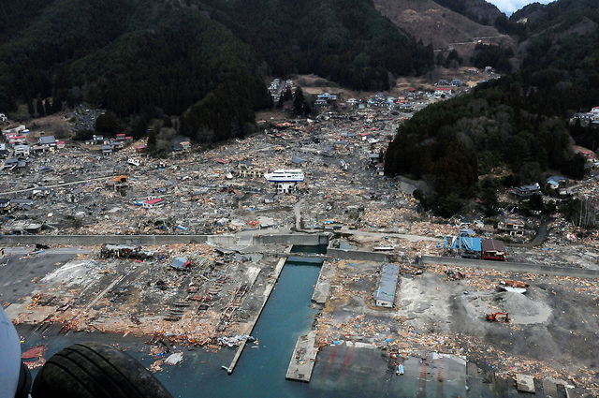
The Tohoku earthquake 11th March 2011 caused a massive tsunami that devastated the shores of Japan's Honshu island. It will take years to rebuild this region.

Slide 25
Aerial Footage of Sendai

Slide 26
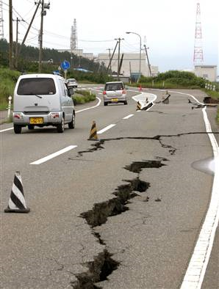
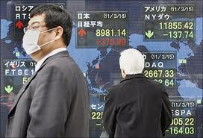
ECONOMIC IMPACTS

Slide 27
Due to the tsunami, earthquake and a nuclear disaster, Japanese economy will face a great economic damage.
The 11 March disaster has been estimated by the government to reach 16-25 TRILLION YEN (316 billion dollars)!
This number excludes the losses of companies, as they were forced to SHUT DOWN. Several ‘’famous’’ industrial productions have been impacted, like Sony or Toyota Motor, these companies had to decrease their production, and sales. When the explosion of Fukushima occurred many people were concerned about the building of another power plant in a quake zone. The value of yen is at risk when banks will spend on reconstructions, the government will be forced to impose taxation which might cause inflation.

Slide 28
The insurance industry will be heavily hit with the costs. The loss of two nuclear power plants means the Tokyo region will face the summer peak demand with a loss of about 20% of capacity. The tsunami closed down the key ports Some airports shut down

Slide 29
Before and After

Slide 30
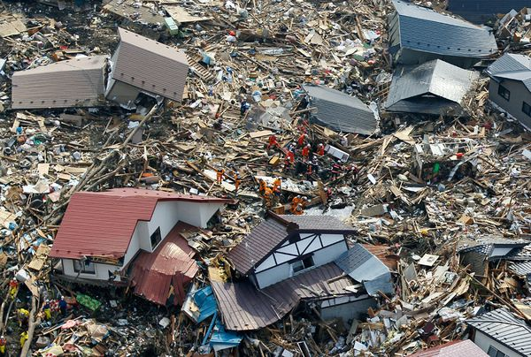
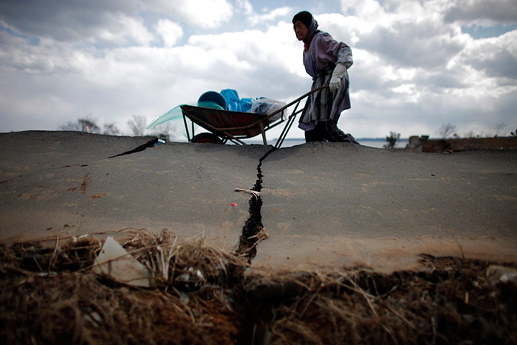
Social Effects
A humanitarian disaster, with more than 18,000 deaths
The region most directly affected by the earthquake and tsunami was relatively sparsely populated
Hundreds of thousands of people have been made homeless
Loss of property and personal items
An estimated 250,000 people are living in emergency shelters

Slide 31
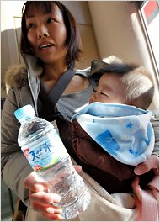
Social Effects
Food, water and fuel are in short supply
People are unable to work
Much of the country is experiencing rolling blackouts due to the loss of the electricity from the damaged nuclear plants
Abnormal radiation levels reported in tap water, vegetables and milk with concerns that fish may also be affected
About 6,000 residents of a village near the plant have been told not to drink tap water
A ban has been imposed on shipments of milk, spinach, and kakina – a leafy vegetable – produced in the area

Slide 32
Social Effects
Government officials missing
Towns have to rebuild without their leaders
Town halls destroyed
Rebuilding after devastation on such a grand scale is difficult for all people
People are struggling to envisage a future in their towns

Slide 33
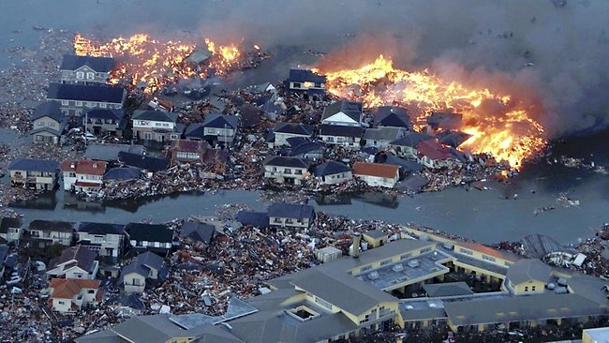
Environmental Effects

Slide 34
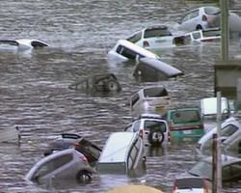
Environmental Effects:
- Drinking water contanimated due to the powerplant explosion and release of radioactive matieral.
- The air now contains radioactive material which can cause cancerous diseases such as thyroid cancer.
- Due to structural damages, the risk of fires and gas leakages increases.
- The Tsunami carried a lot of material from land into the ocean which increases the water pollution and harms fish and other sea animals.
- Trees and other vegatation were lost after the earthquake and the tsunami.
- Radiation and fires destroy crops and other plants.
- The release of radiation and other gases interrupts the natural ecosystems.
- Food affected by the radioactive material causing shortages of food and plants and animals can't be used for food anymore.

Slide 35
What happened?
Describe the management of the hazard event - before, during and after?
Planning, preparation, prediction, hazard mapping, evacuation, warnings.
Help with recovery, aid - local, regional and international, role of NGOs.

Slide 36
No country is more prepared for earthquakes than Japan…

Slide 37
Describe the management of the hazard event - before, during and after?
Earthquake
Before
Early warning systems using seismographs were put in place in order to warn the population within Tokyo about an oncoming earthquake
Emergency services are subjected to simulations of what to do during an earthquake in order to get them ready for an actual earthquake allowing for efficient and swift action to help the injured and to prevent additional losses.
People are given free tutorials in order to inform them on what to do in order to protect themselves during an earthquake

Slide 38
During
Warning systems are active causing a chain reaction with the Japanese population who took measures to protect themselves under table and away from any heavy objects that may fall causing injury.
After
Shelter's are set up in order to provide a location for those who have lost their homes because the infrastructure was not sound enough to withstand the magnitude of a high Richter Scale earthquake.

Slide 39
Continued
- After
- The tsunami happened where around 10,000 people
have died and up to 10,000 people are missing.
-A number of people have died due to radiation poisoning
after a nuclear power plant explosion where over 1,700
people have died.
-215,000 people are in emergency shelters.
-Around 50,000 rescuers have been deployed.
-Six fires occurred in Tokyo after the earthquake.

Slide 40
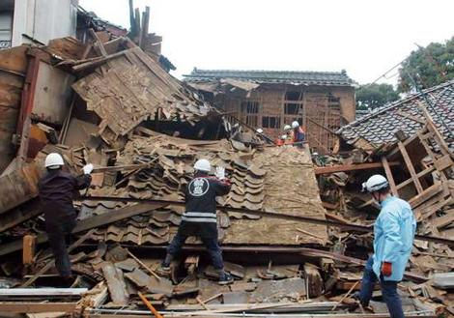

Slide 41
What were the mitigation strategies?

Slide 42
One minute before the effects of the earthquake hit Japan, the Earthquake Early Warning system sent out warnings on television warning the people of Japan.
This early warnings saved many lives.
Tsunami warnings were issued in at least 20 other countries as well.

Slide 43
Warning Service – reading the signals
An effective warning system requires continuous monitoring of our planet; on local, regional and global scales. Several global infrastructures serves various nations needs depending on their particular natural hazards challenges. A multitude of instruments picks up a vast number of signals like crustal movements, sea level changes, seismic waves etc.

Slide 44
In the case of an event (earthquake) the seismic signals are immediately recorded and used to make the first estimates of where (location) the earthquake takes place and it's size (magnitude). However, in cases where the earthquakes are so big as the Tohoku earthquake (9.0), the seismic techniques are not quick enough to produce correct estimates of the magnitudes which in turn provides the basis for tsunami warnings with times of arrival, sea level and inundation maps.

Slide 45
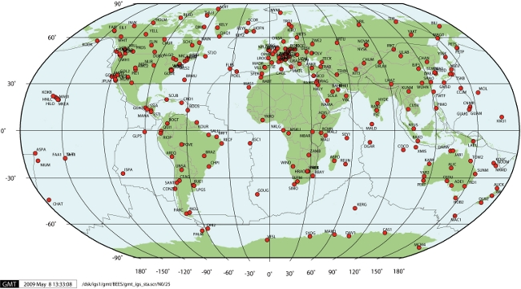
The international GNSS (Global Navigation Satellite System) stations, which consist of GPS stations from countries all over the world, form the basis for monitoring crustal movements.

Slide 46
Early Warning and Mitigation
The UN International Strategy for Disaster Reduction (UNISDR) has defined what an early warning system is.
In general terms an early warning is the provision of timely and effective information that allows individuals exposed to a hazard to take action to avoid or reduce their risk and prepare for effective response.
An early warning system therefore consist of the following 4 elements:

Slide 47
Earthquake Early Warnings
The Japan Meteorological Agency (JMA) provides residents in Japan with Earthquake Early Warnings. This is a new system that issues prompt alerts just as an earthquake starts, providing valuable seconds for people to protect themselves before strong tremors arrive.

Slide 48
When an earthquake occurs, JMA immediately issues information on its hypocenter, magnitude and observed seismic intensity. If the seismic intensity is 3 or greater, the Agency issues a Seismic Intensity Information report within one and a half minutes. The information is provided to disaster prevention authorities via dedicated lines, and reaches the public through local governments and the media. This information also plays a vital role as a trigger for the initiation of rescue and relief operations related to earthquake disasters.

Slide 49
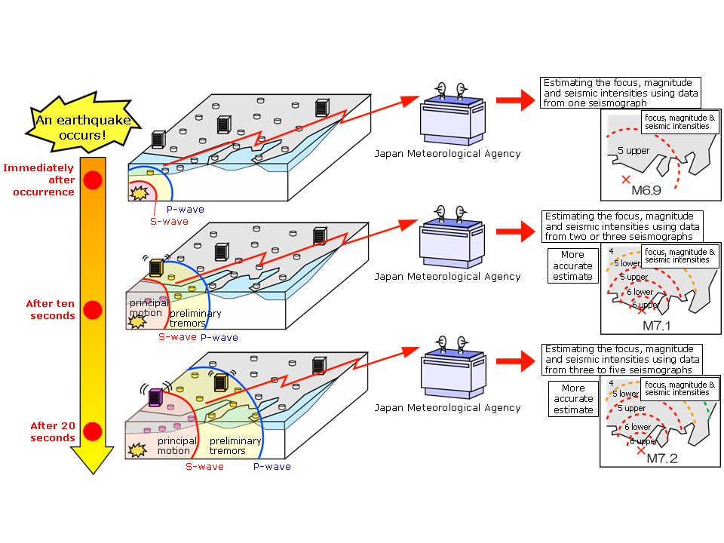
The Earthquake Early Warning system provides advance announcement of the estimated seismic intensities and expected arrival time of principal motion.

Slide 50
Earthquake Early Warning Announcement

Slide 51
How It Works

Slide 52
How It Works 2

Slide 53
Earthquake Early Warning Video

Slide 54
Tohoku Earthquake
1 minute
prior to the effects of the earthquake being felt in Tokyo, the earthquake Earthquake Early Warning system connected to more than 1000 seismometers in Japan sent out warnings on television of an impending earthquake to millions.
This was possible because the damaging seismic S-waves, travelling at 4 kilometers per second, took about 90 seconds to travel the 373 km to Tokyo. The early warning is believed by the Japan Meteorological Agency to have saved many lives.

Slide 56
Tsunami Warnings To reduce and mitigate catastrophic losses caused by tsunamis, immediate provision of tsunami information for coastal regions is essential. When an earthquake occurs, JMA estimates the possibility of tsunami generation from seismic observation data. If a damaging tsunami is expected in coastal regions, JMA issues a Tsunami Warning/Advisory for each region within around two to three minutes of the quake. If tsunamis are generated by seismic events far from Japan, the Agency engages in coordinated action with the Pacific Tsunami Warning Center (PTWC) in Hawaii and issues warnings for long-propagating tsunamis.

Slide 57
Timing The window of time from the announcement of an Earthquake Early Warning until the arrival of the main tremors is very short, i.e. a matter of seconds (or between several seconds and a few tens of seconds). In areas that are close to the focus of the earthquake, the warning may not be transmitted before strong tremors hit.
False alarms When using data from only one seismograph, false Earthquake Early Warnings may occur as a result of noise from accidents, lightning or device failure. Magnitude estimation There are limits to the accuracy of estimating magnitude, especially for large earthquakes.
It is difficult to separate earthquakes and provide accurate warnings when multiple earthquakes occur almost simultaneously or in close proximity to each other.

Slide 58
Tsunami Detection Buoy

Slide 59
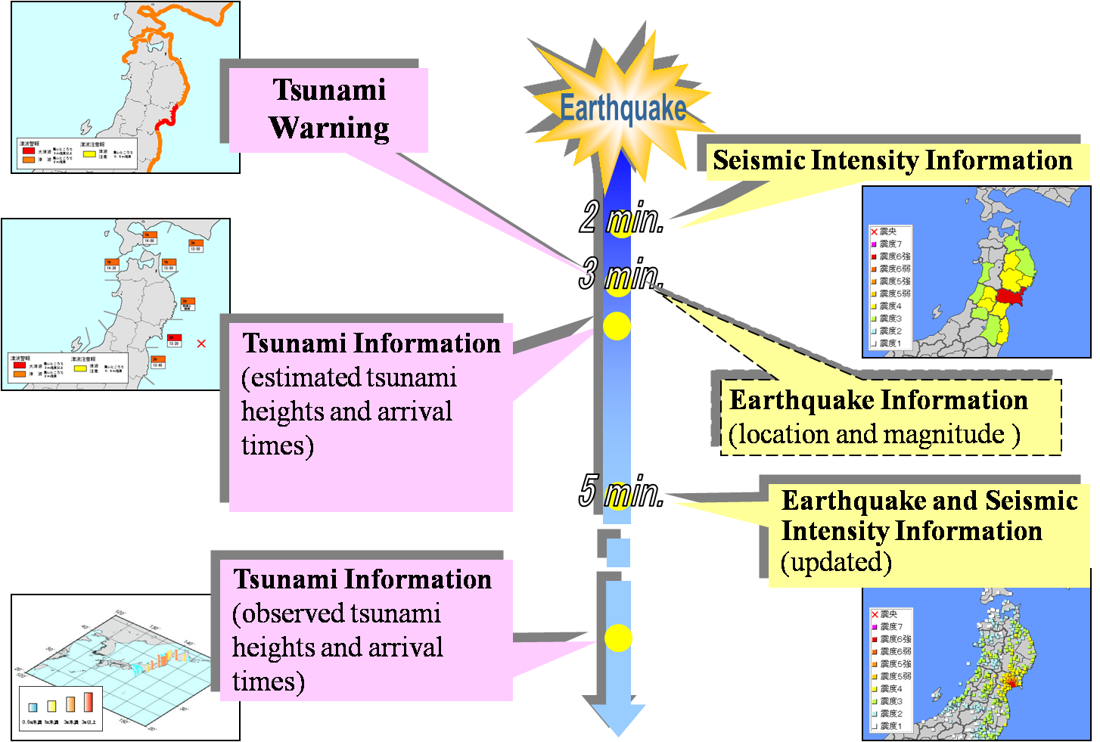

Slide 60
Activities of Aftershock
The activities of aftershocks of "The 2011 off the Pacific coast of Tohoku Earthquake" has been very active.
As of 12:00 JST, 16 March, the aftershocks larger than magnitude 7.0 occurred 3 times, and those larger than 6.0 occurred 48 times.
Notes on Disaster Prevention
In the area where strong shaking was observed, keep vigilant to tremors by aftershocks which may cause landslides and house collapses.
Many places could be dangerous after tsunami and earthquakes. Be cautious and ensure adequate safety on your way back from the evacuation center, by following instructions and directions of the local emergency officers.
Stay away from coasts when tsunami warnings/advisories are issued.

Slide 61
AID In the beginning Japan only wanted aid from its neighbours, like sniffing dogs from South Korea.
Response to Japan's earthquake has now come from more than 90 nations. Nations struggling to meet their own needs, such as Afghanistan, Sri Lanka and North Korea have sent money for emergency supplies.

Slide 62
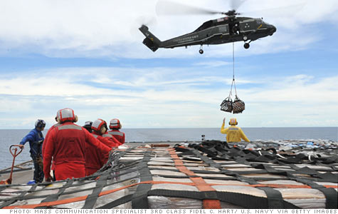
Donations to Japan lag far behind Haiti or Katrina

Slide 63
Japan, with the world's third largest economy, has significant disaster, health and safety infrastructures. And, with the largest mobilization of its highly trained military since World War II, the nation has rolled out its own massive rescue effort.
But the enormous scope of the still-unfolding tragedy — and the looming specter of possible nuclear disaster — means that the country will need help, some now and more eventually, officials say. But it should be up to the Japanese, they say, to decide what is needed and when. And cash provides the greatest flexibility for filling needs as they are identified. "The most important thing to remember: The government of Japan is still trying to learn what it needs."

Slide 64
Japan Aid

