Slide 1
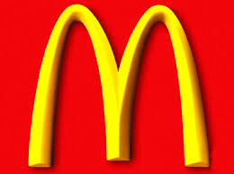
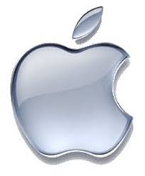
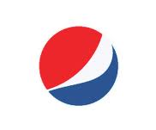
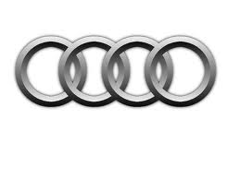
From the symbols below, decide what “TNC”
stands for…
Today’s Title:
“Trans-National Corporations”

Slide 2
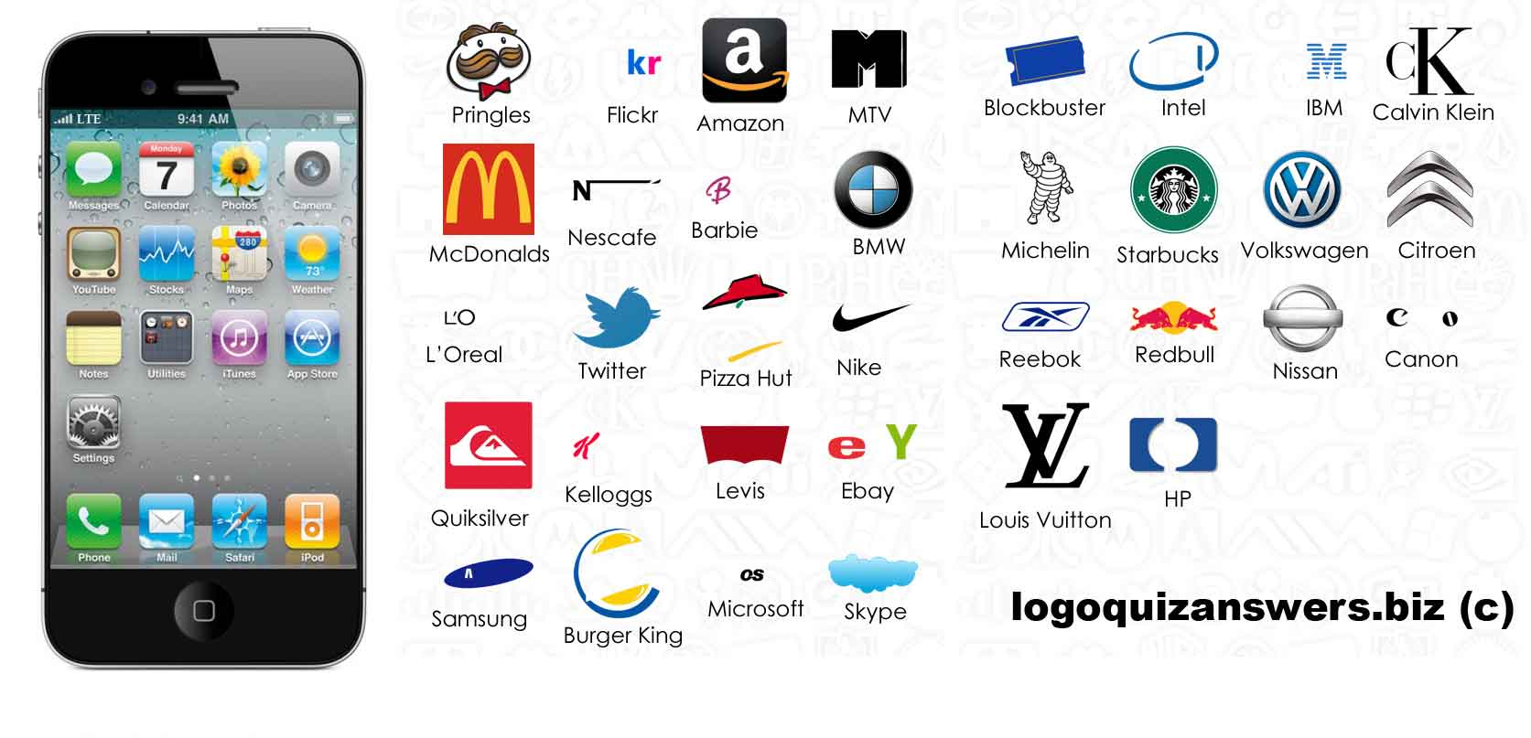
How many brands can you name?

Slide 3
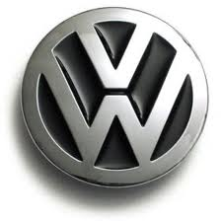
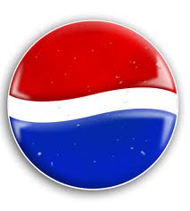
Globalisation is driven by TNC’s
A TNC is a business owned by one country but with factories and stores in many different countries

Slide 4
A TNC is a global ______________ which is recognised all over the world.
TNC’s have helped __________________to take place.
They often have _______________ in an HIC and ___________________ in LIC’s.
It does this so it can make goods for a ____________ price.
This means that ____________ like you and I can buy goods for a lower price. This makes ________ happy.
consumers corporation factories headquarters cheaper brand
globalization consumers

Slide 5
1. How much ‘power’ do TNC’s have? 2. Where can power come from?
Which is more powerful – governments or TNCs??
Is McDonalds more powerful than the Bahamian government?
This is the GDP of the Bahamas - $22.31 billion (2014)
Go To the Website: New Heading: Globalization & Trade
Click on the Link: “McDonald’s vs. Bahamas”
Answer the Question Above and Choose An Example from the website to Record in Your Book.

Slide 6
Choose your own TNC….
Do some research and present your information as creatively as you can!
Information:
Symbol or brand
Who is in charge? What do they make or what service do they offer? Where is the HQ? Where are the factories? Do they have any famous people who advertise their products? GDP compared to Bahamas? Perhaps a map may be useful?

