Slide 1
Inequality: What does it feel like?
What does it look like?

Slide 2
China’s Growing Income Inequality
How does a growing economy, fewer people, and a rural population contribute to a concentration of wealth?

Slide 3
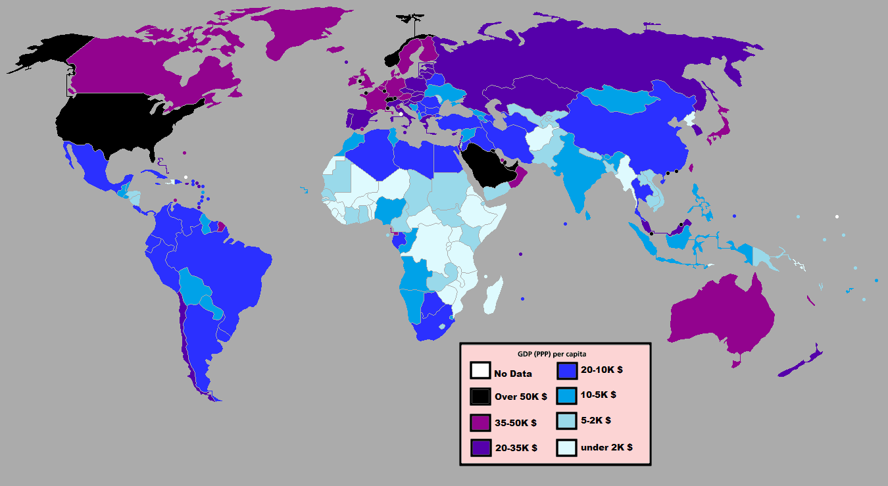
Per Capita Income:
Also known as “income per person” – calculate by taking the total income of a country and dividing it by the population.

Slide 4
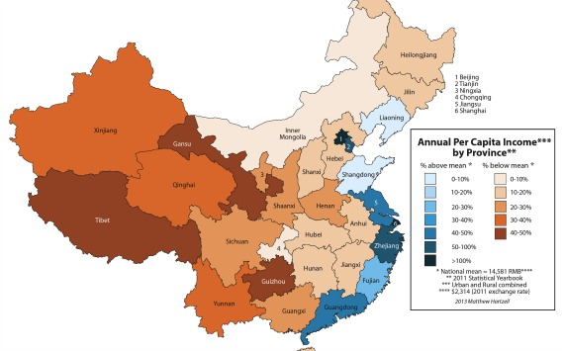

Slide 5
China has growing income inequality:
As the whole country gets richer, “wealth” is concentrated in the hands of only some.
In China, this “wealth” is concentrating along the cities closest to the oceans and rivers
Industry tends to form along the water because it is easier to ship goods to other places. In China this is important because they make and ship a large amount of exports

