Slide 1
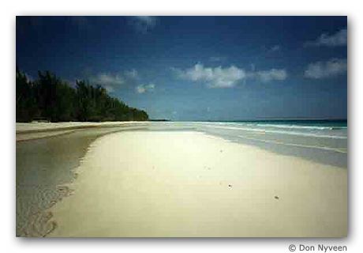
Identify the following factors which affect the incidence of tourism…

Slide 2
Factors affecting tourism?
Natural Landscape to visit – mountains, beaches , rivers, etc Climate – hot and sunny or ski areas Vegetation and wildlife – coral reefs, mangroves, rainforest, deserts | Economic Exchange rates Employment – multiplier effect Affluence – disposable income
Political Instability eg. 9/11 attacks reduced plane travel. Government coup in thailand 1992 reduced visitors by 30% | Social Culture – language, customs food, architecture, wine, clothing etc. Age of tourists Transport Hosting sports event eg. world Cup Religious Sites

Slide 3
Tourism is also affected by the resources available:
Primary Resources:
Natural Resources (landscapes, climate)
Cultural Resources (heritage, arts)
Social Resources (financial capital, health)
Secondary Resources:
Accommodations, Catering, Travel Organization, Transportation, Entertainment, Information

Slide 4
For a tourism to be successful it must have Primary and Secondary resources
Shocks (long or short term):
A tourist destination may also have negative factors which deter tourists. These are called tourism shocks
Trends:
Tourism is also subject to changes in fashion - places and activities are popular and then become less fashionable. The current trend in fashion is away from mass tourism (crowded beaches, sun, sea and sand) to niche tourism offering new and different experiences on a smaller and often more sustainable style.

Slide 5
Choose one tourist hotspot in the world
Identify and describe one of each factor:
Natural
Economic
Political
Social
Describe two specific resources in each caetgory:
Primary
Secondary

