Slide 1
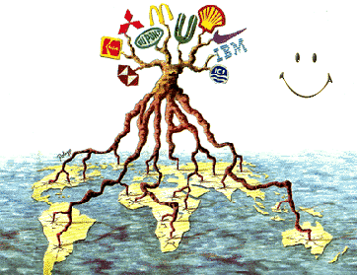
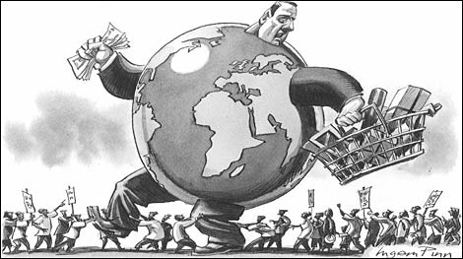
Aim: To define and measure globalisation

Slide 2
Global interactions
Measuring global Interactions
Changing space— the shrinking world
Economic interactions and flows
Environmental Change
Sociocultural Exchanges
Political outcomes
Global interactions at the local level

Slide 3
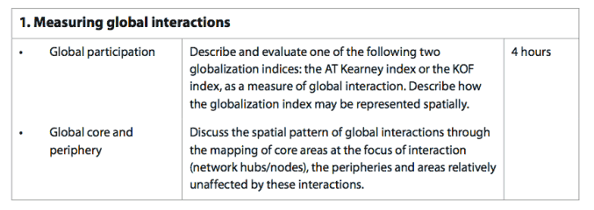

Slide 4
Define globalisation…….
On the mini whiteboard – try to represent your definition of globalisation – a definition or pictures…..
The growing interdependence of countries worldwide through the increasing volume and variety of cross‑border transactions in goods and services and of international capital flows, and through the more rapid and widespread diffusion of technology
LEARN THIS

Slide 5
How can we measure globalisation?
Ideas????
How can we measure which person in the room is the most globalised?
How could we compare the globalisation of the Bahamas to other places?

Slide 6
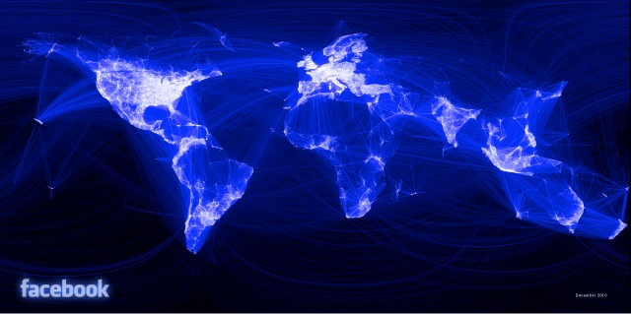
Facebook interactions

Slide 7
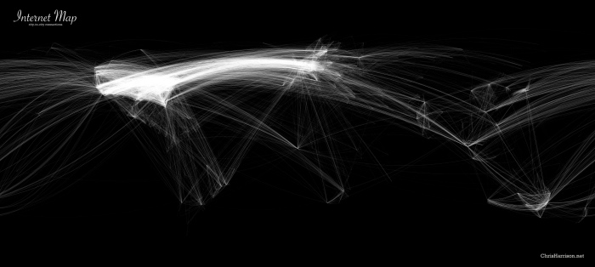

Slide 8


Slide 9


Slide 10
We will use one method of measuring globalisation
Predict – top 5 and bottom 5

Slide 11
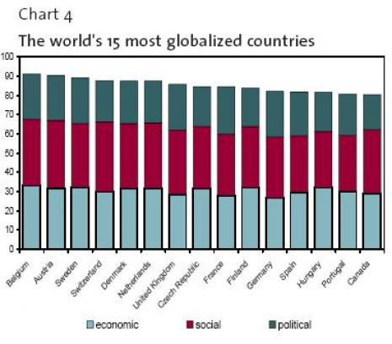
KOF index of globalisation
http://en.wikipedia.org/wiki/Globalization_Index

Slide 12
How is the KOF index measured?
100% is highest
Economic globalisation
(38% of total)
Political globalisation
(23%)
Social globalisation
(39%)

Slide 13
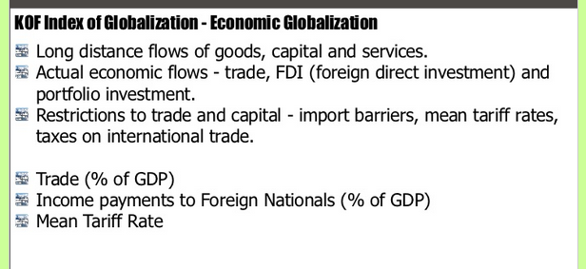
Economic ?

Slide 14
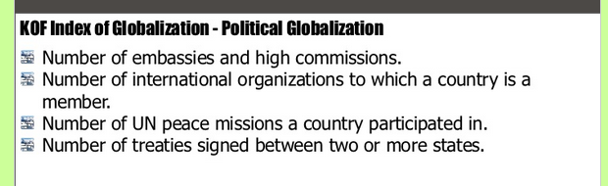
Political ?

Slide 15
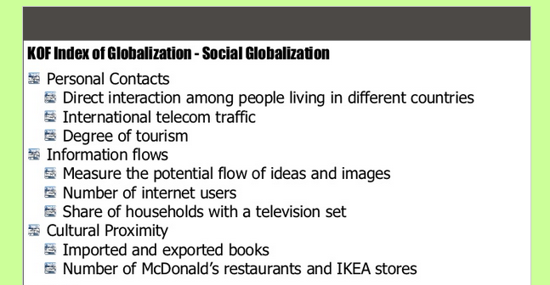
Social ?

Slide 16
Task
Use the book page 317-319 to write a bit more detail about what statistics are measured for Economic, political and social globalisation

Slide 17

Good points/ bad points of KOF index
Good points
Data from 1970 for 158 countries – large data set for analysis
The results are measurable - comparisons can be made between countries
Includes a variety of data including culture
Method of calculation has developed over time to take into account new technologies in ICT eg. Internet users per 1000 people
Bad points
Large variations within a country eg urban and rural areas in Sub Saharan Africa
According to the 2009 data, Belgium is the world's most globalised country although it is not on the top of any of the three dimensions
Political factors have a lower weighting and yet government policy may be the biggest factor in determining level of globalisation.
US companies dominate in the cultural proximity category eg. Number of McDonalds
Do some of the measures really measure globalisation eg. Possession of TV set or participation in UN war?

Slide 18
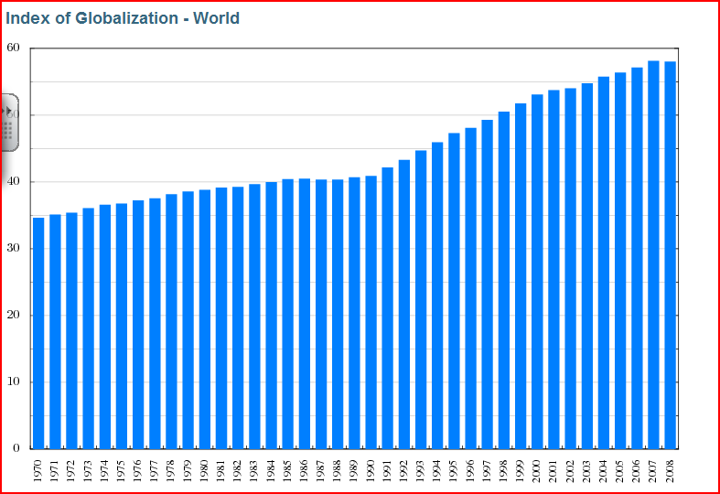
Trend of globalisation
Describe the trend shown by this graph

Slide 19
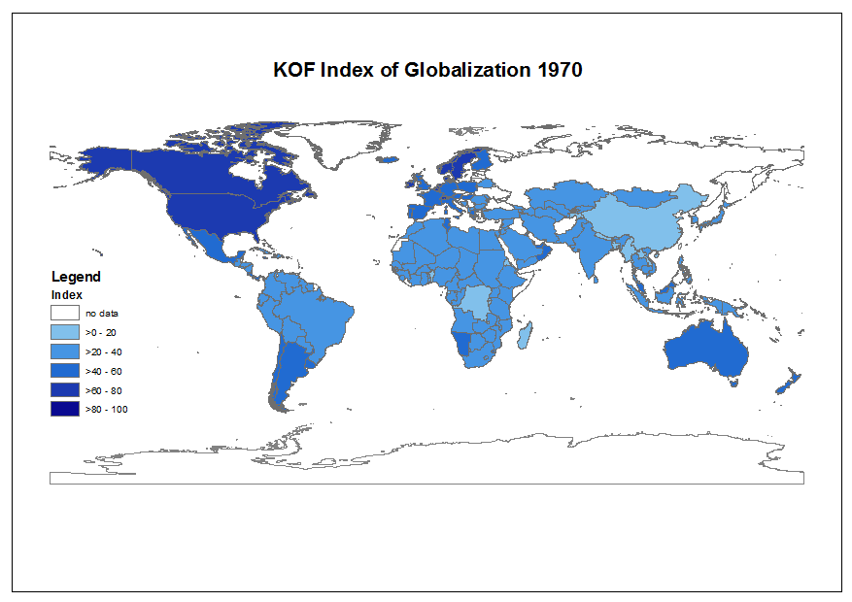

Slide 20
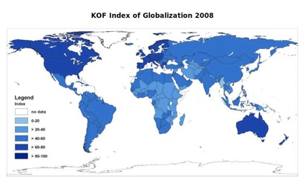

Can you identify CORE areas and PERIPHERY areas? Within the core areas can you identify key cities?

Slide 21
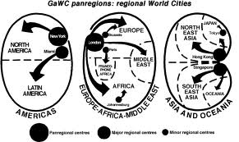
Using page320
1. Define Core areas, periphery areas and semi periphery areas
2. What are the core primary cities?
The global economy has changed from being INTERNATIONAL to GLOBAL. Explain what this means.
Define World City - What features do they have in common?

