Slide 1
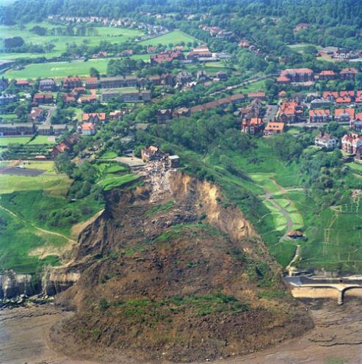

Slide 2
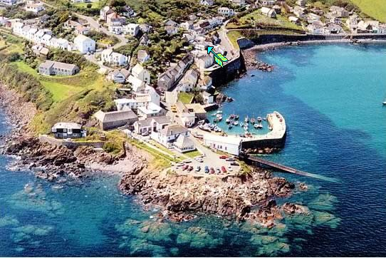
NEW UNIT: COASTAL ENVIRONMENTS Factors Affecting the Coastline

Slide 3
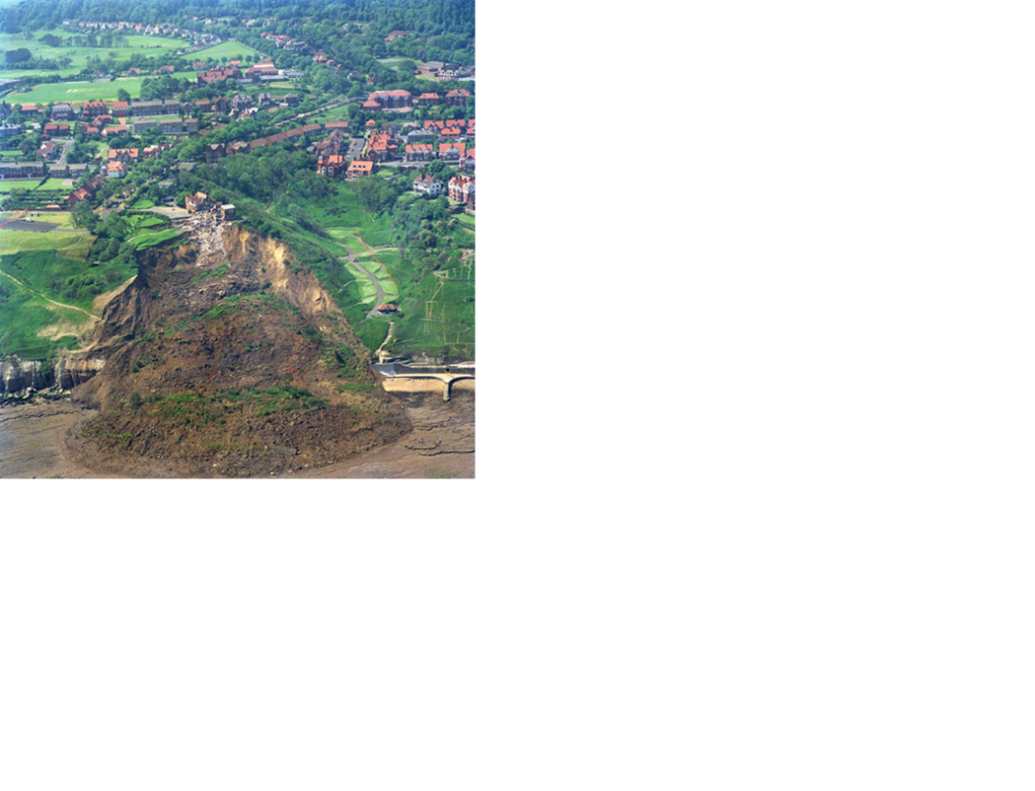
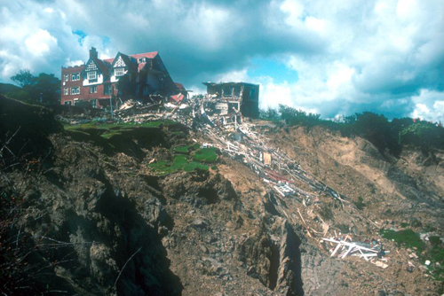
WHY DID HOLBECK HALL FALL INTO THE SEA??
From the 3-5th of June 1993, the Holbeck Hall Hotel fell from a cliff in a landslide into the open ocean. Over 70 metres of the cliff was removed and over 1 million tonnes of dirt was involved in the landslide….. How did this happen??

Slide 4
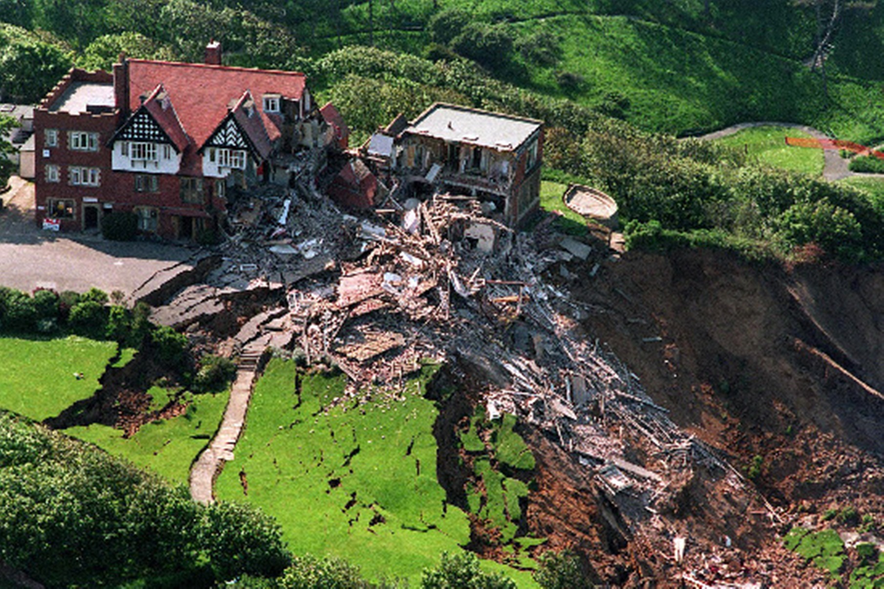
You have been called to the scene by the city council who is being sued by the owners of Holbeck Hall for damages for not preventing the landslide.
You are to investigate the occurrence and decide whether the city should settle with the owners or go ahead with the lawsuit and meet them in court.

Slide 5
Before collecting evidence record and remember the difference between CAUSE and EFFECT:
CAUSE: the person or thing that leads to an action
EFFECT: the result of that action
YOU are trying to determine THE CAUSE of the landslide and who is at fault…

Slide 6
SORT the statements into groups of similar information
Create LINKS between statements that go together to try and explain why something happened
Produce a MIND MAP to show the reasons why Holbeck Hall fell into the sea
Write a CLEAR CONCLUSION (short paragraph) on your findings and decide whether the city should SETTLE (because they were at fault) or GO TO COURT

Slide 7
Factors affecting the coastline

Slide 8
LAND
Physical processes
Geology and relief
River sediment
Ecosystems
SEA
Physical processes (waves)
Changes in sea level
Water depth
ecosystems
Factors affecting the coastline
HUMAN ACTIVITY
Settlement (where people live)
Development
Coastal management
WEATHER AND CLIMATE
Wind strength and direction
Rainfall and temperature
Storms and surges
Climate change
Referring to each of these 4 areas, what factors affect the coastline of Grand Bahama?

