Slide 1
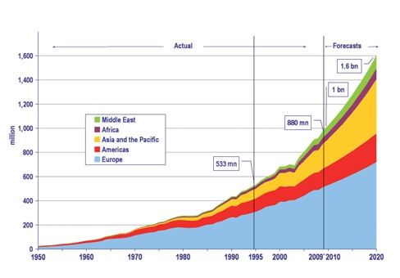
Task 1
Describe the trends in tourism over time
Describe the current pattern shown by the graph
Which area is expected to grow the most in future? WHY?
Notes:
1

Slide 2
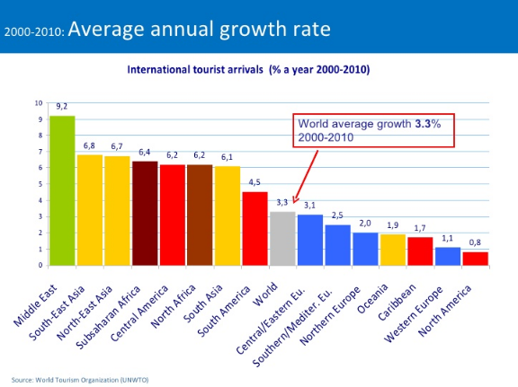
Describe the patterns in the growth of tourism over space

Slide 3
Growth of Tourism Around the World
Most travelers are from ?
China
The top destination in 2015 with 86.3 million tourist arrivals? (estimate)
France
Country that earns most money from tourism?
USA – 50 billion dollars! (1.44 trillion worldwide)
Over _________ % of tourists are from just 20 countries (mostly in located in the northern hemisphere)
80%
Fastest growth in tourism is in ___________ at 97% per 2015 year (followed by South Korea, Moldova, Kiribati)
Notes:
3

Slide 4
In 2014, arrivals increased worldwide from 2013…
181 million international tourist arrivals to the Americas, an increase of 8.0% over 2013
over 51 million international tourist arrivals to the Middle East, an increase of 5.0% over 2013
55.7 million international tourist arrivals to Africa, an increase of 5.4% over 2013
around 263.0 million international tourist arrivals to Asia and the Pacific, an increase of 5.0% over 2013.
over 582 million international tourist arrivals to Europe, an increase of 3.0% over 2013
Rank them!!

Slide 5
If you had to guess the top ten countries with the most tourist arrivals in 2016?

Slide 6
France
United States
Spain
China
Italy
Turkey
Germany
UK
Mexico
Russia

Slide 7
If you had to guess the top ten countries with tourist arrivals in 2004?

Slide 8
France Spain USA China Italy UK Russia Mexico Germany Austria

Slide 9
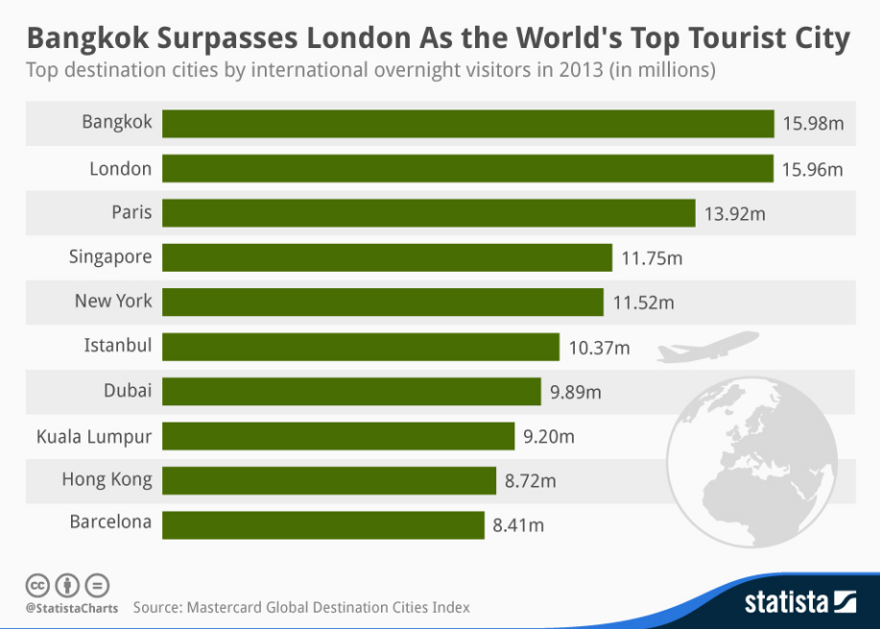
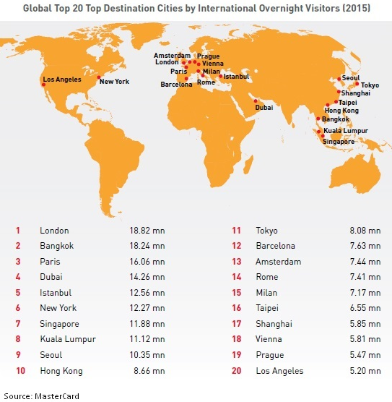
Top Tourist City?

Slide 10
Biggest Tourism Spenders?
China – 164.9
USA – 145.7
Germany – 106.6
UK – 79.9
France – 59.4
Russia – 55.4
Canada – 33.8
Australia – 31.9
Brazil – 10.0
Italy – 28.9
Followed by: Japan, Belgium, South Korea, Saudi Arabia, Singapore, Hong Kong, Netherlands, Switzerland, Norway, Sweden (p.222)

Slide 11
Tourism is already the world’s largest industry, The number of international tourists increased from 170 million in 1970 to 1087 million in 2014 to 1,235 in 2015.
Prediction: 2020 the global number of travelers will reach to 1.6 billion (an increase of 4.1% per annum) and the travelers will spend around US$ 2 trillion every year on tourism.
Notes:
11

Slide 12
What is sport?
What is leisure?
What is recreation?
What is tourism?
There are many difficulties in applying these definitions because they overlap – eg. someone may go swimming (leisure) whilst on holiday (tourism)

Slide 13
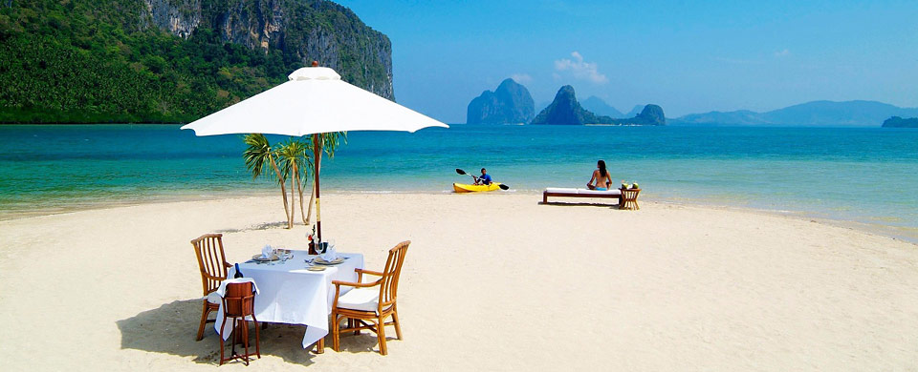
Leisure, Sport, Tourism, Recreation???

Slide 14
Sport: physical activity involving events/activities (with professional participants)
Leisure: any freely chosen activity or experience that takes place in non-work time.
Recreation: an activity undertaken voluntarily for enjoyment; includes organized outings, individual and team activities, non-paid sports
Tourism: travel away from home for at least one night for purpose of leisure (no day trips)

Slide 15
The Growth of Tourism

Slide 17
TOURISM in particular has experienced massive growth over the past 30 years…
Why such huge growth?

Slide 18
INCREASED DEMAND, ACCESS and SUPPLY:
Increased mobility of people
Increased accessibility (technology!)
Increased leisure time and paid holidays (High Income countries)
Affluence (increased disposable income)
Media coverage (creating attractions)
Organization (mass tourist industry by TNCs)
Infrastructural improvements at destinations particularly in LICs
Notes:
18

Slide 19
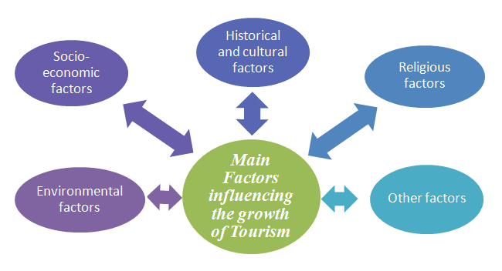

Slide 20
Cost, Duration, Destination
Watch “Why Has Global Tourism Increased’ (take notes)
Distinguish between ‘mass tourism’ and ‘niche tourism’ in your notes in a short paragraph (including the subcategories)
Create a table to describe the differences in definition, cost, duration and destination for one ecotourism location, one adventure tourism location and one silver tourism location (be specific)

