Slide 1
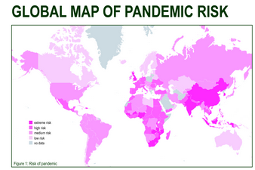
What is the pattern of risk from a global pandemic?
Can we explain these patterns?

Slide 2
Aim: To explain how the geographic concepts of diffusion by relocation and by expansion apply to the diffusion of diseases.
Diffusion: occurs when a disease is transmitted to a new location. Implies that the disease spreads / pours out from a central source…

Slide 3
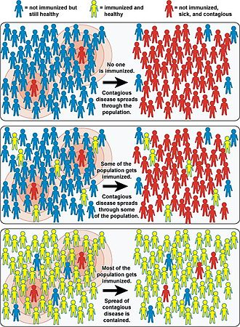
Herd Immunity: a form of indirect protection from infectious disease. When a large percentage of a population becomes immune to an infection… protecting those who are not immune

Slide 4
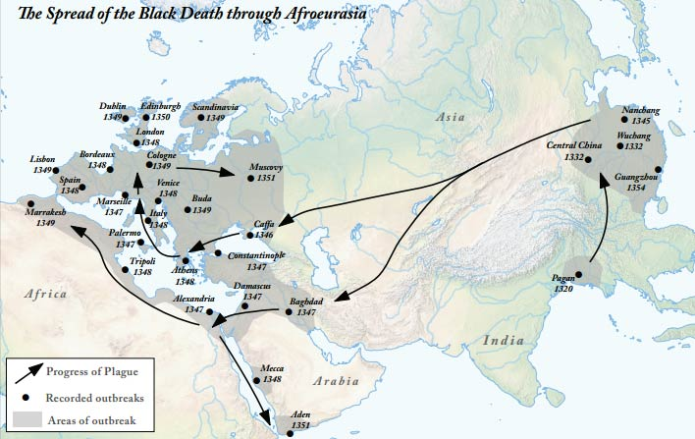
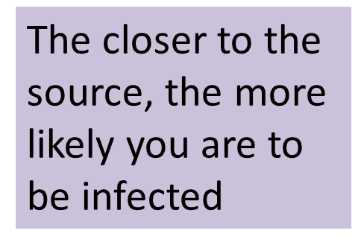
Diffusion by Expansion
Occurs when the expanding disease has a source and diffuses outwards into new areas

Slide 5
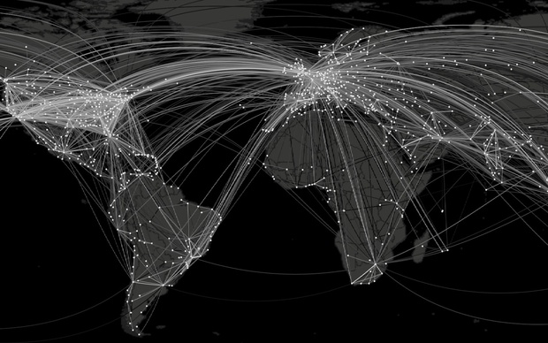
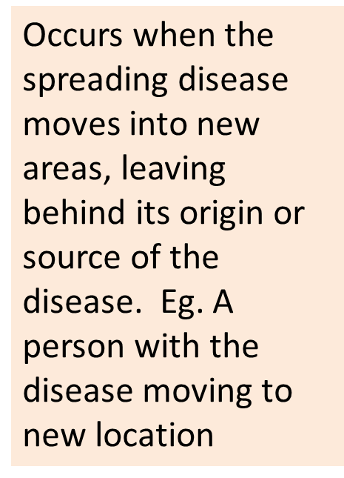
Diffusion by Relocation
Where are areas most AT RISK with this type of DIFFUSION?

Slide 6
Key points
High risk areas may be in both LIC and HIC’s
LIC- spread is easy due to poor medical/ sanitation services, lack of education and weakness in immune systems from malnutrition
HIC – May be a hub for international travel eg. London so a focus for disease transmission
Swine flu originated in Mexico. In 2009, more than 2 million people flew from Mexico to more than 1000 cities in 164 countries worldwide.

Slide 7
http://vax.herokuapp.com/
Simulation of disease spread – go on the tour then try the game!
What did you learn about disease from the game?

