Slide 1
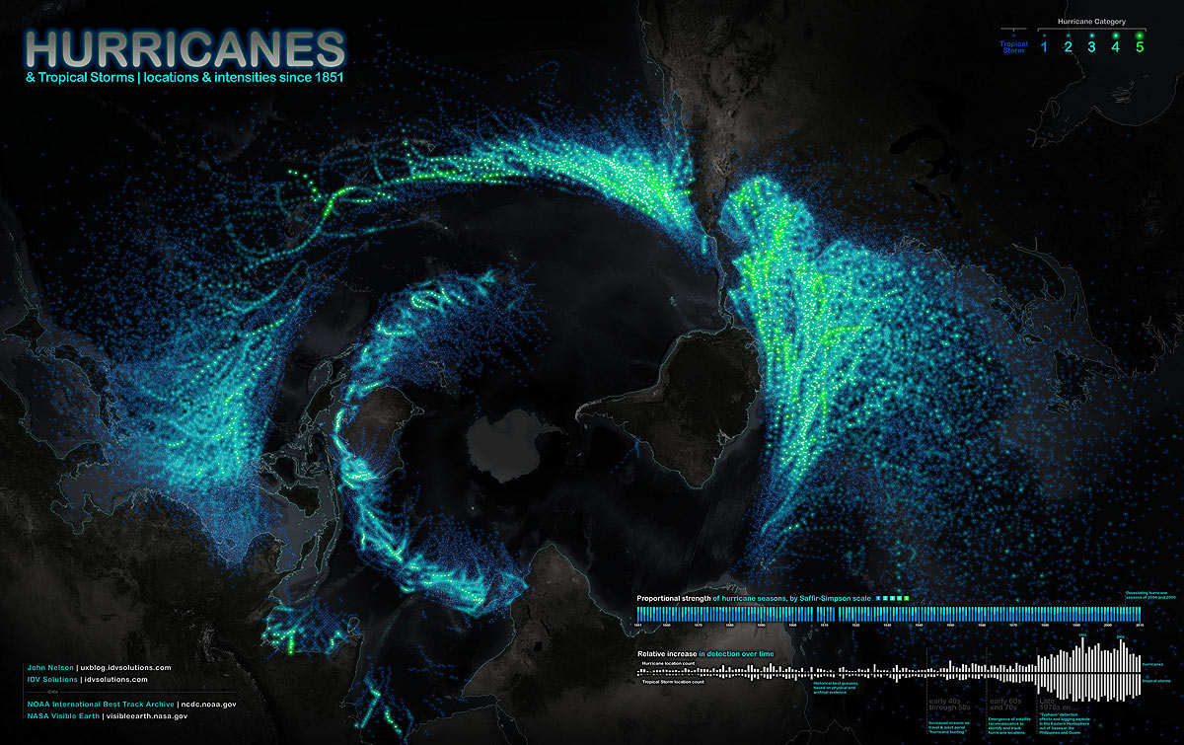

Slide 2
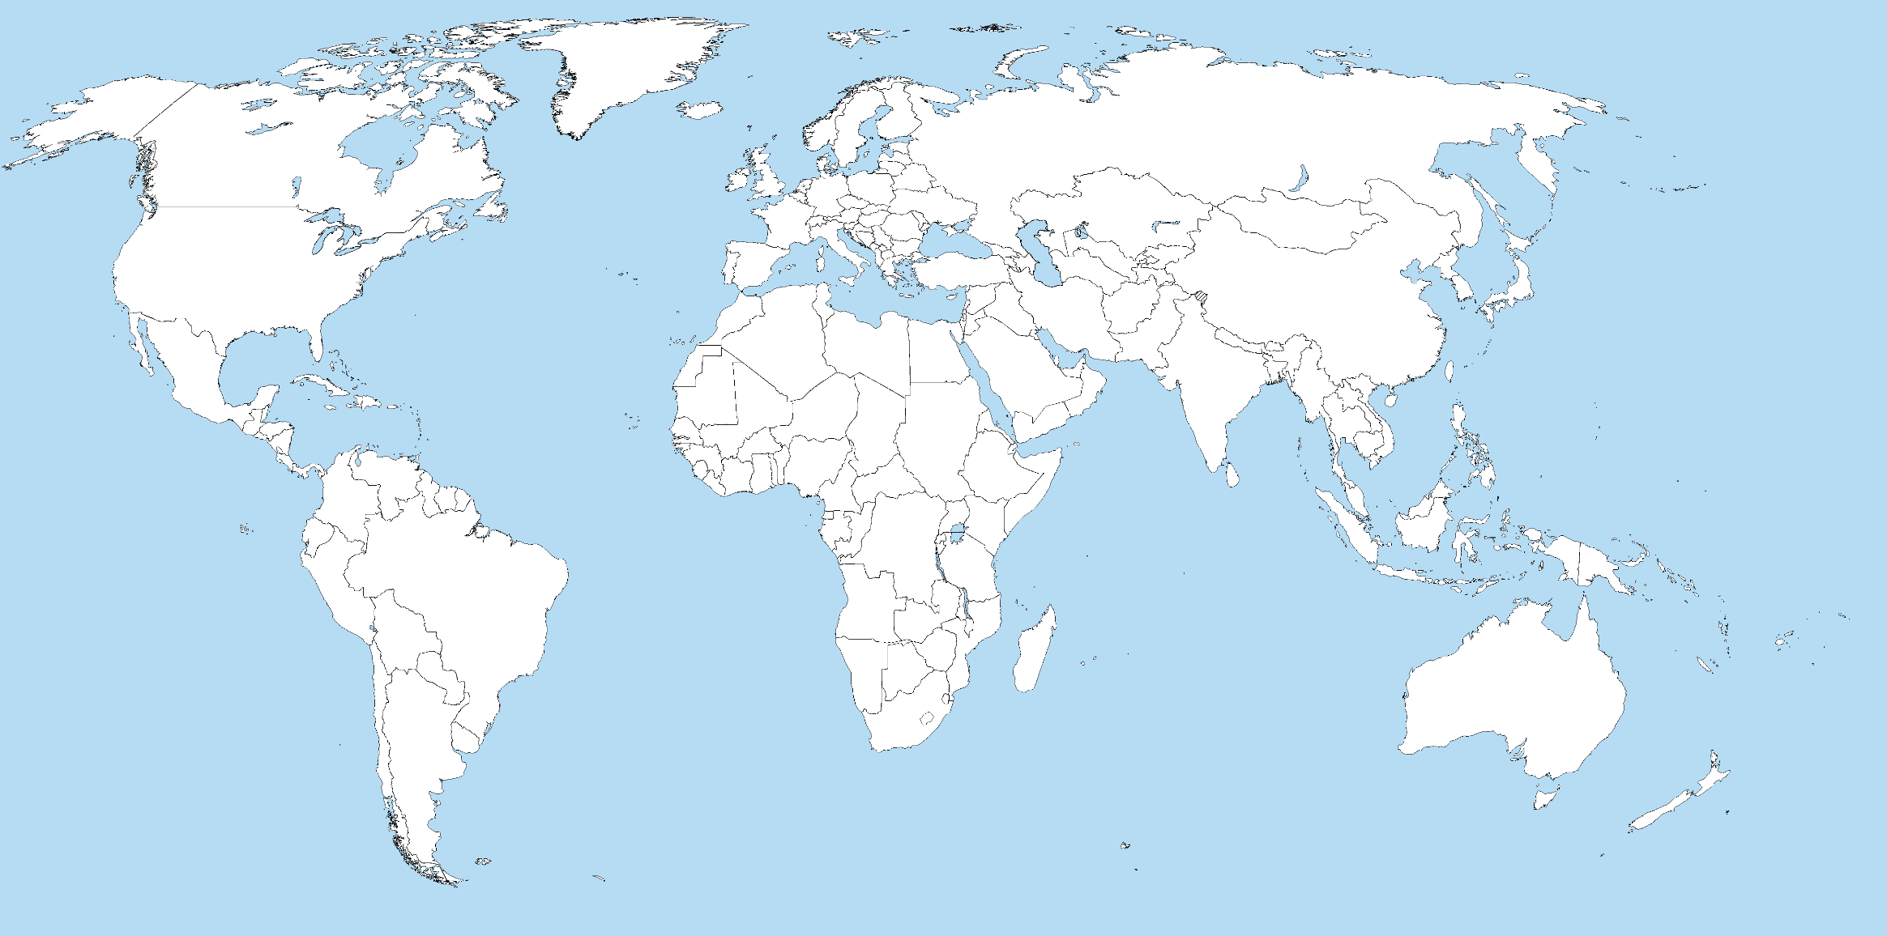
What does distribution mean?

Slide 3
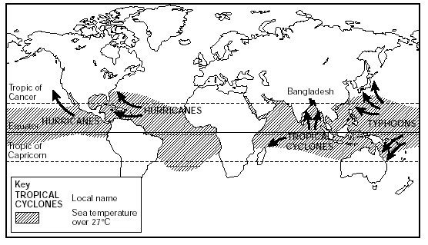
Map to show distribution of tropical revolving storms
Map from memory
Questions
1. What is the relationship between the tropic of Cancer and Capricorn and the location of tropical storms?
2. What is the difference between a typhoon, a hurricane and a cyclone?
3. Why do hurricanes occur between June and November?

Slide 4
Between the tropics: the “Intertropical Convergence Zone” where opposite trade winds of the North and South Hemispheres meet
There is no difference between typhoons, hurricanes and cyclones.
The water is warmer in the summer months, hurricanes need temps of 27’C or more to form…
Warm ocean water adds moisture and heat to rising air, which then condenses forming more clouds and rain, releasing more heat/air

Slide 5
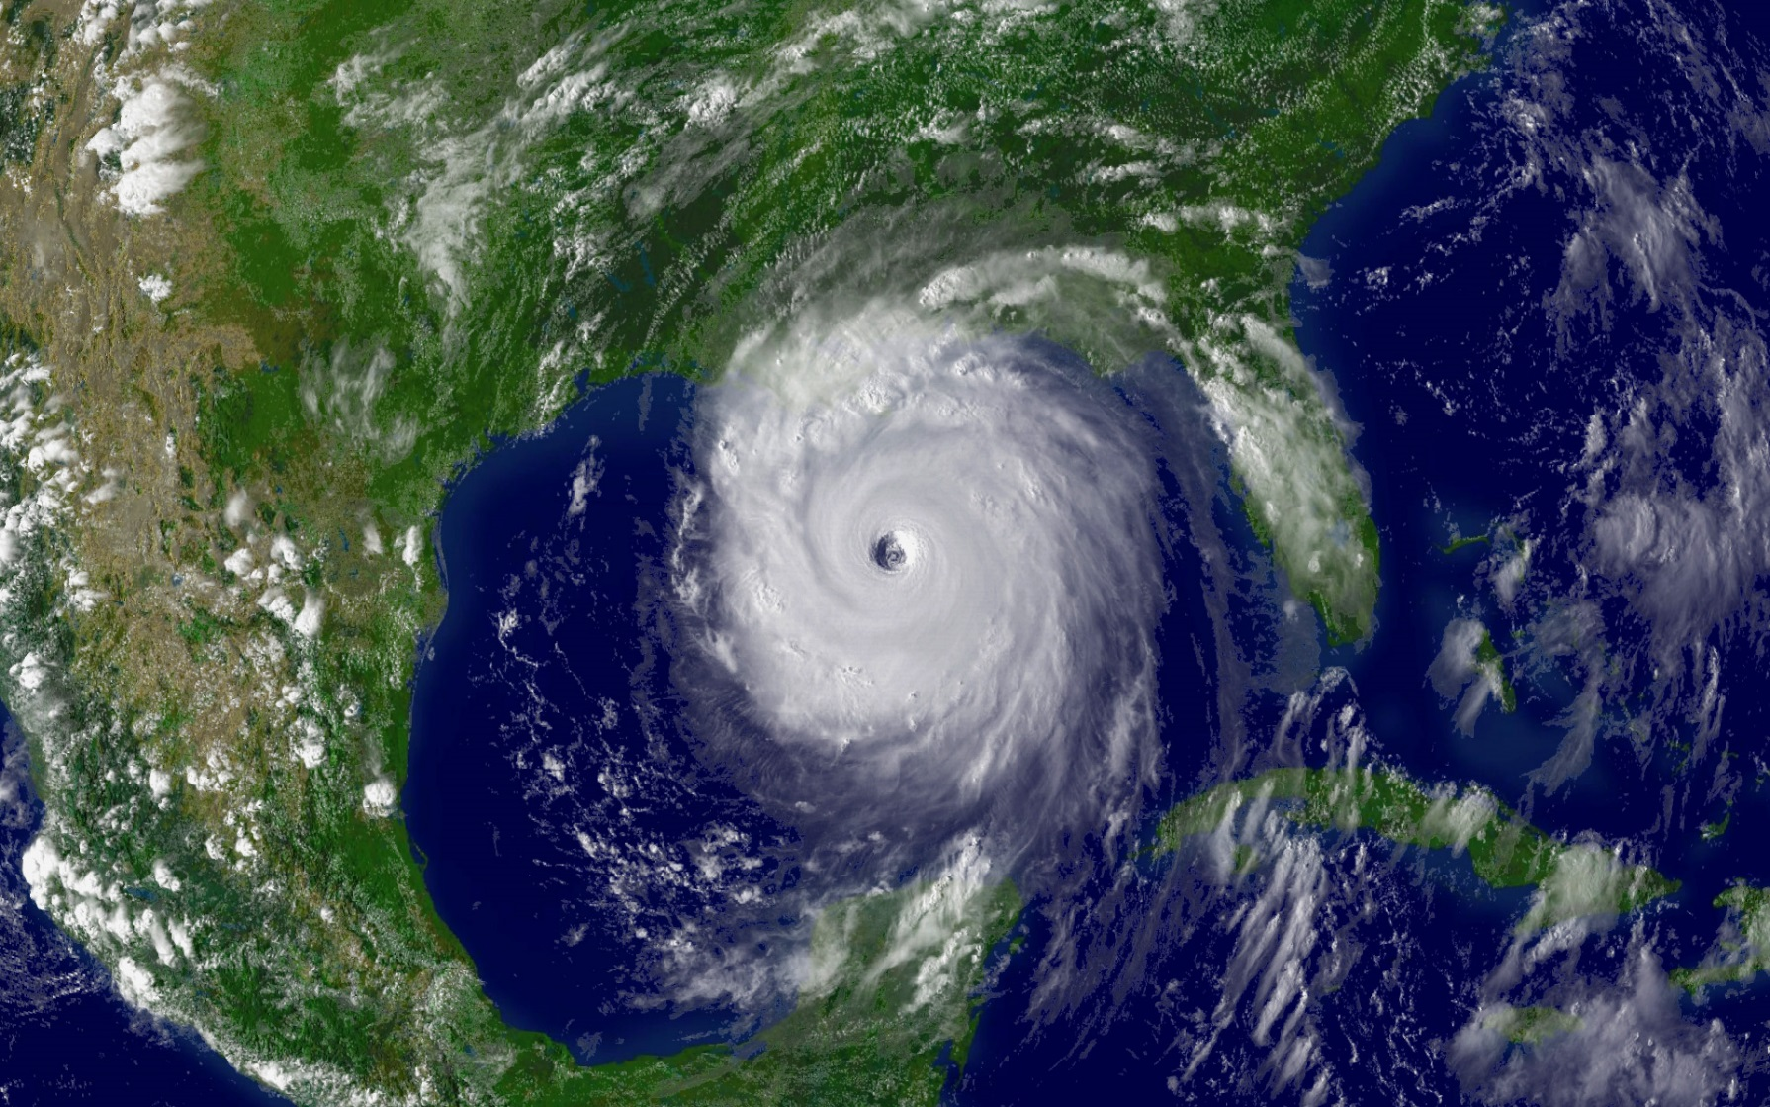
If we cut through the tropical storm what would we see?

Slide 6
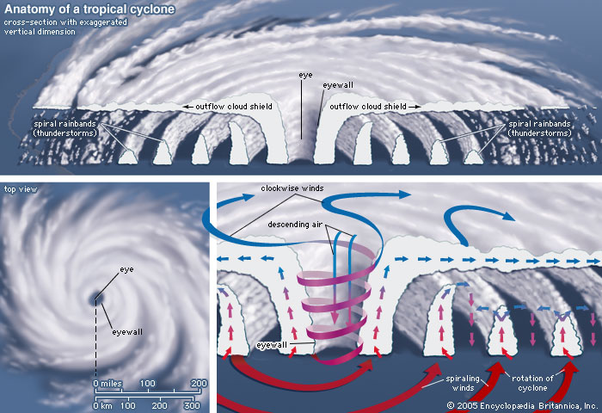
Where is the worst weather?

Slide 7
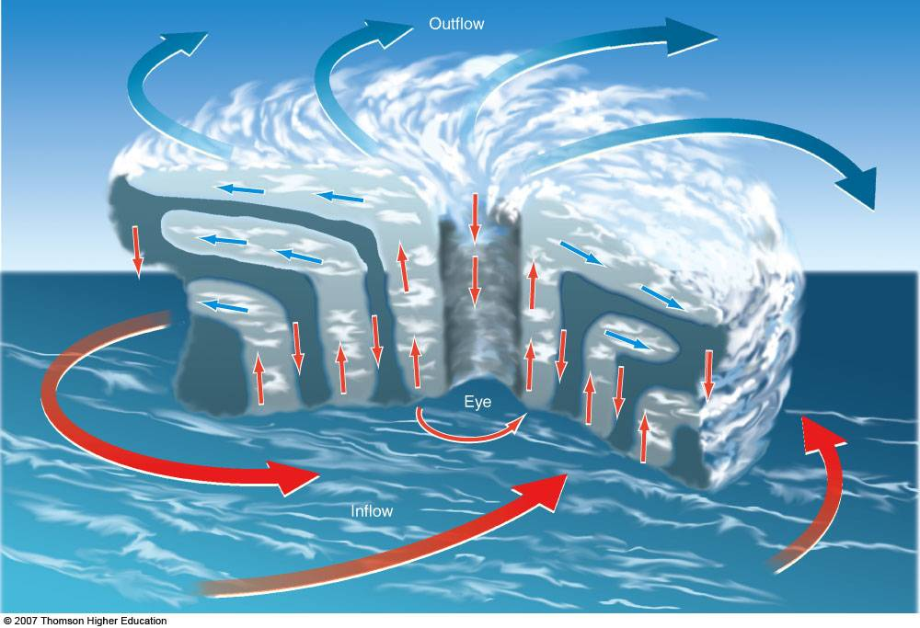
Task (using pg. 71 and L13, b) Hurricane Interactive from the website, complete the following)
Draw a diagram to show a cross section through a tropical storm
Add labels to explain why the hurricane forms.
You are stood in Freeport as a hurricane passes directly overhead! Describe how the weather changes as the storm passes.
Ensure you have at minimum these labels:
Edge of storm, vortex, eye, strong winds, ocean, cumolo-nimbus clouds, converging surface winds, high humidity intensifies storm, very low pressure, thunderstorms, torrential rain, dense cloud, less cloud, less wind and rain, calm

